Slide 1
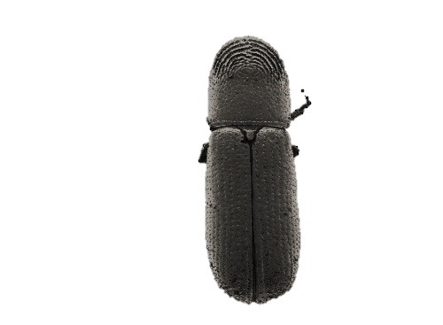




Thousand cankers disease
Biology
Signs and Symptoms
Hosts
Adapted from Presentations By:
Gail Ruhl, Purdue Plant and Pest Diagnostic Laboratory
Whitney Cranshaw, and Ned Tisserat, Colorado State University
Early Detector Training
Forest Pest Outreach Survey Project
Notes:
In this session I will be discussing Thousand cankers disease, which is a fungal disease carried by a tiny invasive beetle that affects eastern black walnut and butternut trees. This disease has not yet been discovered in Indiana, but in states where it has shown up it has caused heavy mortality in black walnut trees, so it is a situation the regulatory agencies in the state are monitoring very closely. Walnut is a valuable nut and timber tree, and is a widespread species in Indiana. Before we begin, I would like to thank Gail Ruhl from Purdue’s Plant and Pest diagnostic laboratory and Whitney Cranshaw and Ned Tisserat at Colorado State University, on whose presentations this one is based.

Slide 2
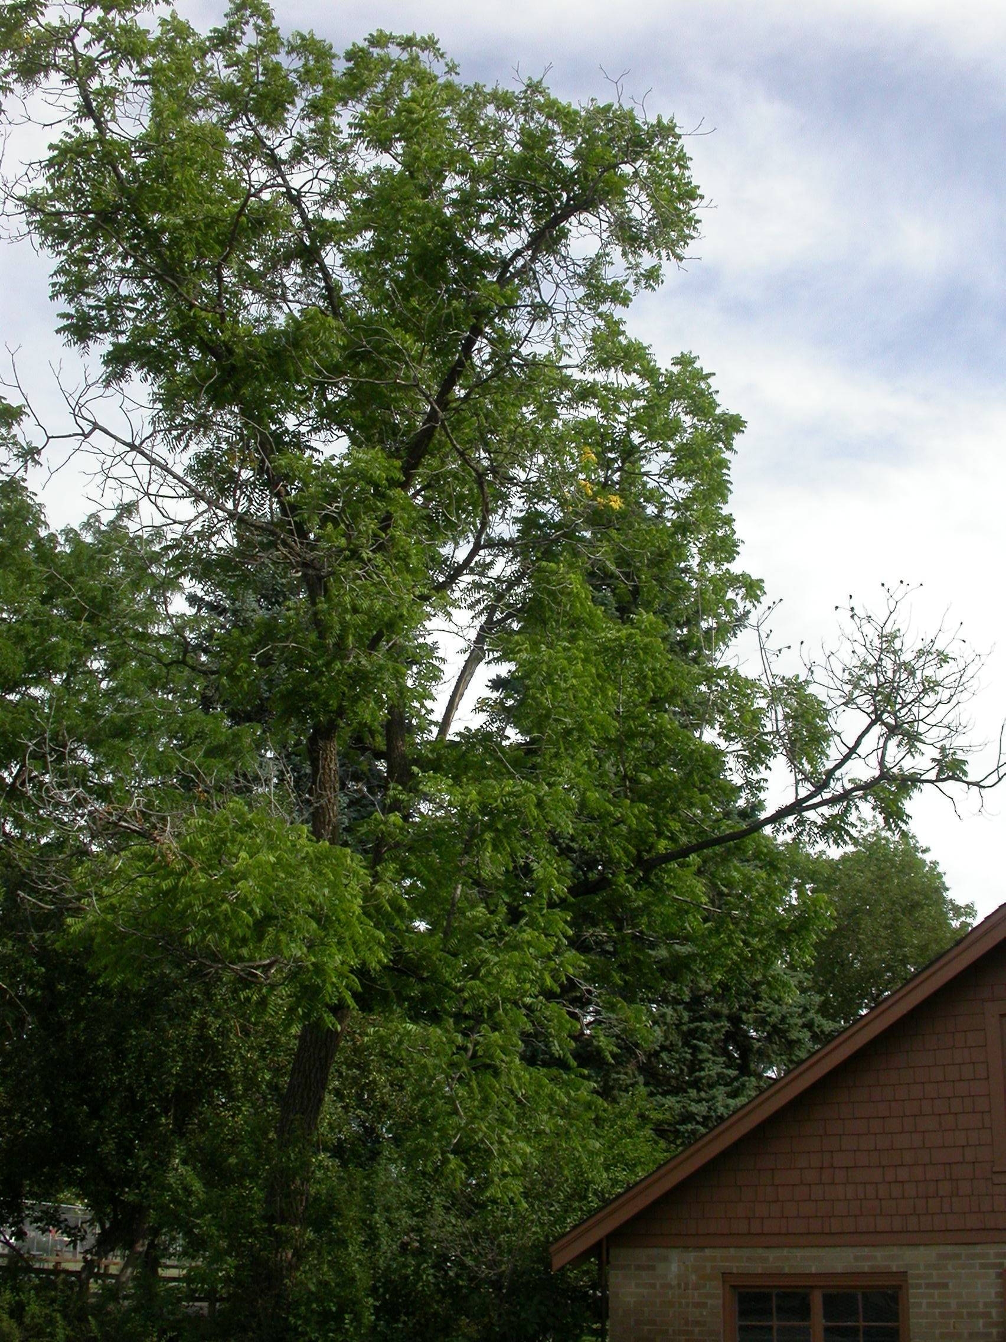
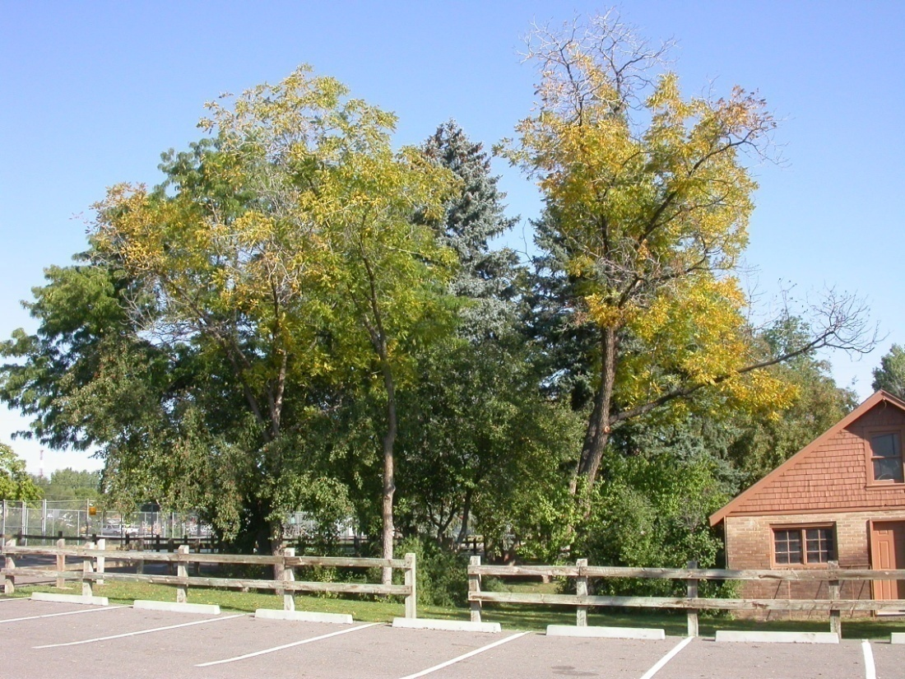
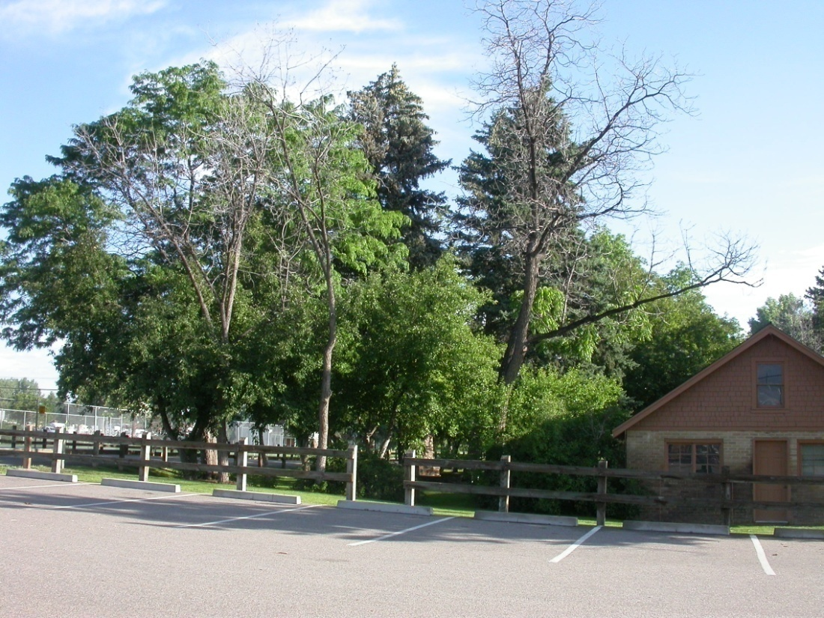
September 2008
June 2008
June 2009
Notes:
One thing that I will be emphasizing thoughout this talk is that external symptoms can take a long time, possibly ten or more years, to appear, but once symptom development begins, it progresses very quickly. Here are some pictures that were taken of TCD infested trees in Boulder Colorado showing what happened to 3 black walnut trees in a park over the course of 12 months. In early summer of 2008 you can see theres some dead branches and some thinning foliage, by september of the same year the trees are noticibly stressed, with widespread yellowing foliage and some more dead branches. By the following june, these trees were totally dead.

Slide 3
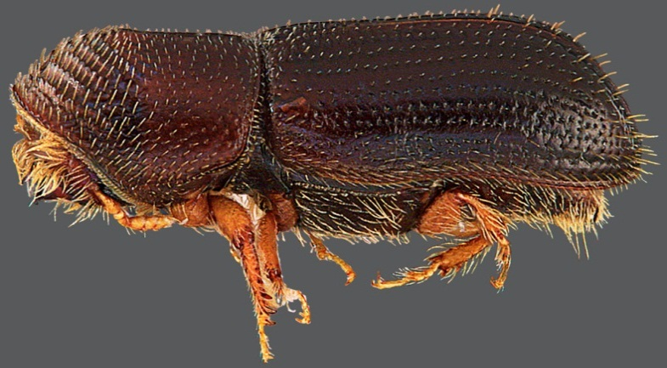
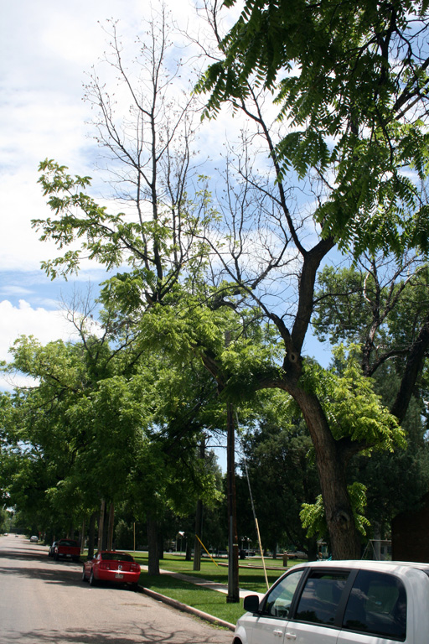
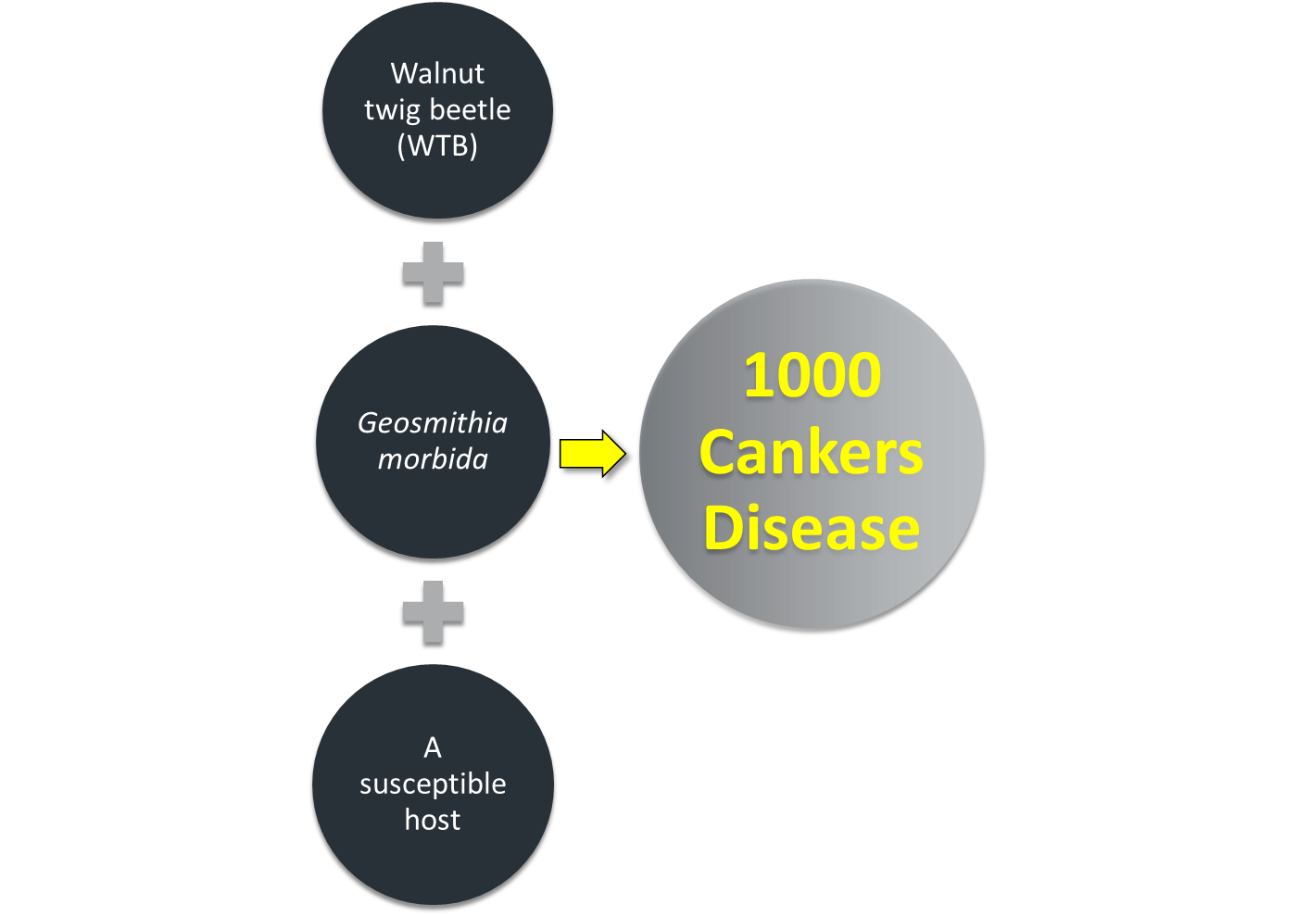
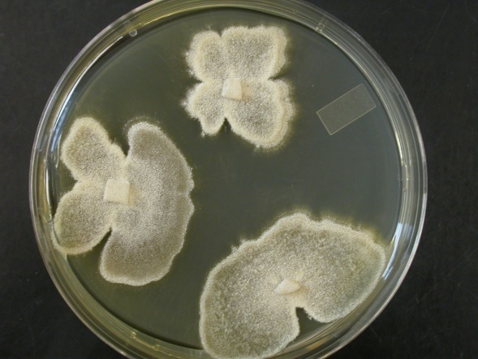
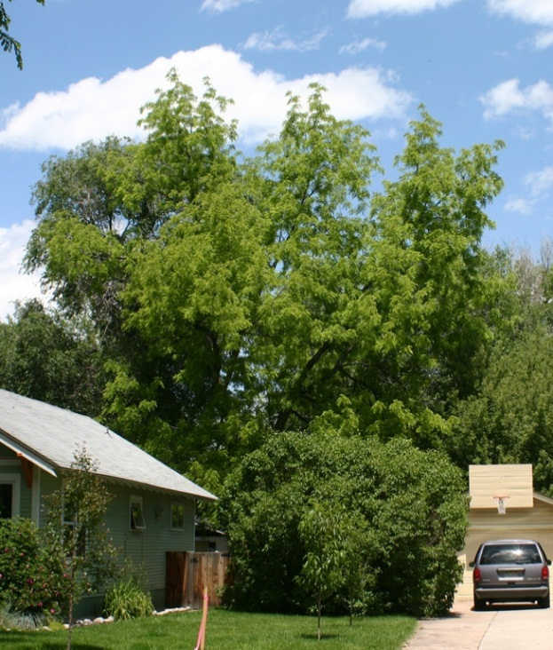
FPOSP
Early Detector Training
Notes:
Thousand cankers is a much more complex situation than the other two pests we will discuss in our trainings, but the answer lies in this equation. Three elements are required for this disease to develop: An aggressive insect, which serves as a carrier or vector of a fungal pathogen. The insect in question here is the walnut twig beetle, which makes its living by feeding and reproducing just underneath the bark of walnut trees. Typically twig beetles behave just as their name implies, attacking only smaller branches and twigs of trees. The fungal pathogen in question here is called Geosmithia morbida. This is a canker pathogen, meaning that it infects and kills the living nutrient conducting tissues located just underneath the tree’s bark. The last element that is needed in this equation is a highly susceptible host. The host tree must be susceptible to both the feeding walnut twig beetles and the canker forming fungus in order for disease to manifest. So we’re going to explore in a little more detail how each of these factors contribute to disease development.

Slide 4
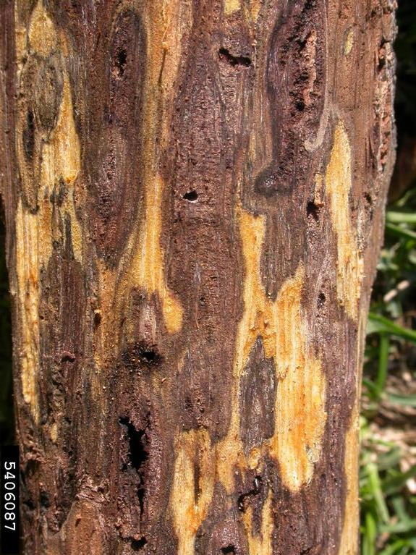
Death by TCD: Working Hypothesis
FPOSP
Sustained beetle attack required
  Only small cankers with fungus alone
Cankers and beetles kill nutrient conducting tissue
Trees weaken as stored energy reserves become depleted.
Trees ultimately die from energy depletion.
Curtis Utley, bugwood.org
Ned Tisserat, Colorado State University, Bugwood.org
Notes:
TCD, unlike other diseases like DED is not a systemic disease. A working hypothesis of how infested trees are killed has been developed through observations of disease progression in walnuts primarily in Colorado Springs. The stems and large branches of these trees are essentially girdled by coalescing Geosmithia cankers that are introduced from sustained attacks by WTB. The trees weaken gradually as their stored energy reserves are used up, and once these reserves become depleted at the very end of the life of the tree is when external symptoms really begin to manifest. It s the energy depletion from the death of the tree’s conductive tissues that ultimately kills it.

Slide 5
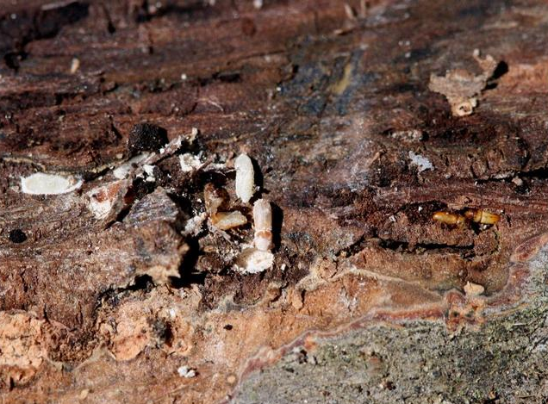
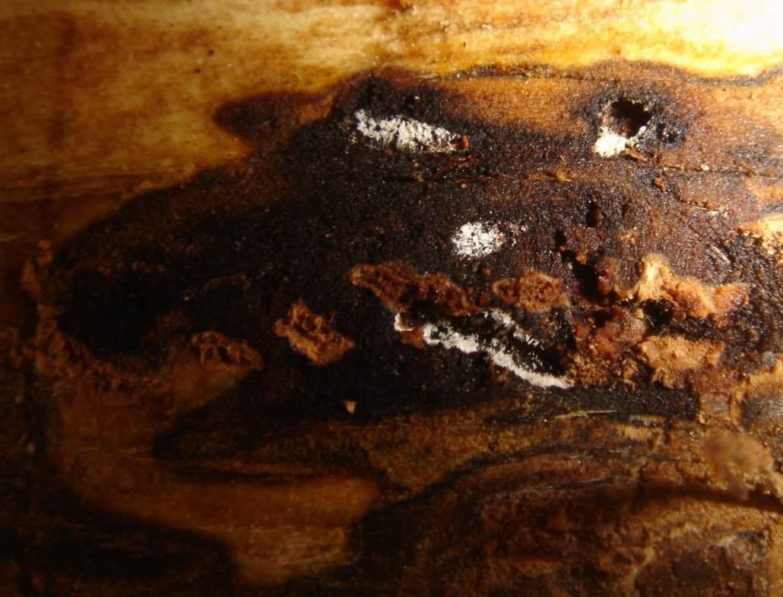
Beetle is Required for Disease Development…
FPOSP
Early Detector Training
Beetle behavior is key to vectoring fungus
  Excavate tunnels to feed and lay eggs
  Readily “taste” branches
Notes:
The Geosmithia fungus is capable of causing cankers on it’s own, but its really the walnut twig beetle that is the essential factor in the development of a killing DISEASE in trees. Anytime Walnut twig beetle has been found in nature thus far, it has been carrying spores of Geosmithia on its body. You can see these walnut twig beetles in this picture are completely covered in the white, asexual spores of this fungus. The fungus grows on the tree’s tissues and sporulates inside the beetle galleries or tunnels like you see here. When the beetles emerge from the tree, they pick up the fungus and carry it to the next tree. Because Geosmithia lives inside underneath the bark, it does not move on it’s own, but relies on the beetle to carry it from tree to tree. Strangely WTB rarely attacks branches smaller than 2in diameter in black walnut, which seems to be a behavior modification that is different from its behavior on other Juglans species. These beetles will very often do something called “tasting” branches…this is where they seem to just chew a little hole for some unknown reason without actually entering the tree to set up tunnels for feeding and reproduction. This tasting behavior is enough to transfer the spores of the fungus to the tree, even though the beetle does not actually stay.

Slide 6
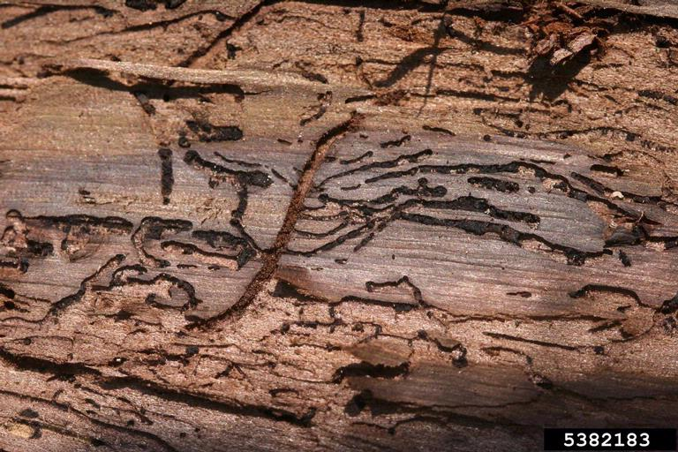
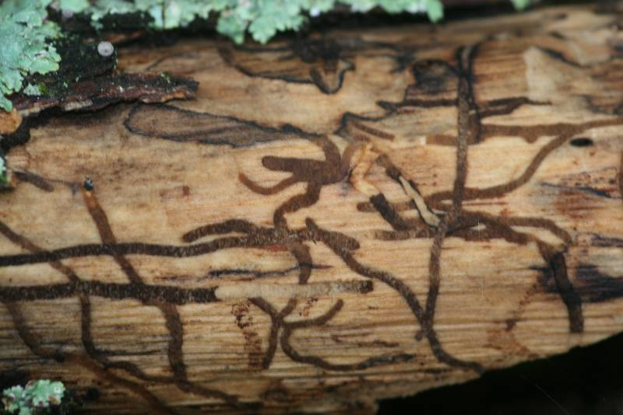
Adult WTB gallery with perpendicular larval galleries
Galleries of other borers may meander, be on dead wood
Notes:
If the beetles find the tree suitable for setting up shop, they create a network of small tunnels just beneath the tree’s bark. This is where the adults will feed and mate and lay eggs. WTB excavates a very characteristic type of gallery like you see here. This main tunnel here is wehre the adult beetles will feed and mate. The eggs are laid at intervals along the periphery of this main tunnel, and when the larvae hatch they form these perpendicular, smaller tunnels as they feed away from the main tunnel. There are other beetles and other types of insects that can leave tunnels underneath the bark of walnut trees, particularly trees that are already sick and in decline or dead wood. The galleries of these borers, however, lack the characteristic perpendicular pattern of the walnut twig beetle tunnels, and will be more meandering. So if you see tunneling damage like this on dead wood or a declining walnut, take a closer look for those perpendicular galleries.

Slide 7
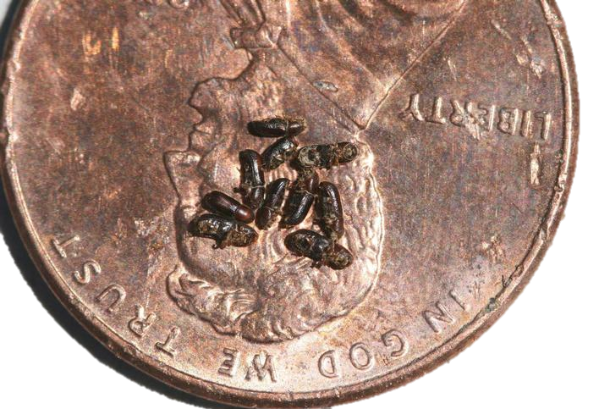
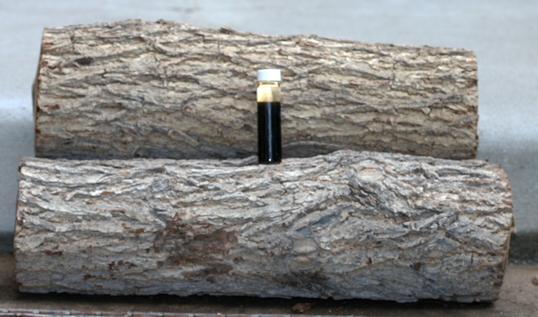
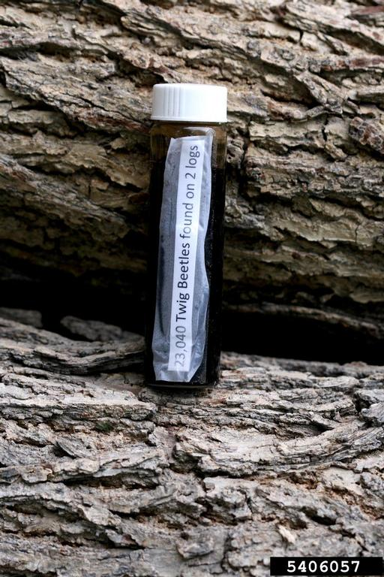
Wood from Infested Walnuts
= Extremely Infectious
FPOSP
Early Detector Training
Two 18-inch logs produced 23,040 beetles in one year after being cut!
Notes:
Walnut wood that is infested with WTB is also extremely infectious to other trees. This vial contains 23,040 wtb’s that emerged from these two 18 inch logs over the course of a season. The beetles are extremely tiny, but infest trees in huge numbers, so you can imagine how many beetles a large tree could be carrying.

Slide 8
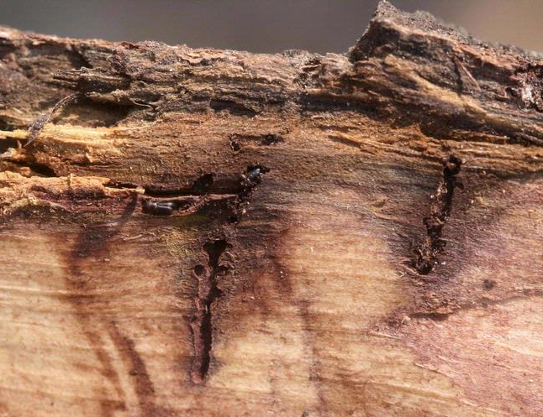
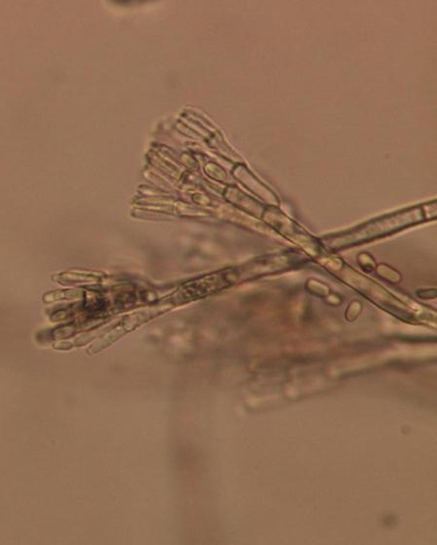
But the Fungus Actually Kills the Trees.
FPOSP
Early Detector Training
Fungus grows in advance of beetle feeding
Sporulates in tunnels
Picked up by adult beetles as they emerge and fly to new branches
Is fungus helping beetle?
Notes:
So the behaviour of walnut twig beetle is key to actually getting the fungus into the tree, and it’s key to getting the fungus in there enough times to KILL a tree…but it’s the fungus itself and the formation of cankers on the main branches and stem of the tree that actually brings the tree down. If you take a look at this WTB gallery here, you can see this dark stained area surrounding the tunnels these adults have made. The dark area is actually the fungus that is growing into the tree’s vascular tissues in advance of the beetles feeding. The fungus produces spores, which are its reproductive structures in the tunnels. You can see in this picture some of Geosmithia’s asexual spores and the fungal structures that actually protrude from the walls of the beetles galleries and hold the spores out to where the beetles can brush up against them. One of the outstanding questions with this disease complex is “is Geosmithia somehow helping WTB?” Mutually beneficial associations between fungi and beetle vectors are quite common, and its been proposed that perhaps the fungus aids in beetle feeding by weakening tree defenses in exchange for a free ride to the next tree. Its also possible that this is a neutral association…we just don’t know at this point.

Slide 9
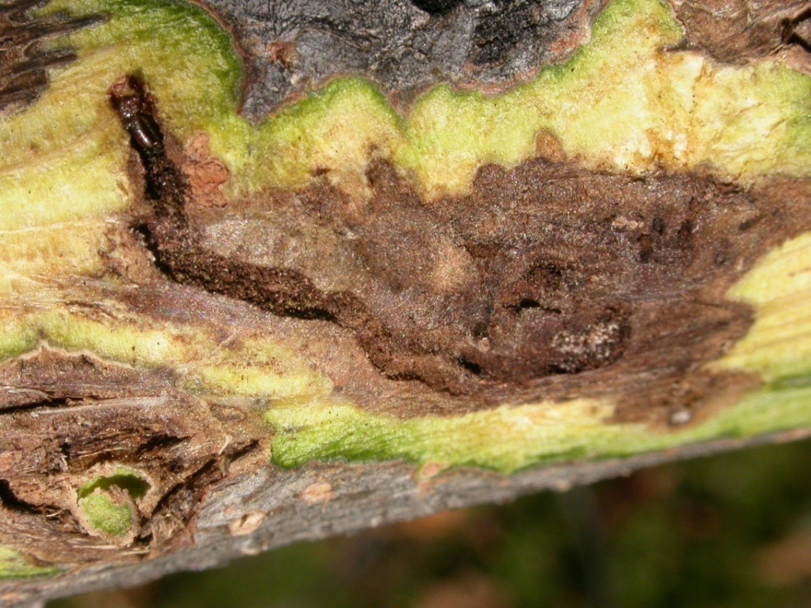
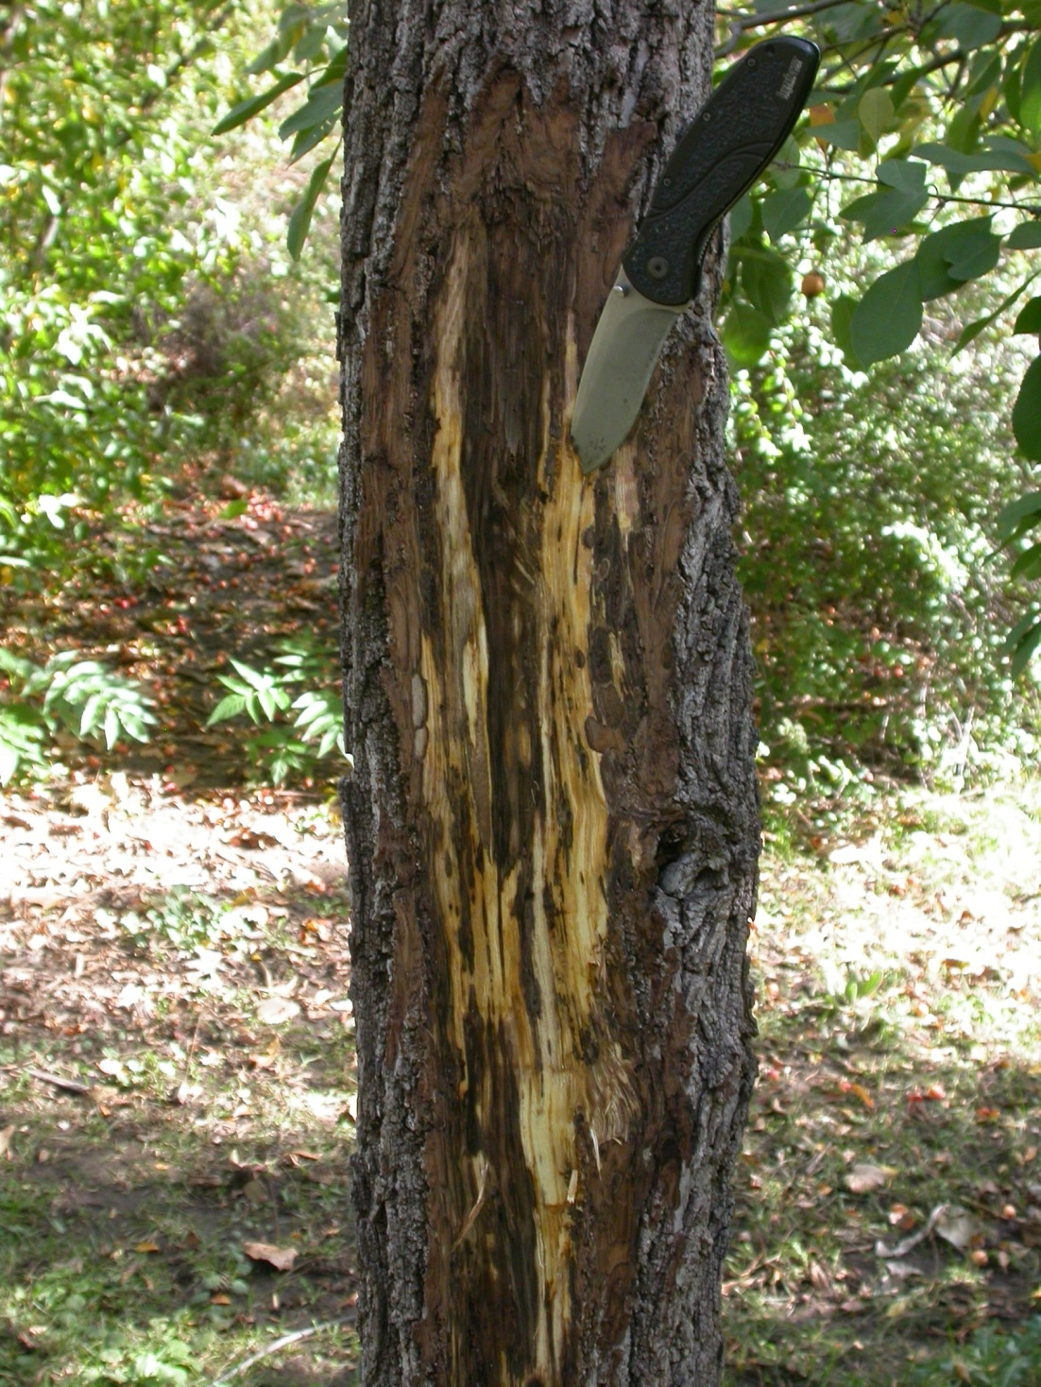
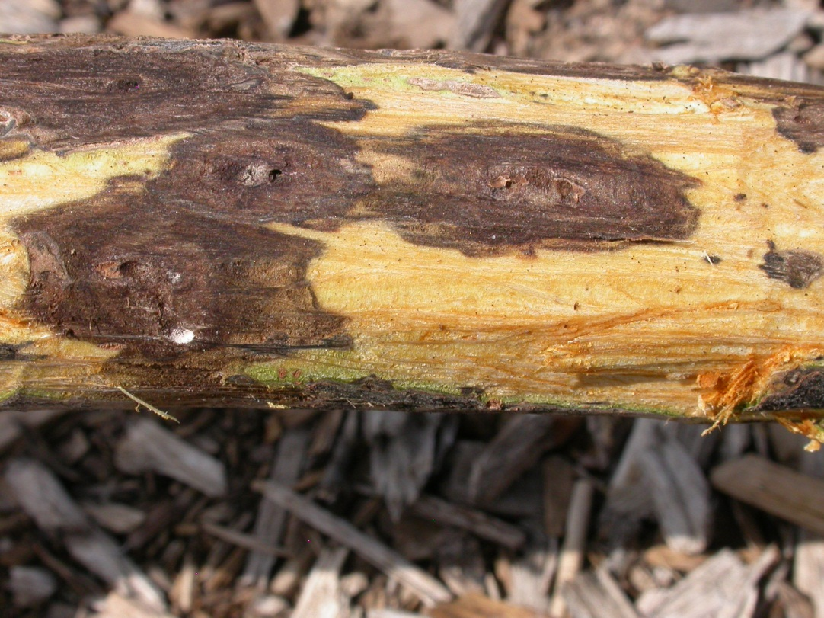
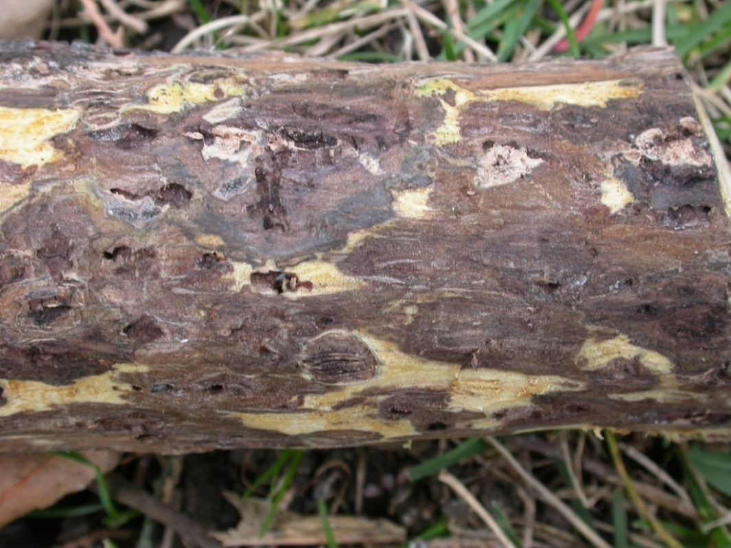
Colonizing WTBs release pheromones that summon other WTBs for a mass attack.
Decline follows sustained introductions of Geosmithia by beetles and formation of thousands of cankers
Notes:
External symptoms and decline are produced only if you have sustained attacks by beetle. You can see in these pictures here the dark cankered area extending out from the beetle galleries. And in this picture these cankers are beginning to run together and cut off the flow of nutrients through this branch. Here you can see the main trunk of a walnut tree that is in advanced stages of TCD. You can see basically all of the phloem tissue here has been riddled with dark Geosmithia cankers. At this stage in the disease development a second fungus called Fusarium frequently attacks these weakened trees, speeding their decline and death. Some of you who are familiar with tree pathology might know that Fusarium can cause a canker disease in its own right on walnut trees. However Fusarium in this case seems to be functioning as a secondary pathogen, coming in after the trees have already been substantially weakened by Geosmithia.

Slide 10
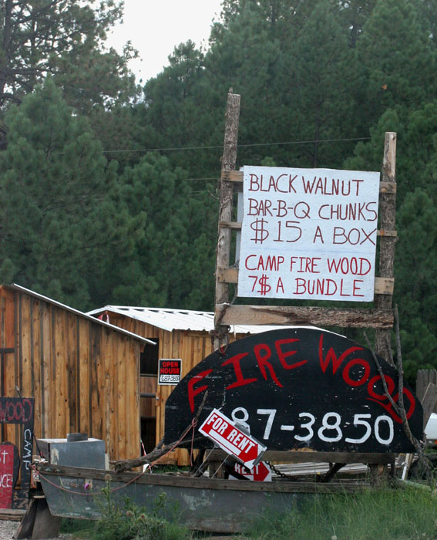
Signs…
FPOSP
Early Detector Training
and Symptoms

Slide 11

When to Look?
FPOSP
LOOK CLOSELY
Early Detector Training
Best time to scout is late June through August
  TCD-related symptoms develop with summer stresses
  TCD symptoms more easily confused with other causes later in year
Initial symptoms are subtle.
One of the earliest is “flagging” or yellowing and wilting of leaves on individual branches or on a single scaffold.
Notes:
The best time to scout for TCD is right about now. Last year was particularly difficult because of the severe drought we experienced, which produced drought stress symptoms such as yellowing and leaf drop on many species of trees including walnut. These drought symptoms are very easily confused with initial symptoms of TCD…so close observation is key when scouting for this disease. Look for patterns. The yellowing or wilting of leaves, called flagging, is often seen affecting a single scaffold or series of connected branches, whereas drought stress may be more widespread thoughout the canopy.

Slide 12
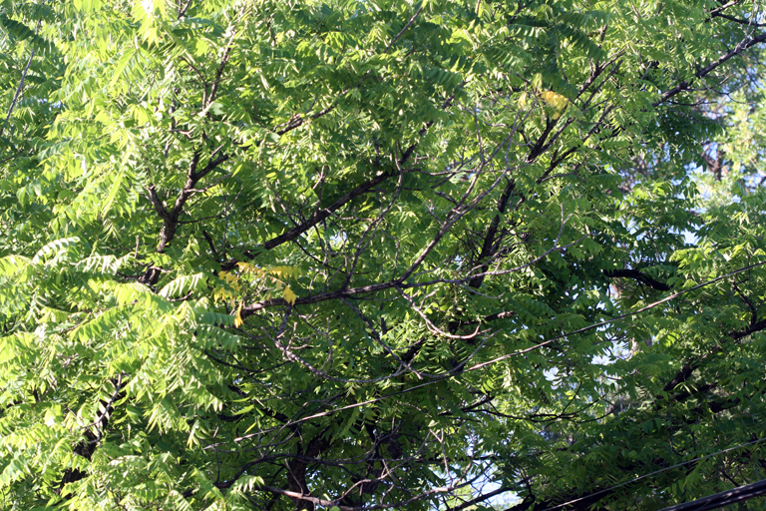
FPOSP
Early Detector Training
Notes:
Here you can see very early symptoms of TCD.

Slide 13
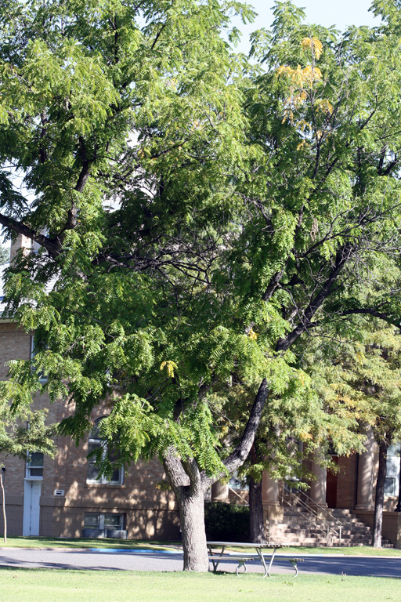
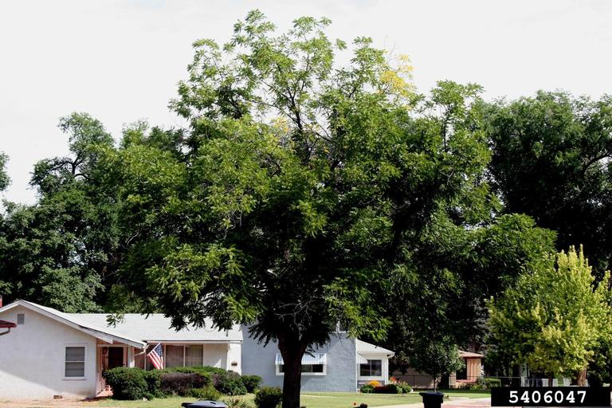
FPOSP
Notes:
Here again we see flagging of leaves on a single or a couple of branches, and a thinning canopy on the right. Symptoms like these can also be caused by things like frost in addition to drought.

Slide 14
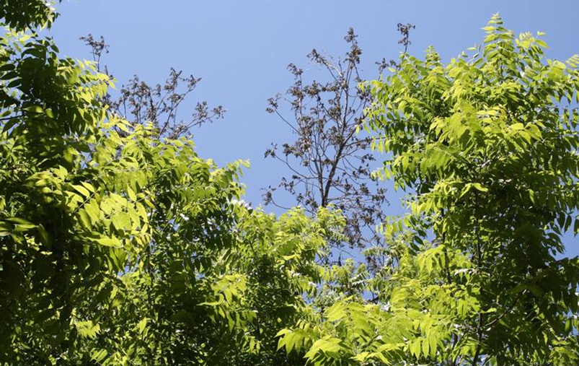
FPOSP
Early Detector Training
Notes:
This symptom in particular is what we want you to be on high alert for. The sudden collapse and retention of brown dead foliage on branches. No other disease of walnut does this, so if you see this symptom you should definitely report it.

Slide 15
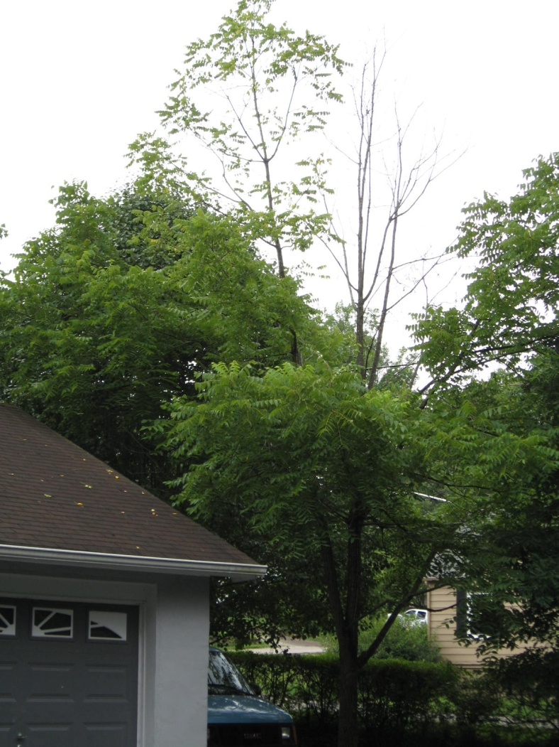
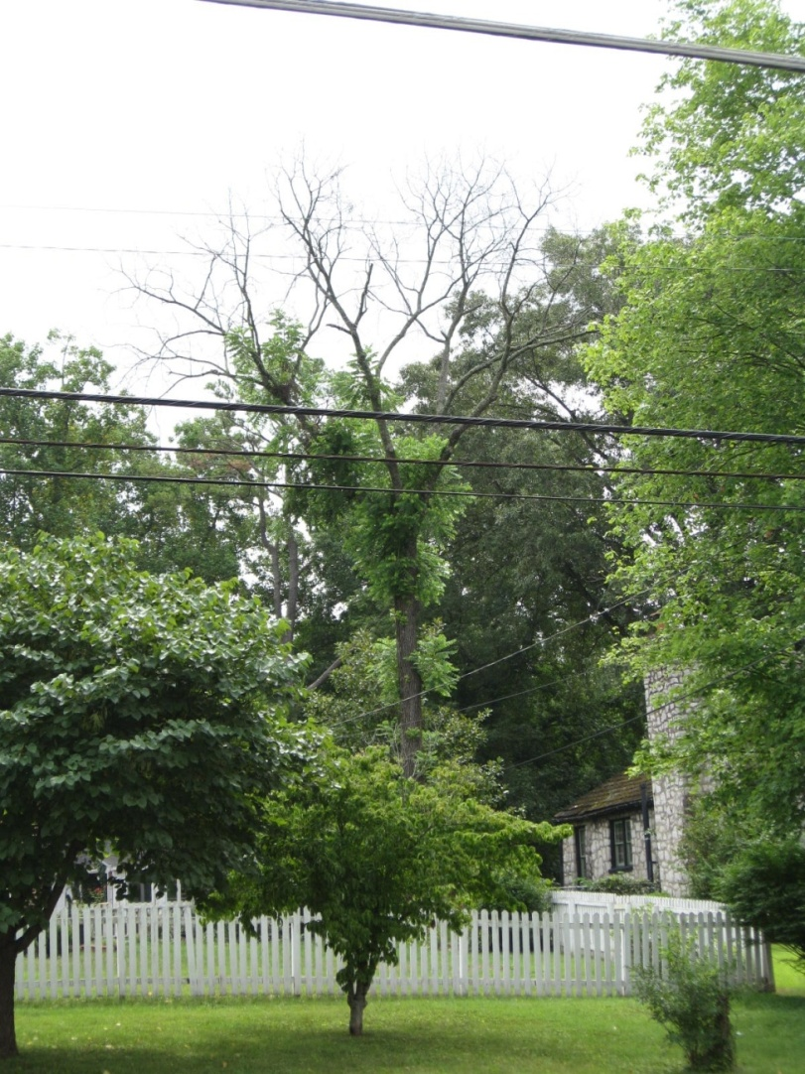
Later stage TCD—Look for Patterns!
FPOSP
Early Detector Training
Dying Walnut in TN
Photo: TN Forestry
Notes:
Also look for patterns of dead and dying walnut trees in the landscape, they may occur in groups. The beetles mass attack the trees using aggregation pheromones, so often several adjacent trees will show symptoms.

Slide 16
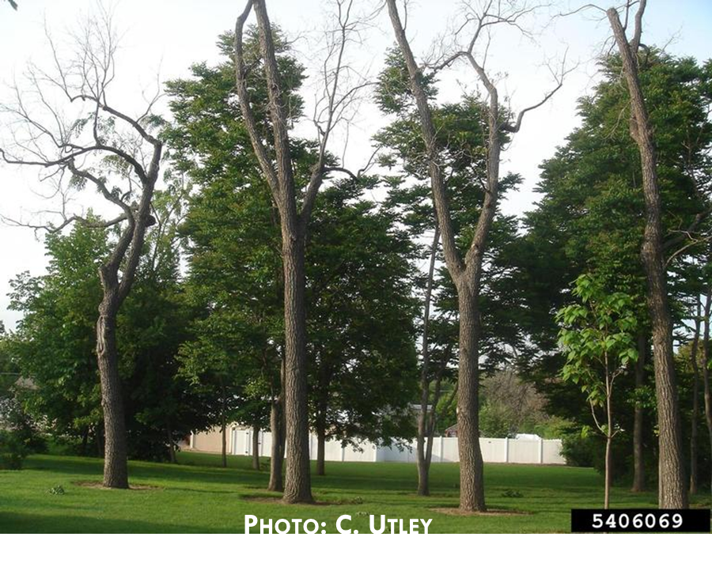
NOTE: Bark does not slough off trees killed by TCD!
Notes:
Another special point of note is that: The bark does not slough off trees that have been killed by TCD. Walnuts that have been killed by other factors or are experiencing decline due to something else will often have pieces of bark fall off. This is a good indicator that it is not TCD.

Slide 17
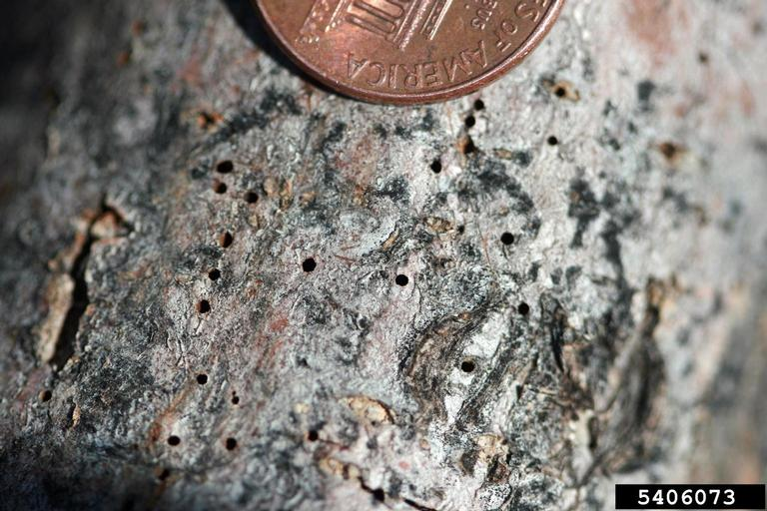
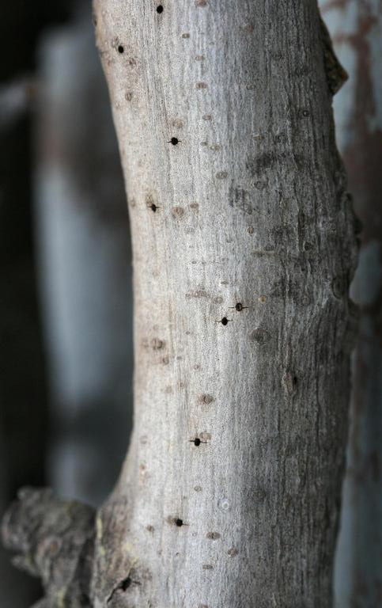
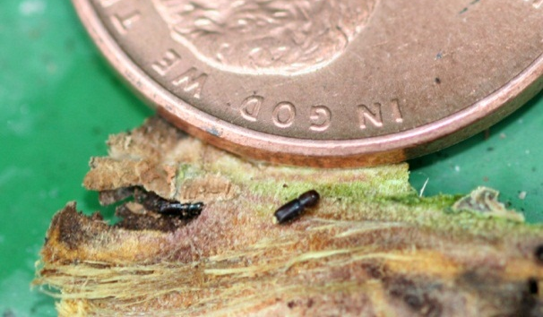
Look for beetle exit holes…
Beetles aggregate in trees (pheromones)
On branches >1inch diameter
  Don’t bother looking at small twigs!
Especially on thin-barked branches
VERY TINY!
Notes:
Beetle exit holes are typically only evident on smaller branches with thinner, smooth bark. These beetles are so tiny that the holes they leave as they chew their way out from the tree are smaller than the head of a pin. So don’t bother looking at very large branches for exit holes, but also don’t look at the tiny twigs, smaller than an inch diameter. Also the beetles don’t attack the fruits, so you will not see symptoms on nuts!

Slide 18
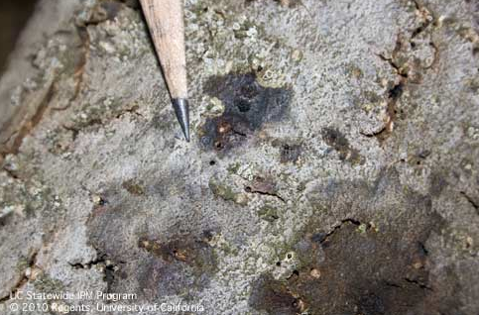
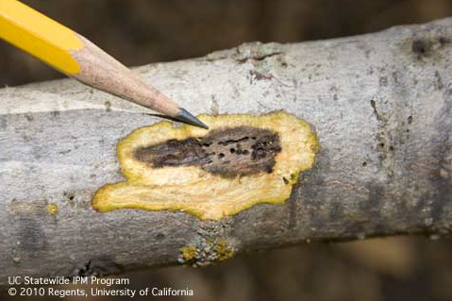
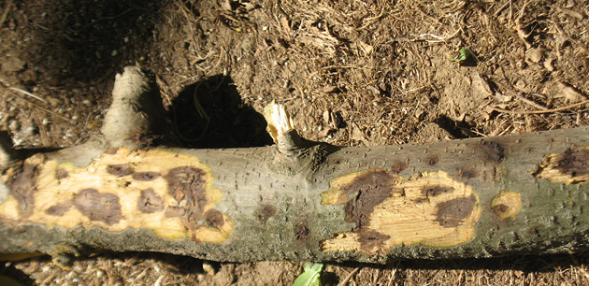
Geosmithia cankers
FPOSP
Early Detector Training
Notes:
Cankers are typically in very shallow in the phloem. Peeling the bark too deeply can cause you to miss the canker.

Slide 19
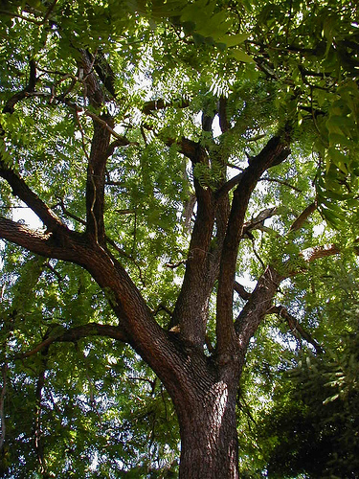
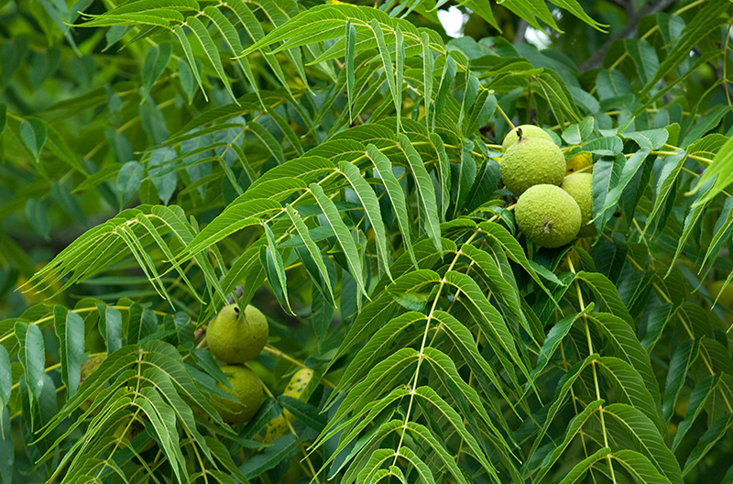
Identifying Walnut
FPOSP
Early Detector Training
Large trees with compound leaves, large round fruit
Notes:
The species name for eastern black walnut is Juglans nigra, and these are large deciduous trees with compound, featherlike leaves and large round fruits, a bit smaller than a tennis ball.

Slide 20
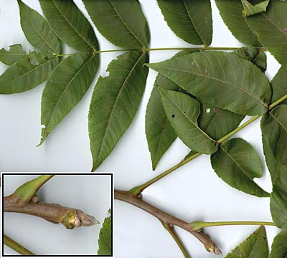
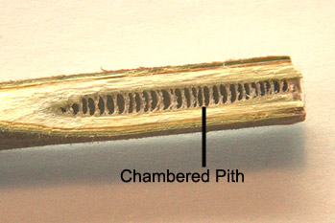
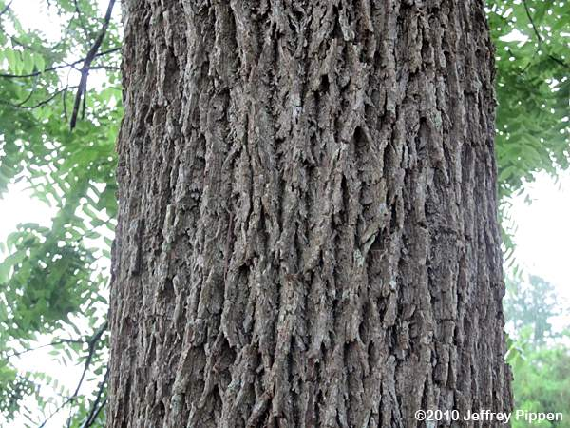
Identifying Walnut
FPOSP
Early Detector Training
Branches alternate
Twigs have chambered pith
Bark dark brown when scraped
Notes:
Walnut trees are often easily confused with ash trees because they both have compound leaves. However the branching pattern for walnut is alternate, rather than opposite as seen in ash. Antoher good diagnostic is that walnut twigs have what we call chambered pith. If you break off a twig and shave back a portion of it it will have a hollow inside that looks like this. Walnuts also have dark gray, rough bark, and if you shave off some bark ridges with a pocket knife, the corky bark inside is a deep, chocolate brown color, as opposed to a light tan that you would see with ash.

Slide 21
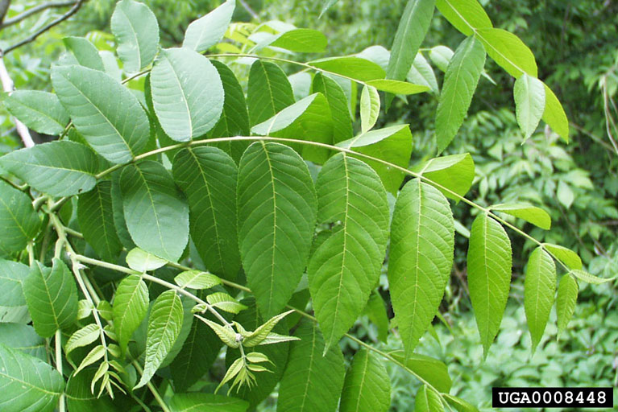

Slide 22
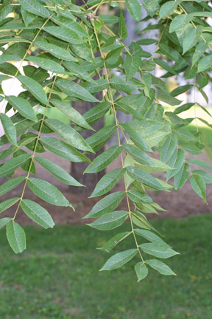
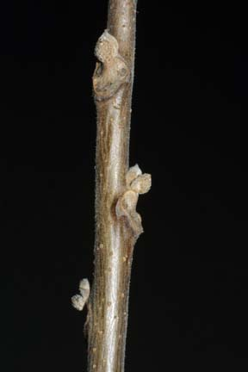
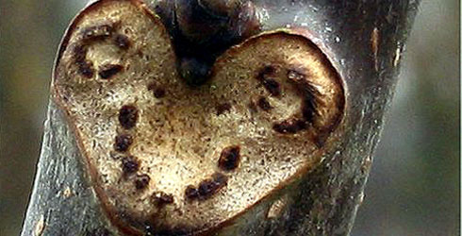

Slide 23
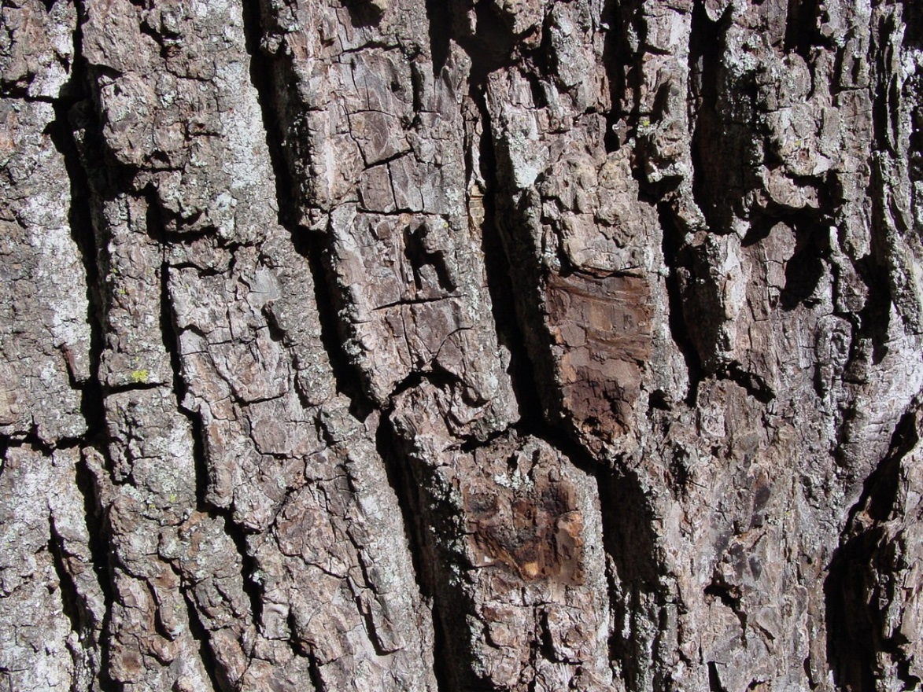
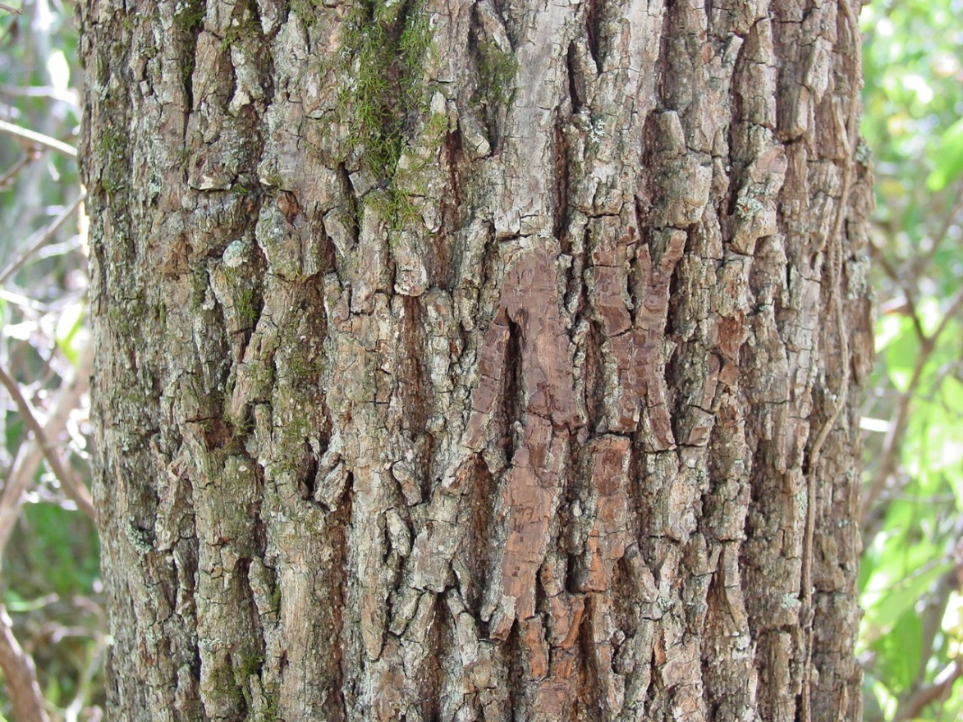

Slide 24
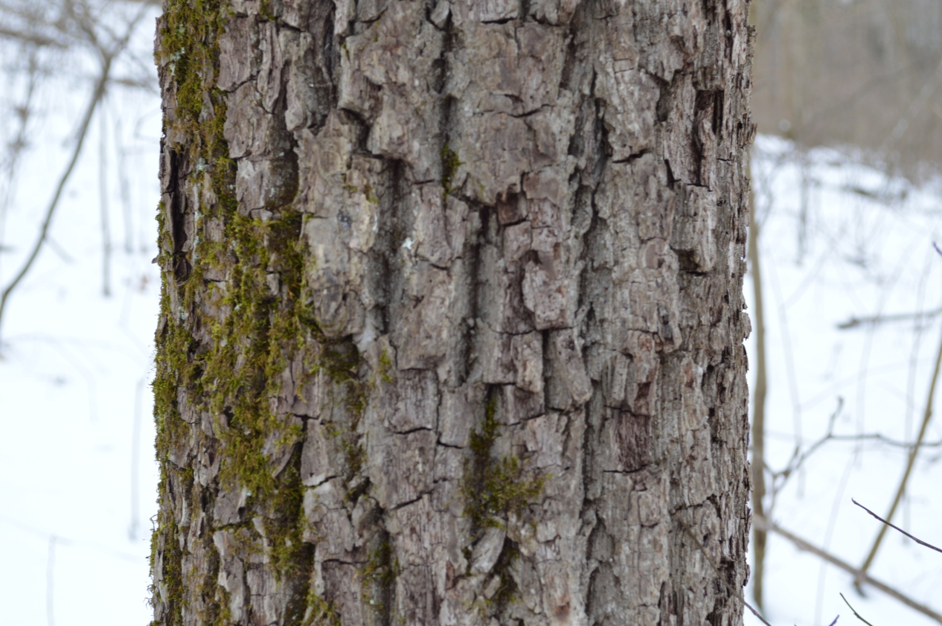
black walnut (Juglans nigra)

Slide 25
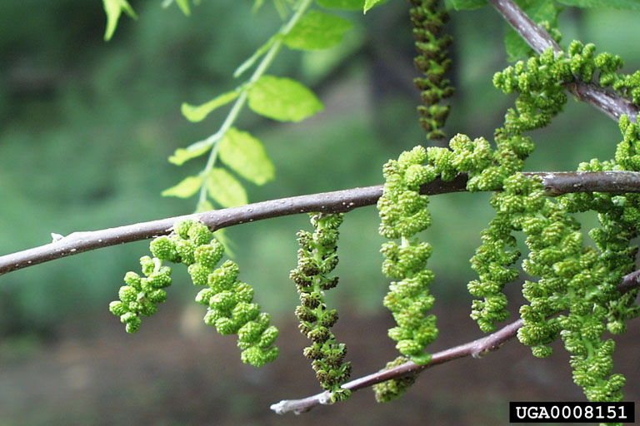

Slide 26


Slide 27


Review
FPOSP
Early Detector Training
TCD is a complex interaction between a susceptible host, an insect vector and a canker fungus.
Notes:
in review, TCD is a disease that results from a complex interaction between a susceptible host tree, an insect vector, and a canker causing fungus.

Slide 28



Review
FPOSP
Early Detector Training
Initial symptoms are subtle! Look for:
  Flagging on single scaffolds
  Wilting brown leaves that remain on branches
  Thinning canopy
  Groups of declining/dead walnuts
Early detection is key!! If you see symptoms…
REPORT IT!!
Photo: Whitney Cranshaw
Notes:
Initial symptoms of decline are very subtle, and normally by the time heavy decline is seen, the tree has been infested for many years. Look especially for wilted brown leaves that remain on branches, and groups of declining or dead walnuts. And as always, early detection is key, and if you see symptoms please report it!

