Slide 1
EMERALD ASH BORER Biology Signs and Symptoms
Early Detector Training
Forest Pest Outreach Survey Project

Slide 2
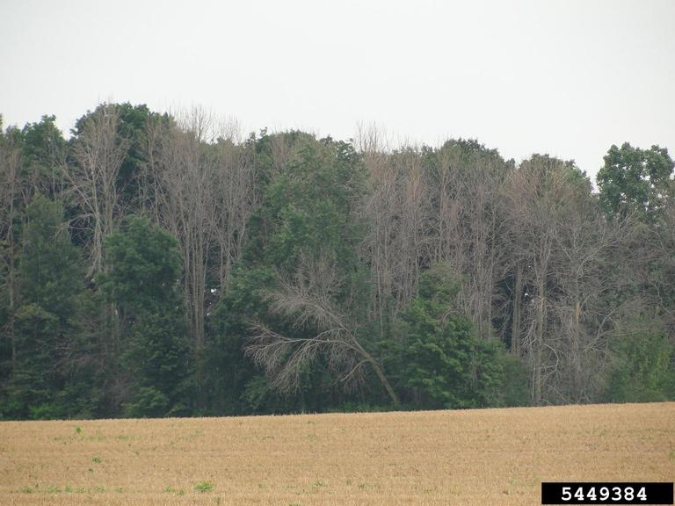
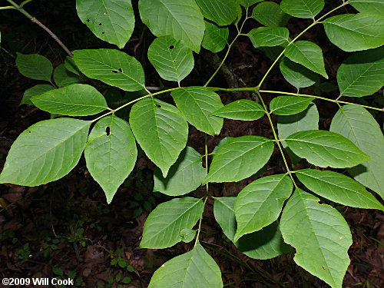
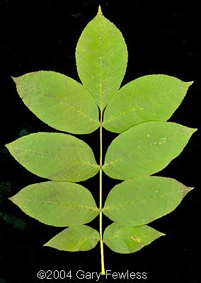
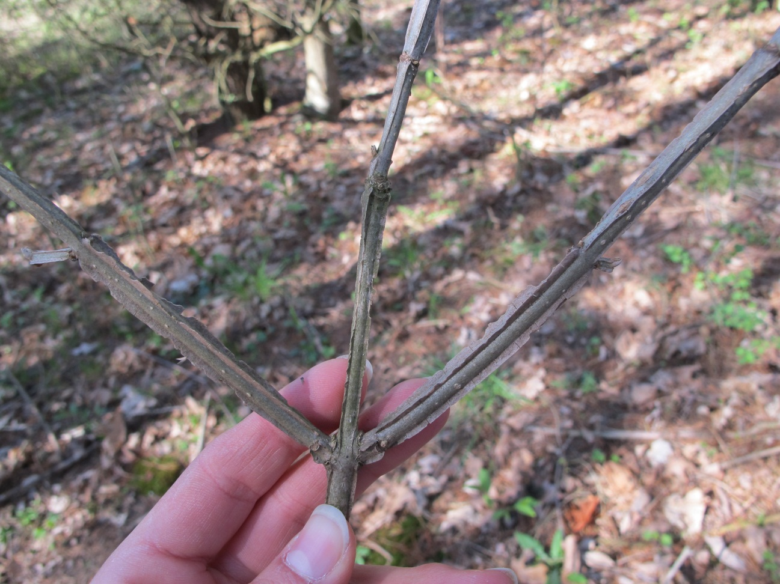
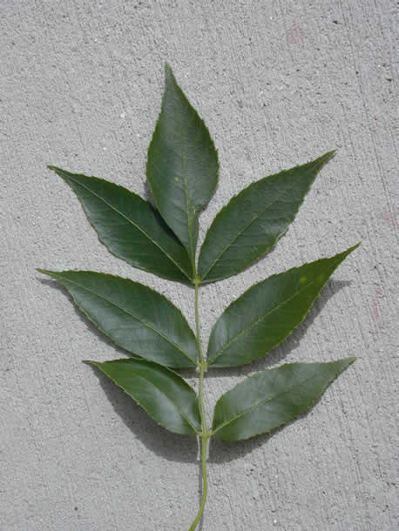
Ash in Indiana
EAB is a death sentence.
It kills nearly EVERY untreated ash tree.
FPOSP
Early Detector Training
Estimated 147 million ash trees in IN forests
6% of forest tree composition
There are several million ash trees in IN urban areas.
Green Ash
Black Ash
Blue Ash
White Ash
Threatens extinction of 5 native IN ash species.
Photo: L. Bauer

Slide 3
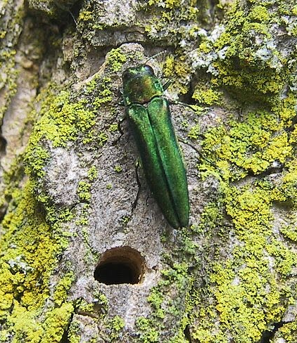
Training Overview
FPOSP
Early Detector Training
Where Emerald Ash Borer (EAB) came from and biology
EAB’s Impact
Signs and symptoms
EAB management options
Notes:
We’ll be discussing where EAB came from and a little about it’s biology, and the impact that it’s having on our state and the ash resource. Then we will talk about the all-important signs and symptoms…what you want to be looking for out in the field. And finally we will touch on what management options are available to deal with this invasive insect.

Slide 4
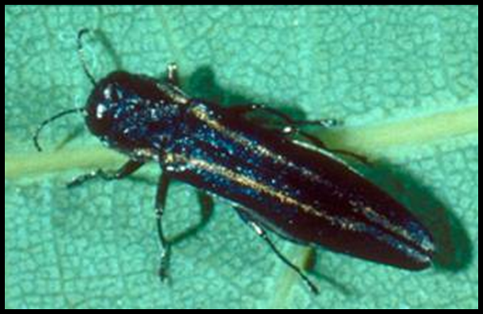
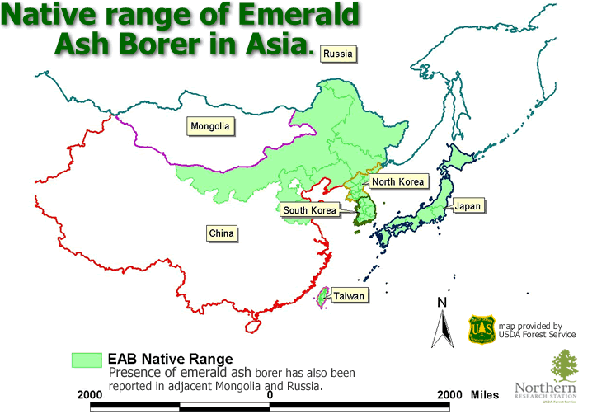
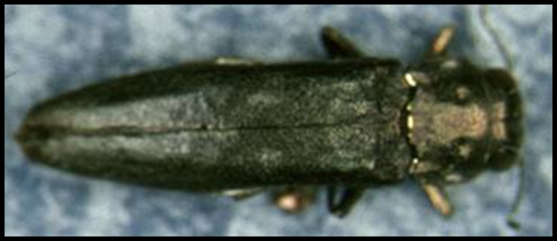
Biology and Basics
FPOSP
Early Detector Training
An invasive beetle native to Asia
In native range is a secondary pest—It’s rare there!
Imported in solid wood packing material in early 90s
First detected in Indiana in 2004
¼ - ½ inch
Photos: Larry Caplan
Two-lined chestnut borer
(Agrilus bilineatus) Primary hosts are oaks
Bronze birch borer
(Agrilus anxius) Pests of native and introduced birch
¼ - ½ inch
Notes:
EAB is a secondary pest in Asia, primary pest in North America. We have native wood borer species in the same genus that play a similar ecological role as EAB in its native habitat. Two lined chestnut borer attacks oak trees that are stressed or weakened by environmental conditions or other insects or diseases. Bronze birch borer is a native pest of birches, but causes significant damage to European birch species that are planted as ornamentals.

Slide 5
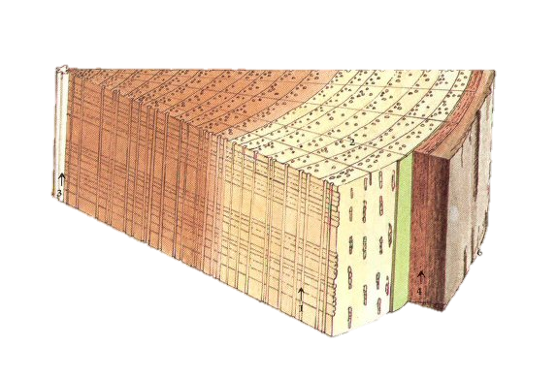
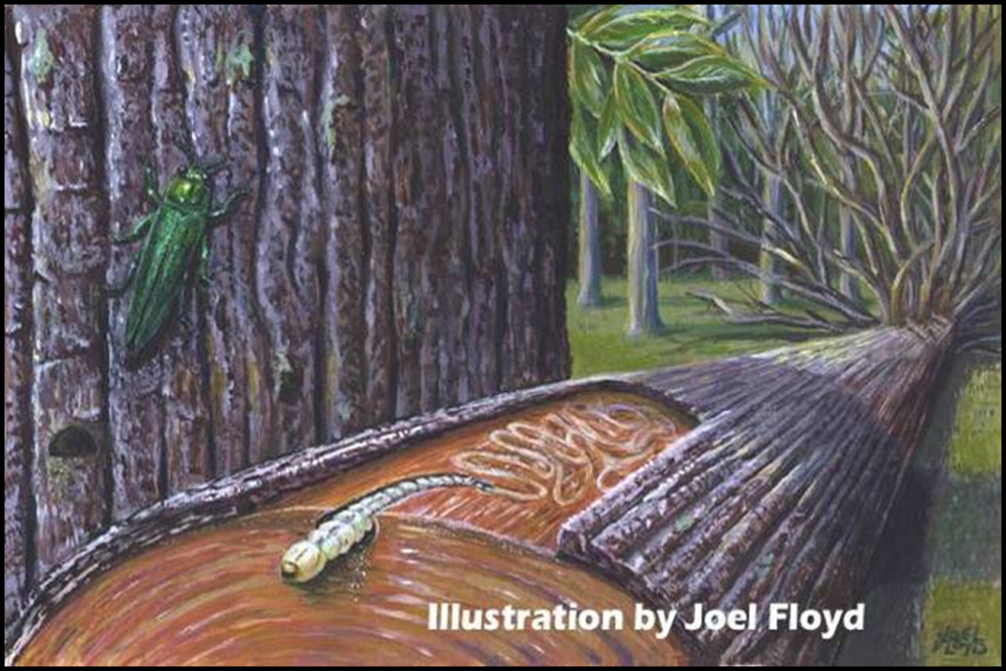
How Does EAB Kill Trees?
FPOSP
Early Detector Training
The larva, or immature stage of EAB, causes the most damage to trees. They feed on phloem and cambium, tissue that is critical for the tree to transport nutrients. When the phloem is damaged by larval feeding, the tree starves to death.
Heartwood
Sapwood
Cambium & Phloem
(EAB feeding zone)
Bark

Slide 6
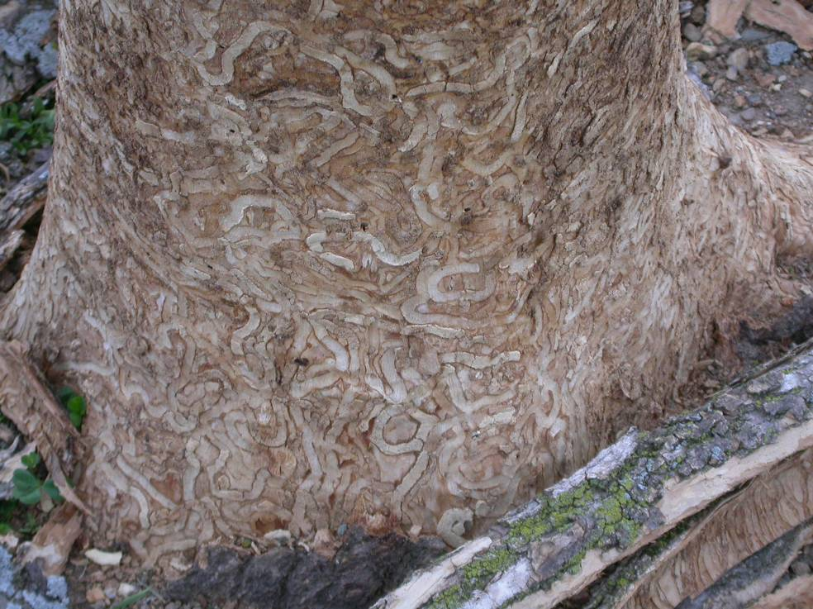
Heavy EAB infestations kill ash trees quickly—within 1 to 3 years.
Notes:
Emerald ash borer larvae usually attack by the hundreds or thousands, causing the tree to lose virtually all of its vascular tissue in a short period of time. The bark was removed from this dead ash tree to reveal the extensive damage caused by heavy larval feeding. Trees that sustain this type of damage die very quickly, usually within 1-3 years.

Slide 7
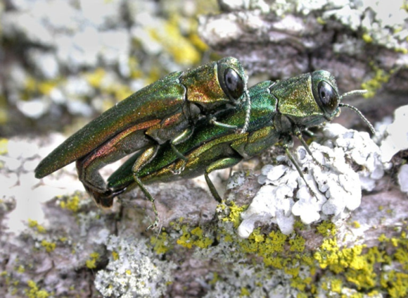
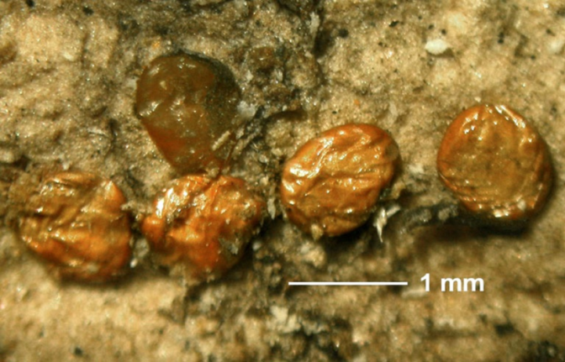
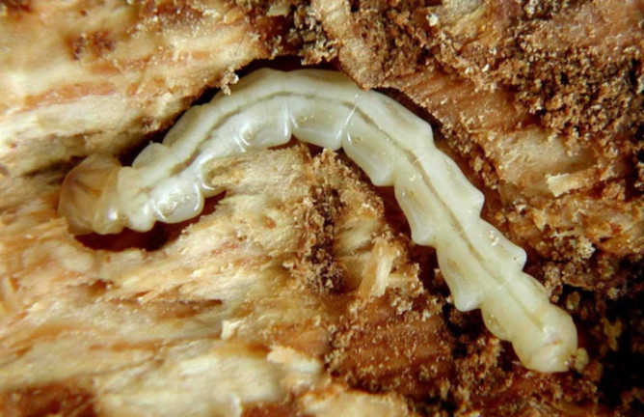
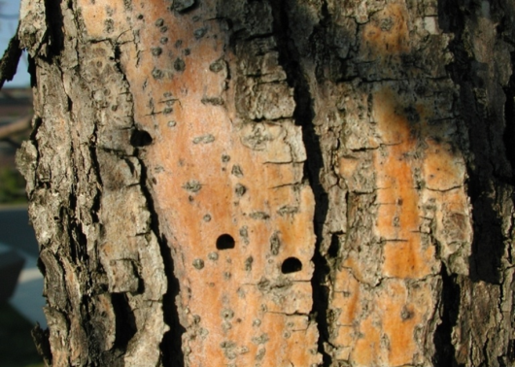
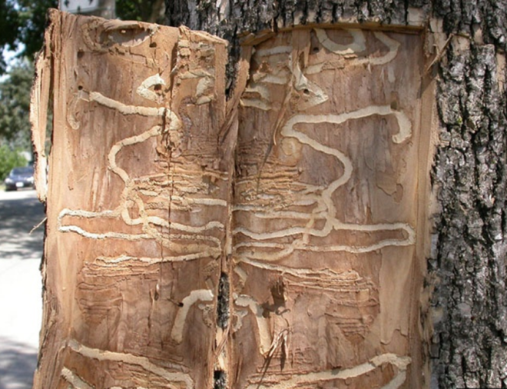
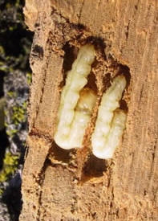
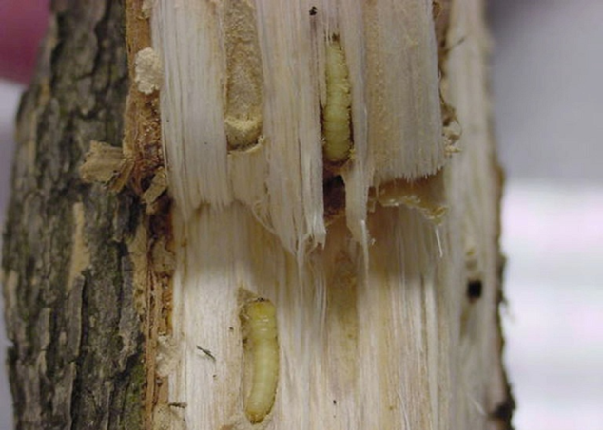
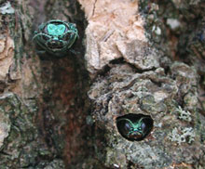
EAB Lifecycle
FPOSP
Early Detector Training
Notes:
Understanding the life cycles of these insects is essential to understanding the damage they cause and the symptoms and signs on trees that we are going to be looking for.

Slide 8
Signs…
FPOSP
Early Detector Training
and Symptoms
and Symptoms

Slide 9
Look For…
FPOSP
Early Detector Training
Thinning of leaves at the top of the tree
Woodpecker activity
Vertical splits in bark
S-shaped larval feeding channels
D-shaped exit holes
Development of epicormic shoots or “water sprouts”
Notes:
While some of these symptoms resemble other diseases or abiotic problems that ash trees can experience, when these are present in combination, they are extremely diagnostic of the presence of EAB. Presented in the order they typically are seen on an infested tree.

Slide 10
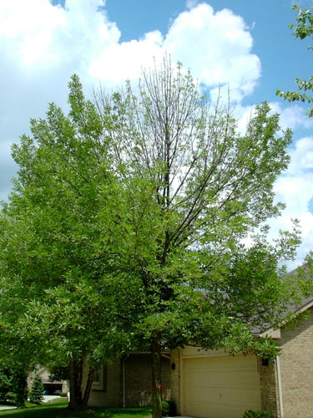
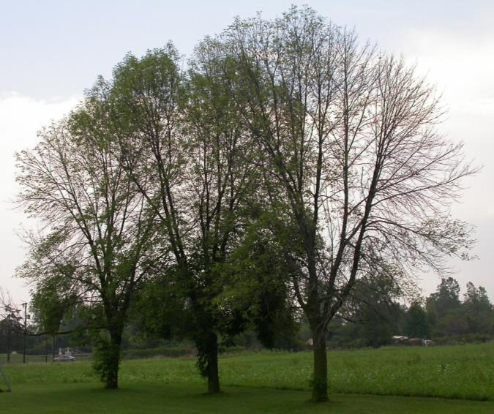
1. Thinning of leaves in the upper canopy
Jodie Ellis, Purdue
As the ash tree loses its ability to circulate nutrients and water, the top part of the canopy begins to die.
The canopy continues to decline until the tree eventually dies.
James W. Smith
Notes:
This usually takes place in the top of the tree first, and gradually progresses down the canopy, until the tree has lost all of its leaves.

Slide 11
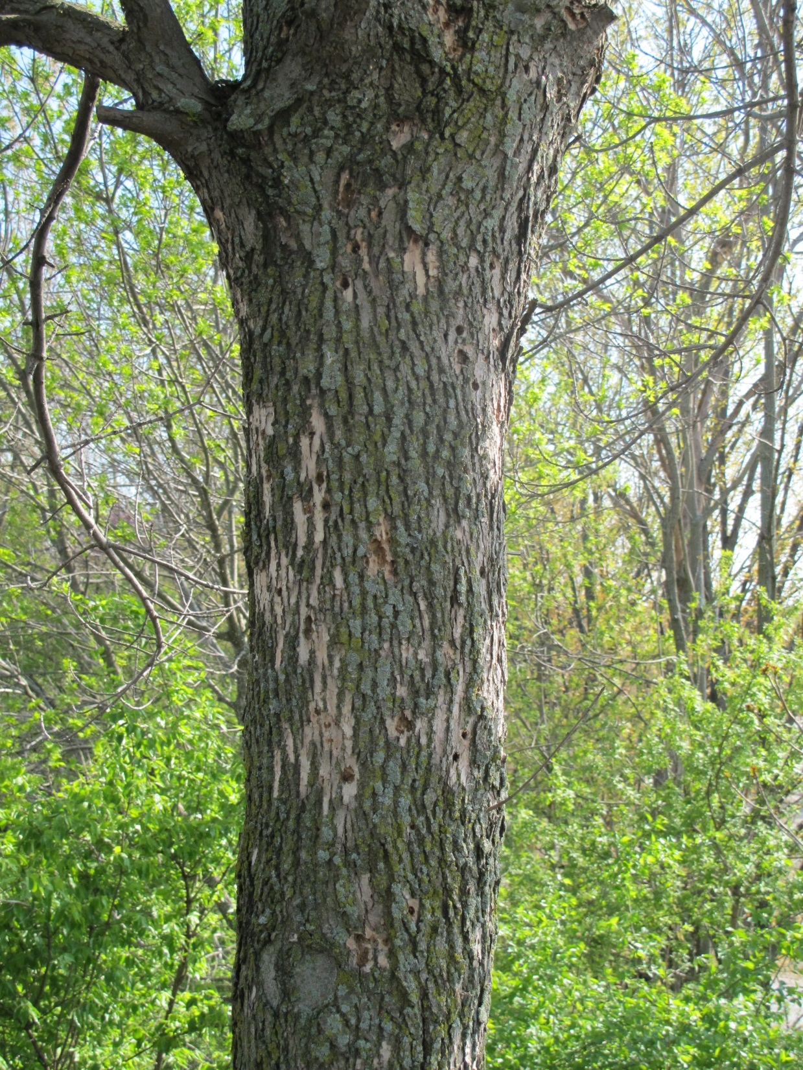
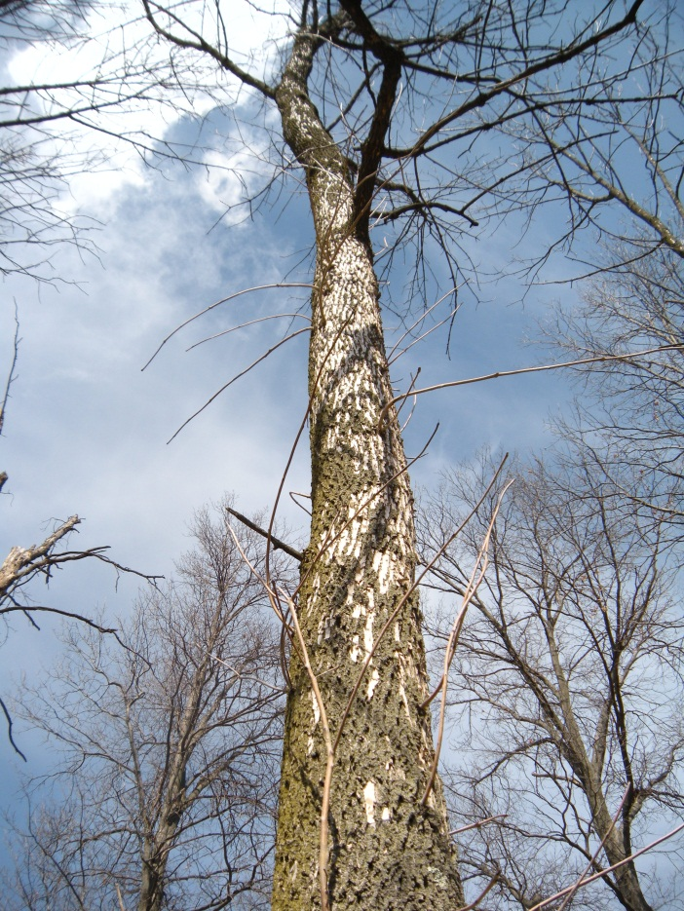
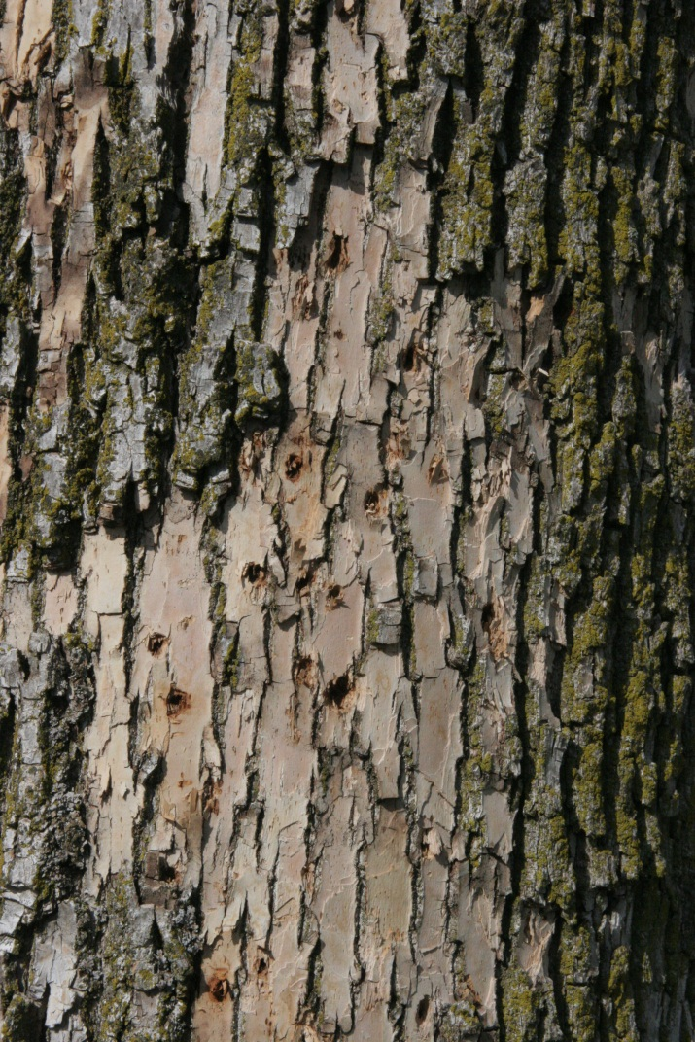
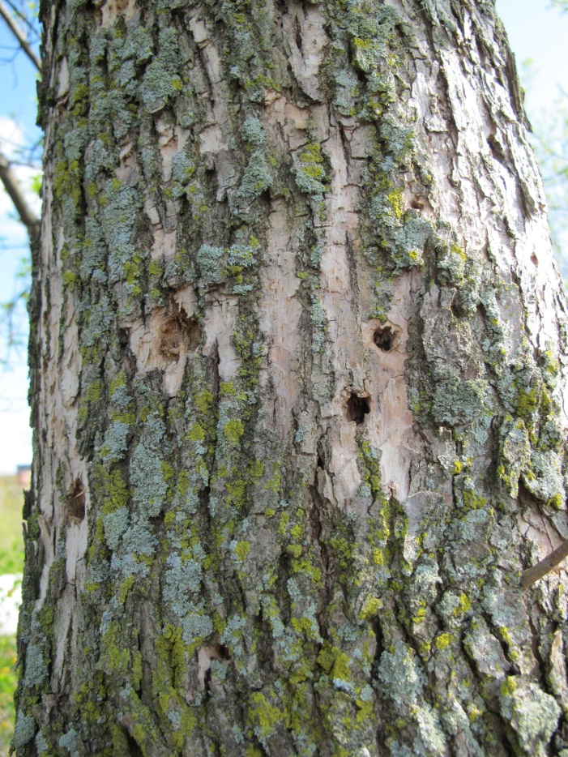
2. Woodpecker Feeding
FPOSP
Early Detector Training
Woodpeckers love to feed on EAB larvae. The marks they leave when scraping the bark from the tree to reach larvae are called flecks. This activity serves as an early warning sign of EAB.
Notes:
Woodpeckers are extremely good at detecting where EAB larvae are under the bark. They scrape off flakes of bark to get at the larvae underneath, creating light colored patches on the branches and trunks.
An excellent early warning sign that the tree is infested.

Slide 12
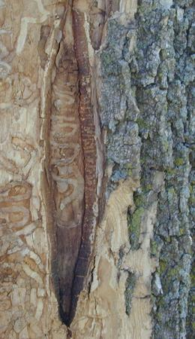
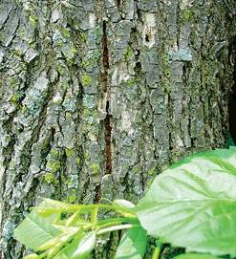
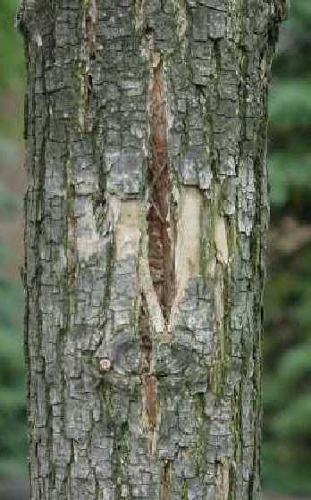
3. Vertical splitting in bark
FPOSP
Early Detector Training
Vertical splits in bark often appear directly above larval feeding galleries, acting as a kind of “window” into the tree.
Notes:
The tree’s bark that lies on top of the larval galleries will often die and split apart, which can form a window into the gallery underneath.

Slide 13
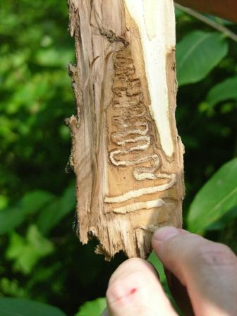
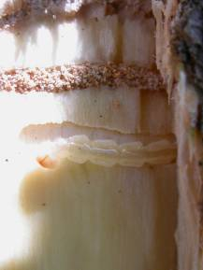
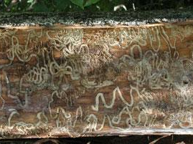
4. S-shaped larval feeding galleries
FPOSP
Early Detector Training
Note the hairpin turns that EAB larvae take as they feed. The channels left behind are packed with sawdust-like excrement (frass).
These zigzagging S-shaped feeding tunnels are diagnostic of EAB in ash trees.
Notes:
EAB larvae leave s-shaped, zig zagging feeding galleries just underneath the bark of ash trees. If you remove the bark of an infested tree, youll often see that the larval tunnels are packed with a sawdust like substance. This is the larval excrement and is called frass.

Slide 14
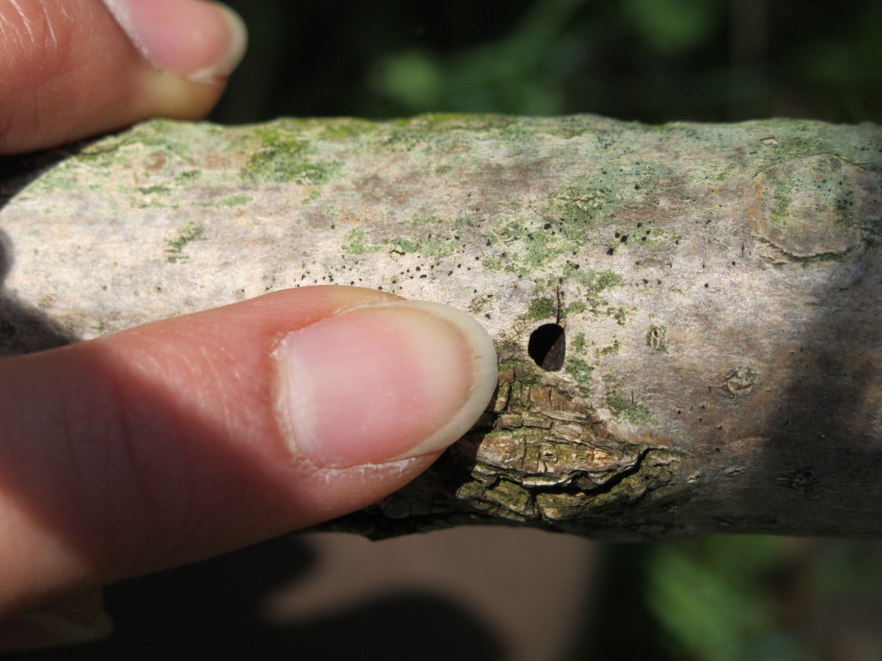
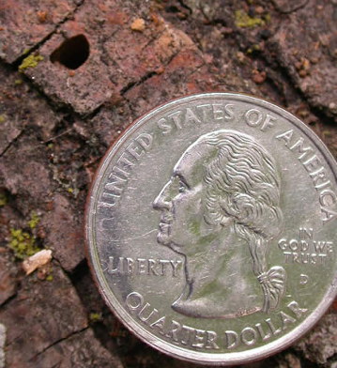
5. D-Shaped exit holes
FPOSP
Early Detector Training
One-half inch
1/8inch
Adults chew their way from under the bark through tiny D-shaped exit holes. These can be found on tree limbs and trunks. Note their small size (about 1/8 inch wide).
Notes:
This is generally only very visible on trees in late stages of infestation, because damage typically occurs first in upper branches, where exit holes are not easily seen.
The small size of the adults and their exit holes is of note. Native ash borers can also leave exit holes in the trunks of trees that are stressed or sick. These are often confused for EAB damage, but are typically larger and more round than EAB exit holes.

Slide 15
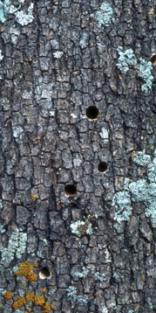
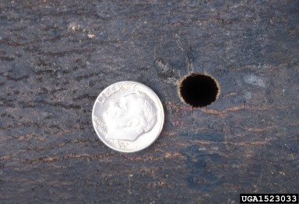
Watch out for the natives…
FPOSP
Early Detector Training
Red-Headed ash borer exit holes
(native longhorned beetle)
Photo Dan Herms, bugwood.org
Notes:
The small size of the EAB adults and their exit holes is of note. Native ash borers can also leave exit holes in the trunks of trees that are stressed or sick. These are often confused for EAB damage, but are typically larger and more round than EAB exit holes.
The native ash clearwing borer will often leave its cast pupal shell in its exit holes…a tell tale sign that the holes were not made by EAB.

Slide 16
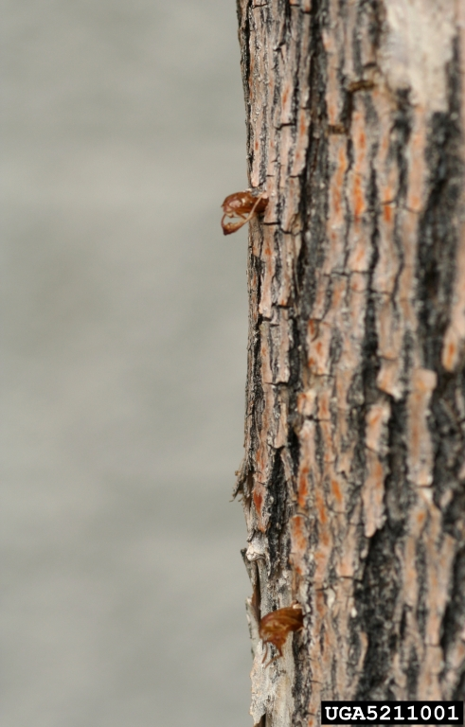
Watch out for the natives…
FPOSP
Cast pupal skins
Early Detector Training
Ash Clearwing Borer
Exit holes (a native moth)
Photo: Whitney Cranshaw, bugwood.org
Notes:
The small size of the EAB adults and their exit holes is of note. Native ash borers can also leave exit holes in the trunks of trees that are stressed or sick. These are often confused for EAB damage, but are typically larger and more round than EAB exit holes.
The native ash clearwing borer will often leave its cast pupal shell in its exit holes…a tell tale sign that the holes were not made by EAB.

Slide 17
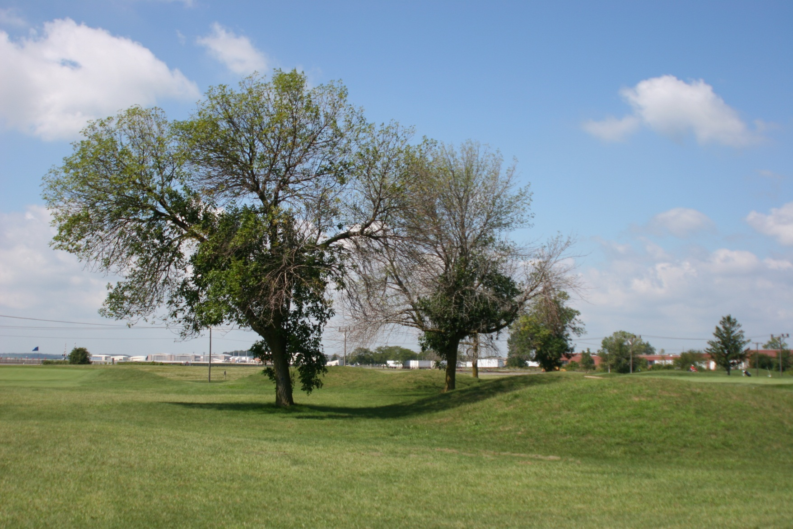
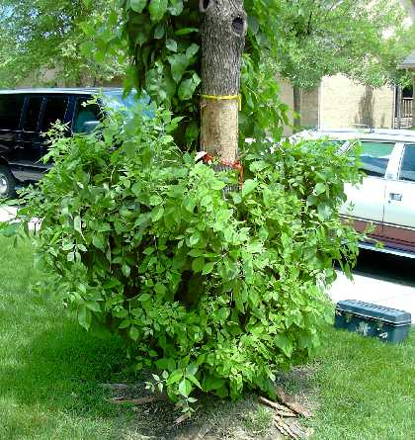
6. Epicormic shoots
FPOSP
Early Detector Training
Dying ash trees send out dense epicormic shoots or water sprouts in an attempt to compensate for leaf loss in the upper canopy.
They are usually composed of large, lush green leaves.
Notes:
A last ditch effort by the tree to make “new trees” and survive. A late-stage symptom of infestation, will not support the tree.

Slide 18
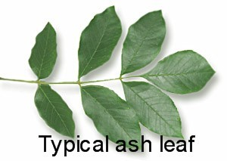
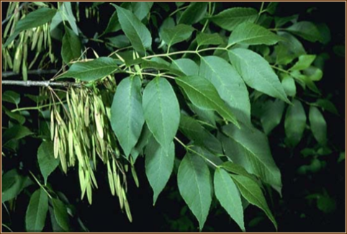
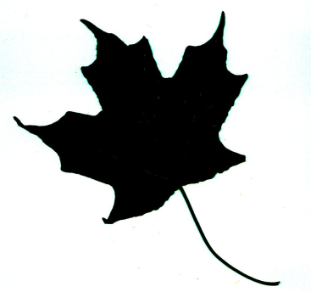
Identifying Ash Trees
FPOSP
Early Detector Training
Leaves are compound, feather shaped, containing 5-11 leaflets
A maple leaf: a good example of a simple leaf.

Slide 19
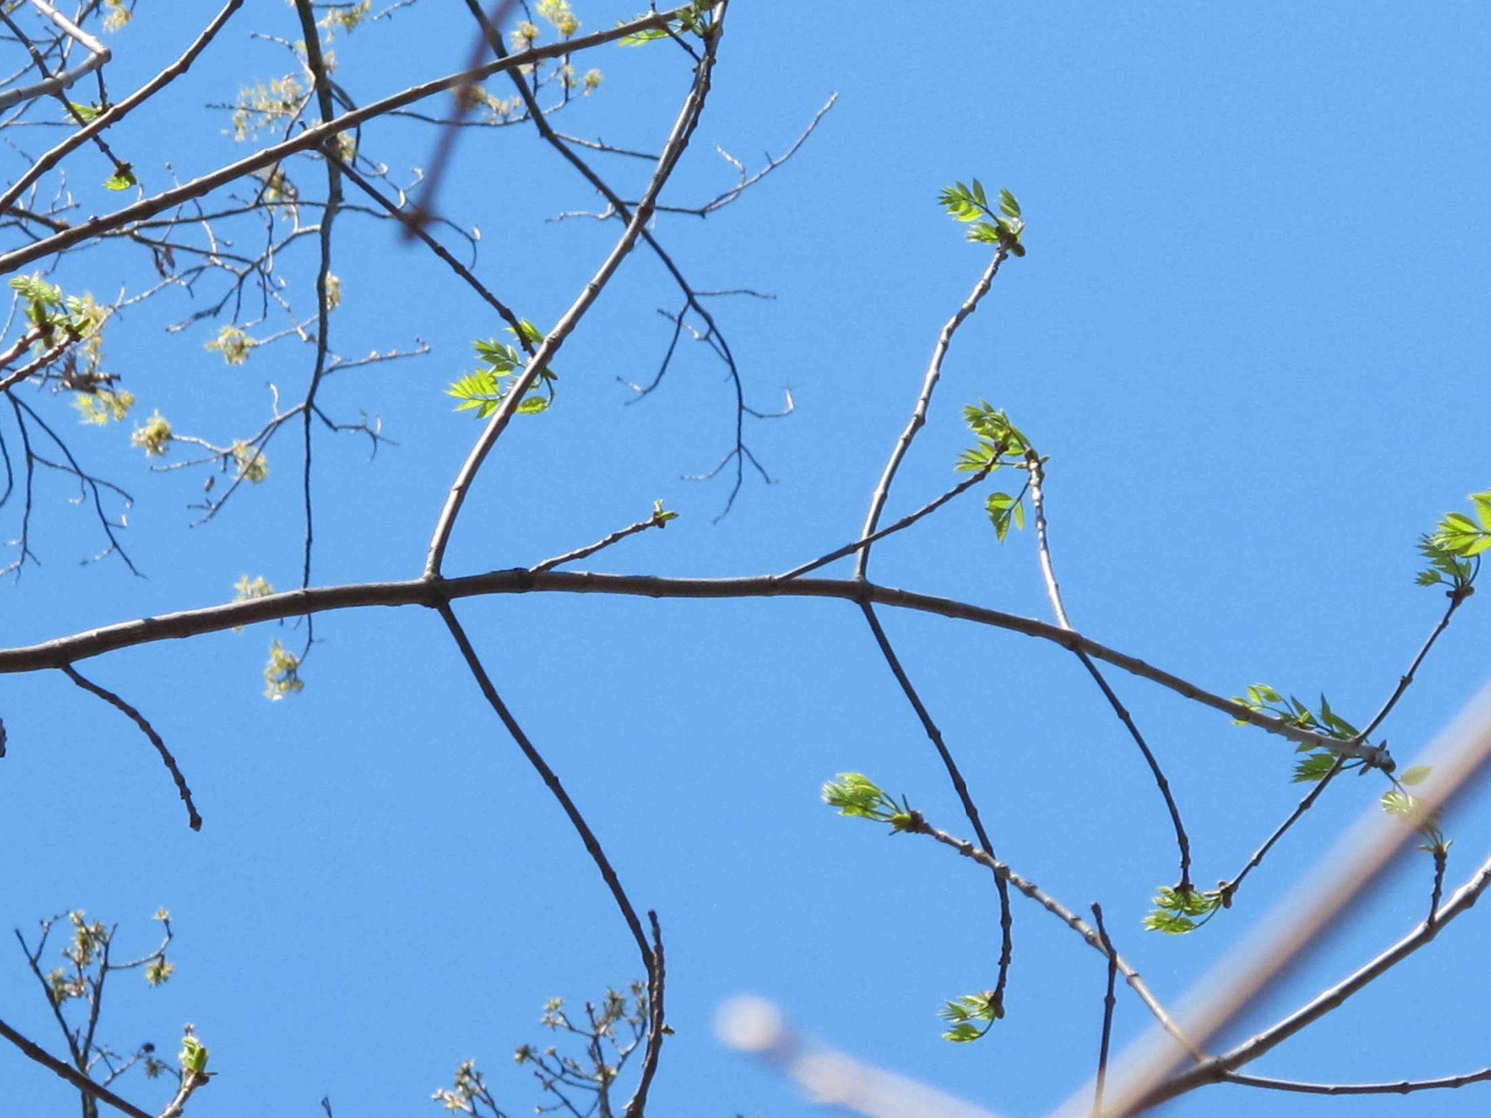
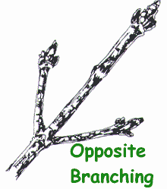
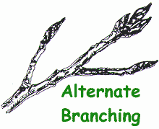
Identifying Ash Trees
FPOSP
Early Detector Training
Branches and buds of ash trees are located directly across from each other (oppositely oriented).
Note: Buds and limbs of ash trees often die and fall off, so not every single branch or bud will have an opposite mate. Look at several examples before deciding.

Slide 20
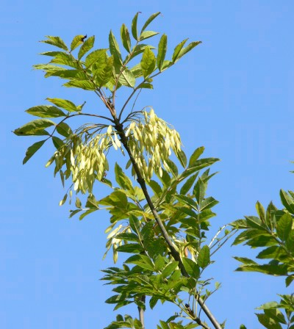
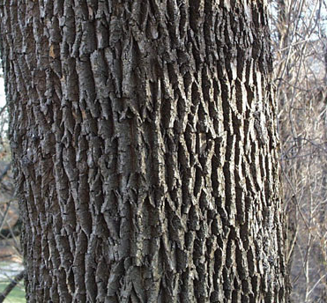
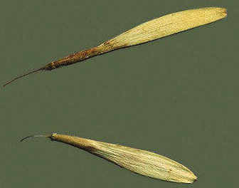
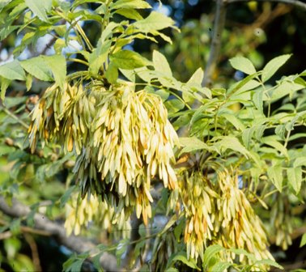
Identifying Ash Trees
FPOSP
Early Detector Training
Bark has distinctive diamond-shaped patterns
Seeds are oar-shaped and borne in clusters

Slide 21
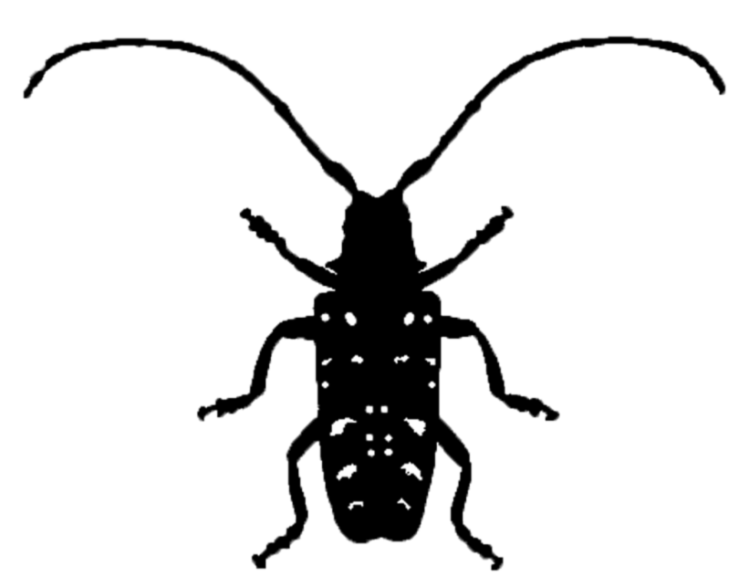
White Ash
EAB

Slide 26
green ash

Slide 27
green ash (Fraxinus pensylvanica)

Slide 29
blue ash

Slide 30
black ash

Slide 31
Helpful comparisons

Slide 32
Some look-alikes…
FPOSP
Early Detector Training
Black walnut has compound leaves and ALTERNATE branching
Mountain ash is not a true ash (Fraxinus)
Boxelder has compound leaves, with paired seeds

Slide 33
Review
FPOSP
Early Detector Training
Look for early symptoms of EAB damage:
Thinning of canopy
Woodpecker holes and flecking
Bark splits with curvy galleries

