Slide 1
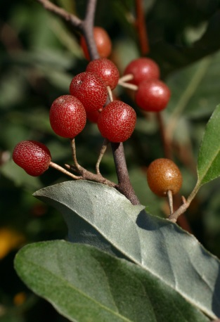
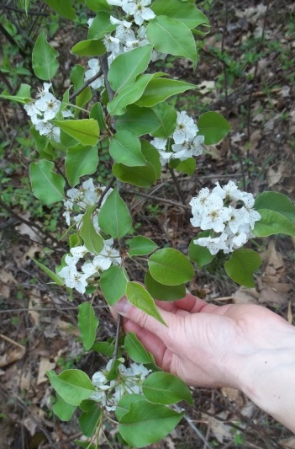
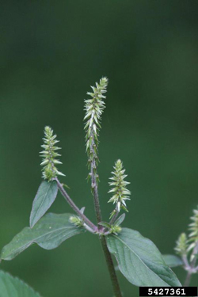
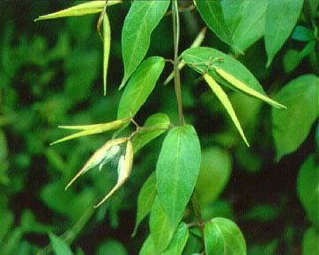
Emerging Invasive Plants in Indiana- The Top 20 to Report on EDDMaps
Indiana Invasive Species Council
Invasive Plant Advisory Committee
August 2018

Slide 2
Watch for and Report These Invasive Plants:
Japanese stiltgrass
Spiny plumeless thistle
Black swallow-wort
Pale swallow-wort
Callery pear
Burning bush
Amur cork tree
Sweet autumn clematis
Japanese chaff flower
Mile-a-minute vine
Lesser celandine
Jetbead
Wisteria
Hairy willow-herb
Mimosa
Chinese yam/Air potato
Small carpetgrass
Ravenna grass
Perilla
Catnip

Slide 3
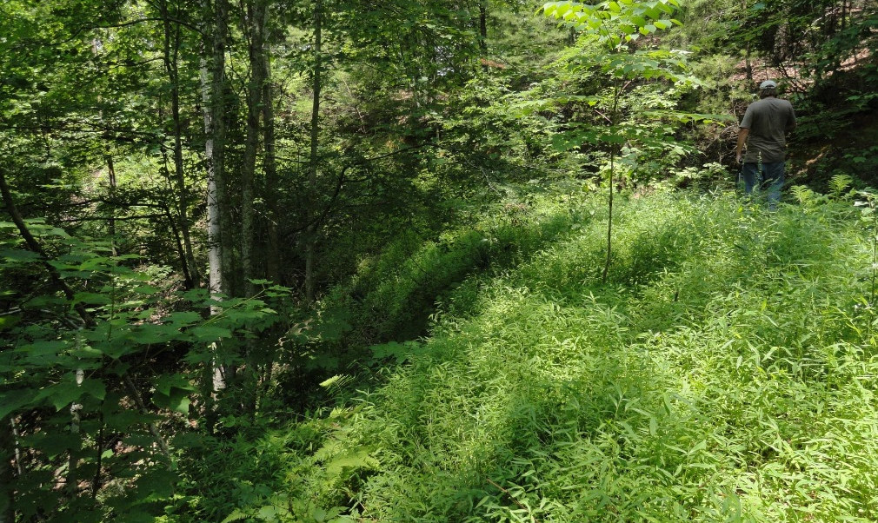
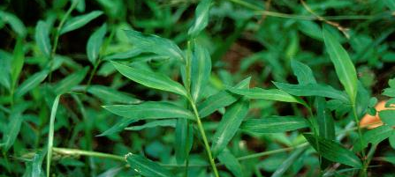
Japanese Stiltgrass Microstegium vimineum
Annual, sprawling grass up to 4 feet tall
Leaves pale green, lance-shaped, 1-4 inches long, with a silvery strip on midrib
Small terminal flower spikes appear in late summer

Slide 4
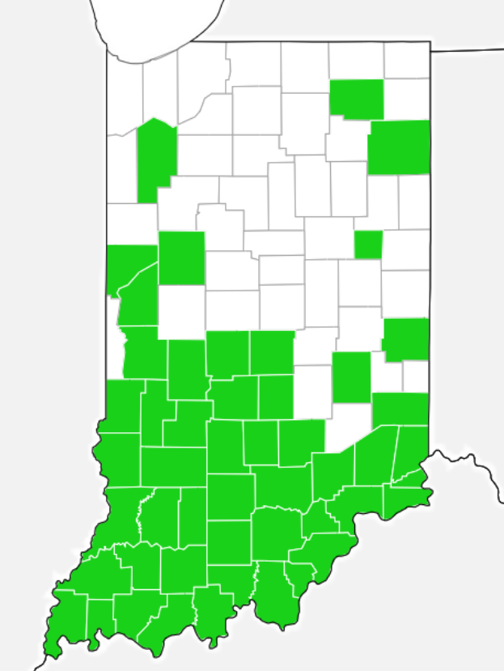
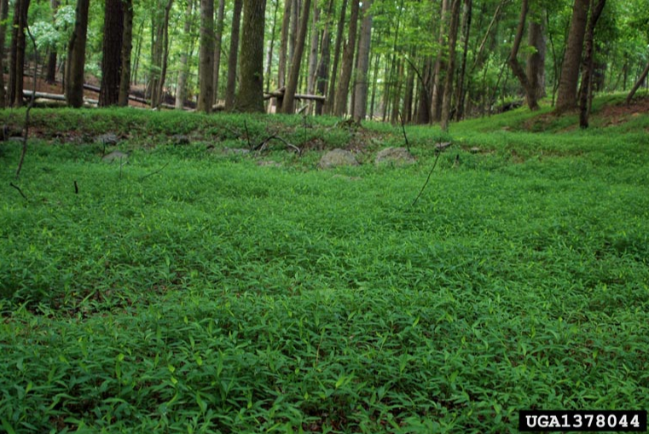
Japanese Stiltgrass Microstegium vimineum
Highly shade tolerant so it’s able to invade forests
Grows densely, displacing native plants
Moving quickly north
Reports are needed to better assess its range
Distribution as of 8/2018

Slide 5
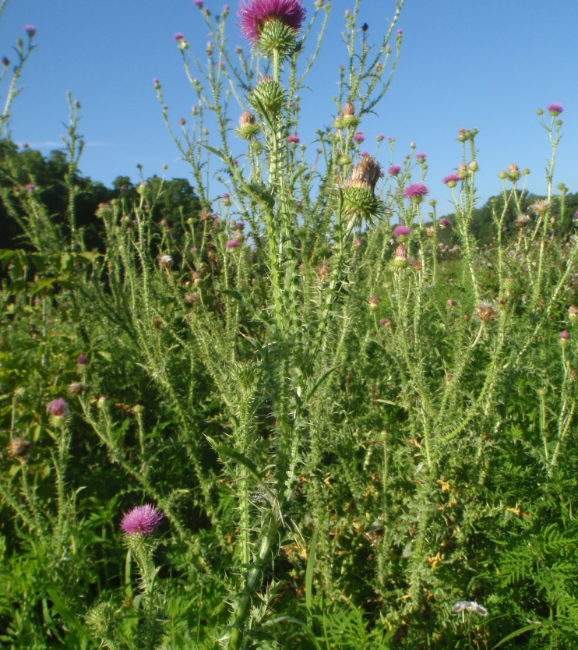
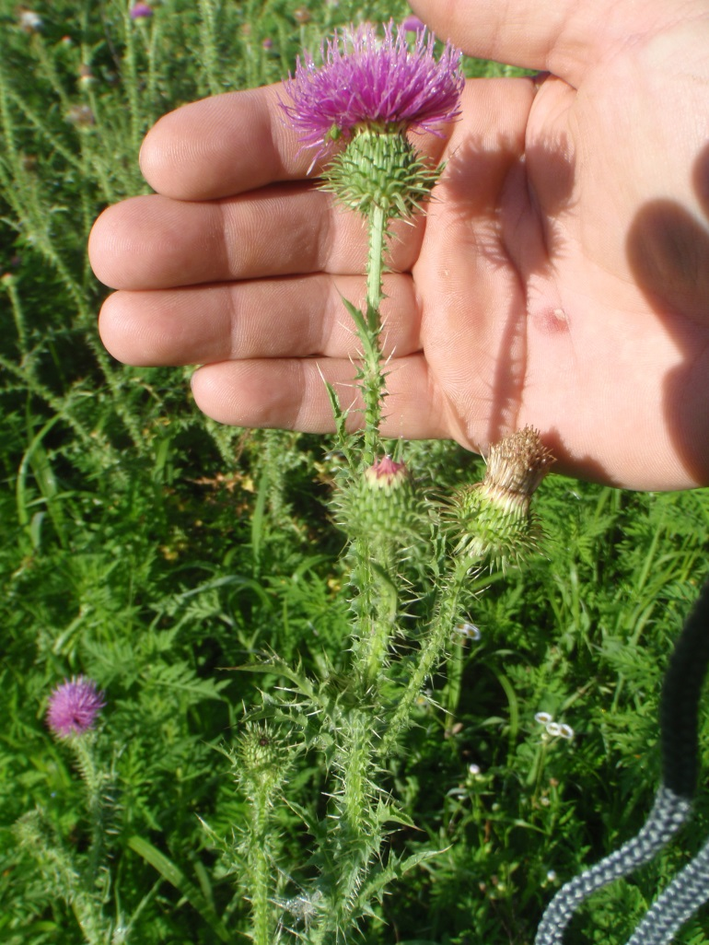
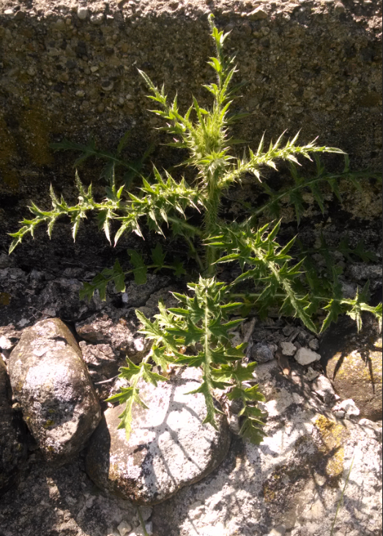
Spiny plumeless thistle Carduus acanthoides
Highly branched biennial, with one flower at the end of each branch
Each flower up to 1” in diameter
Looks like bull thistle, but:
Even spinier than bull thistle
Leaves paler
Flowers 2 weeks earlier (early July, versus bull thistle blooming in late July)

Slide 6
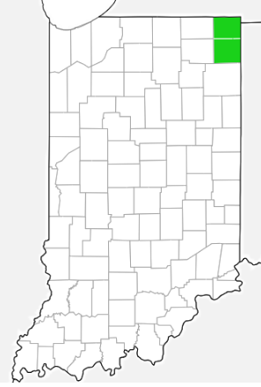
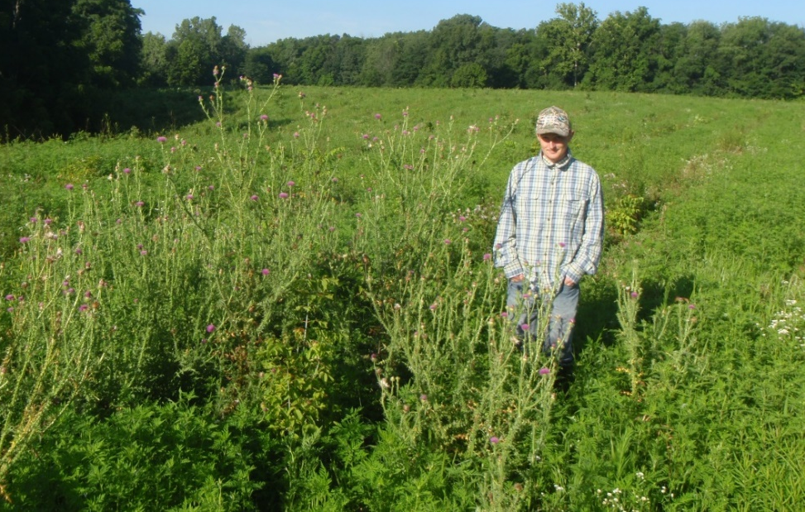
Spiny plumeless thistle Carduus acanthoides
Fast moving biennial thistle with wind-disseminated seeds that move from one open area to another.
Because of its similarity to other thistles it may be more widespread than has been documented.
Distribution as of 8/2018

Slide 7
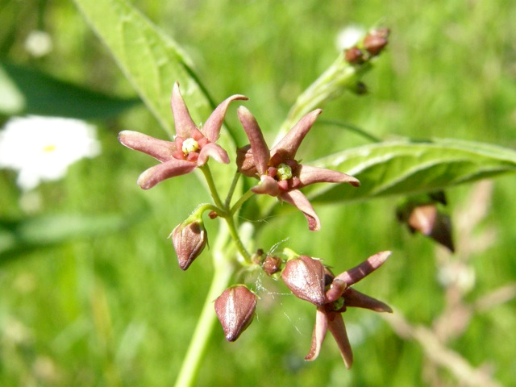
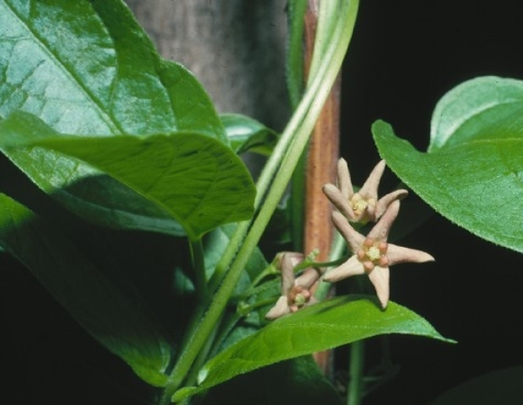
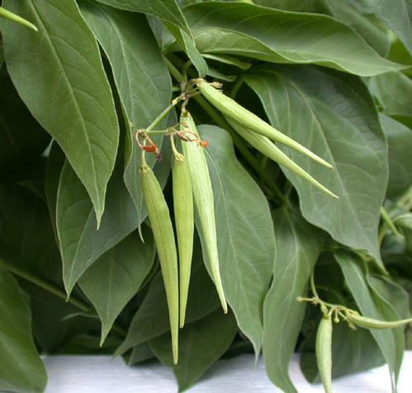
Black Swallow-wort
Vincetoxicum nigrum
Pale Swallow-wort
Vincetoxicum rossicum
Leaves dark green, flowers dark purple, peduncles <2 cm
Leaves medium green, flowers pink to reddish, peduncles >2cm

Slide 8
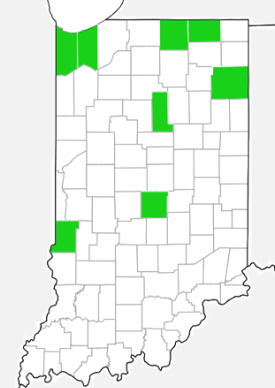
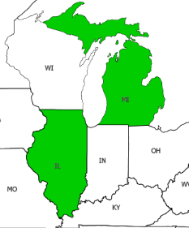
Black Swallow-wort
Vincetoxicum nigrum
Pale Swallow-wort
Vincetoxicum rossicum
Distribution as of 8/2018
Both black and pale swallow-worts create dense thickets that smother native plants.
Monarch caterpillars will ingest swallow-wort, which is related to our native milkweeds, but swallow-worts are toxic to them and kill the caterpillar.

Slide 9
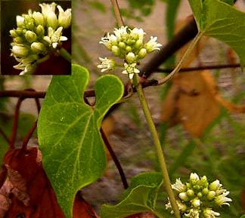
Black and Pale Swallow-wort
Native Look-alike
Invasive Native
Black swallow-wort
Leaf base is rounded
Honey vine, Cynanchum laeve Heart-shaped leaf base and white flowers

Slide 10
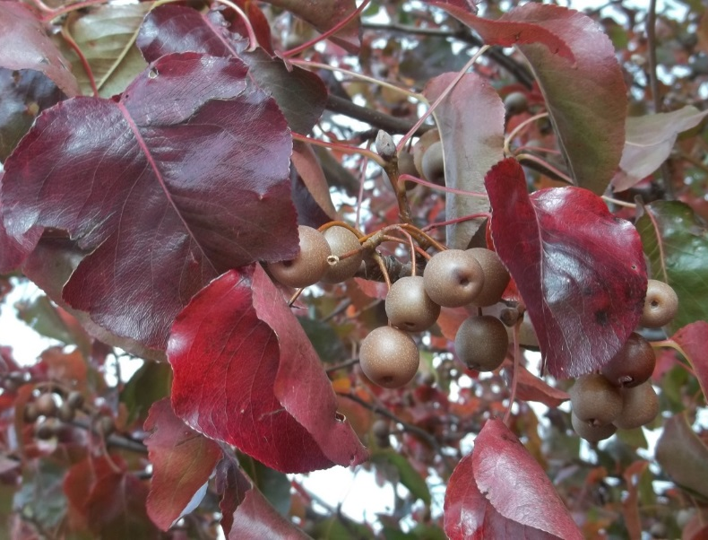
Callery Pear Pyrus calleryana
White flowers in early spring, before or just as leaves emerge
Leaves heart-shaped to ovate with a wavy, finely serrated margin.
Fruits round, brown, ½ inch diameter
Common yard tree, planted in strip malls

Slide 11
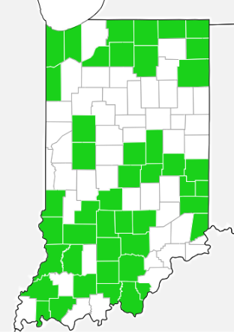
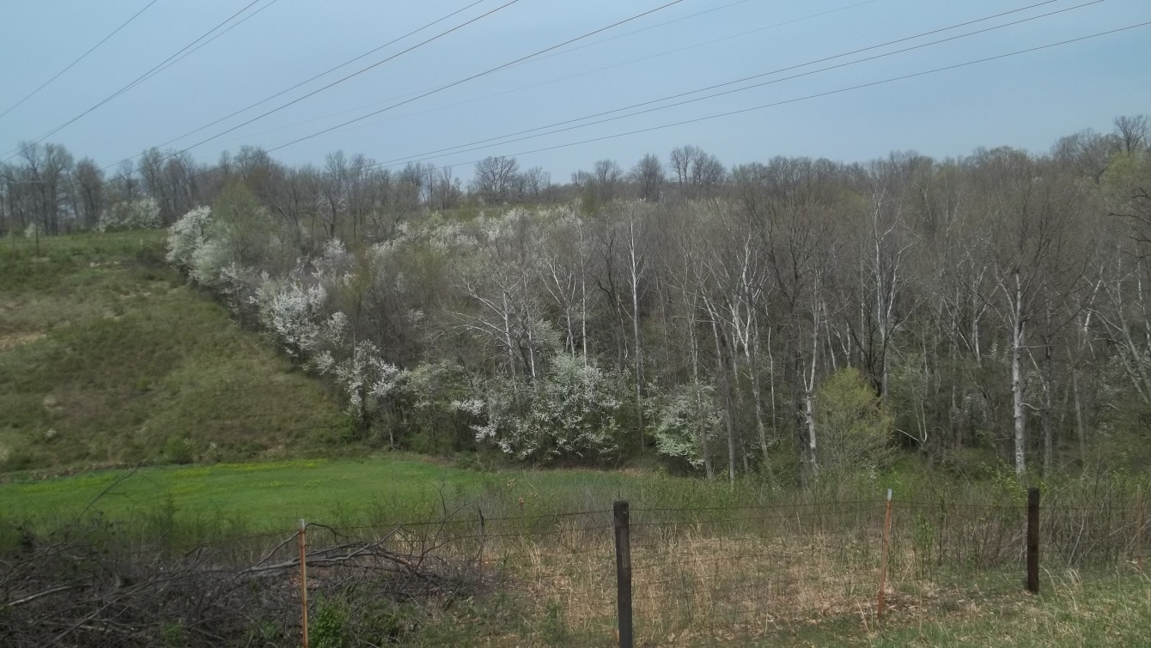
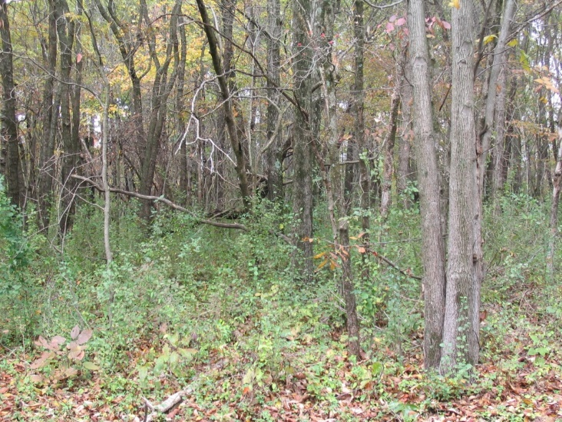
Callery Pear Pyrus calleryana
One of the fastest moving invasive plants in Indiana
Also one of the most commonly planted trees in Indiana communities
Distribution as of 8/2018
Martin County - Callery pear has invaded approximately 80% of a 62,473 acre reserve
All the green is Callery pear dominating forest understory

Slide 12
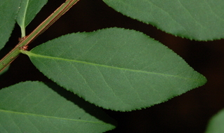
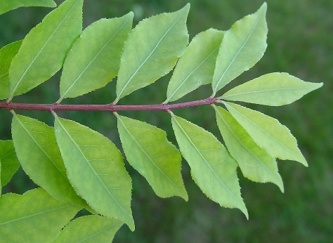
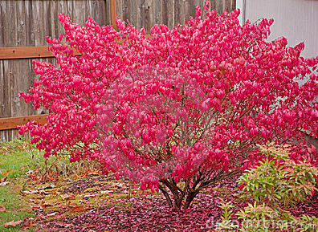
Burning bush Euonymus alatus
Extremely popular landscaping shrub which is invading forests throughout Indiana
Green, more or less winged twigs with finely-toothed opposite leaves, turning bright red in fall

Slide 13
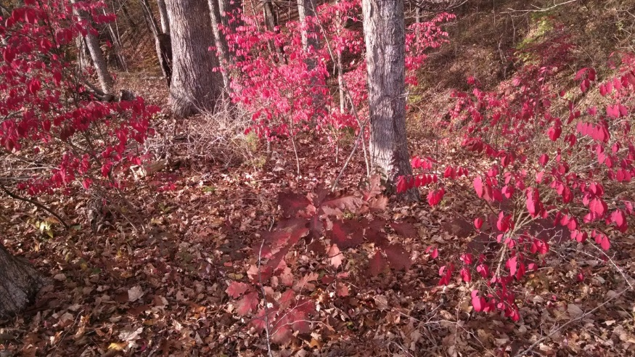
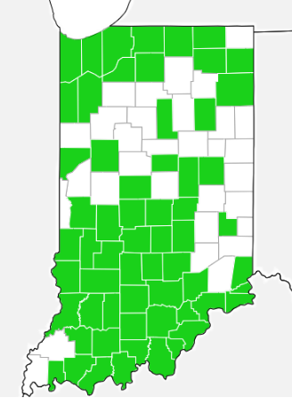
Burning bush Euonymus alatus
Invasions are most evident in October/November when the invading shrubs turn red in forest understory.
Because it is so widely planted, there are many infestations in the state.
More reports are needed to accurately map the infestations and assess the species.
Distribution as of 8/2018

Slide 14
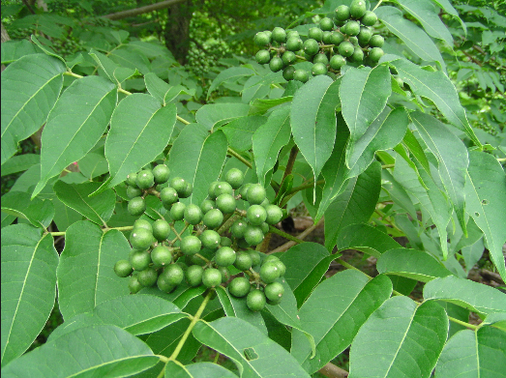
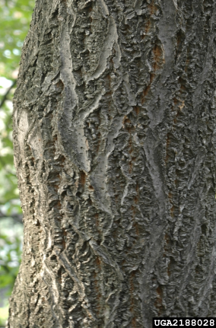
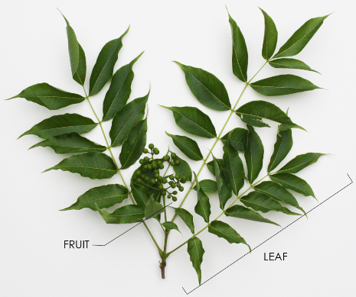
Amur cork tree
Phellodendron amurense
30’-60’ tall tree
Pinnately compound leaves with 5-13 leaflets, opposite arrangement, with acute tips.
Leaves smell like turpentine when crushed
Fruits are small drupes (fleshy fruits with thin skin and a central stone)
Corky bark

Slide 15
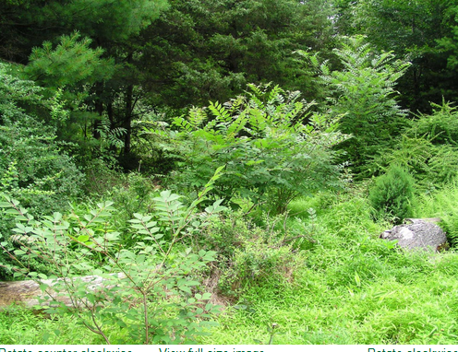
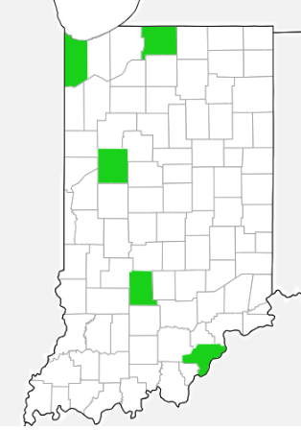
Amur cork tree Phellodendron amurense
Distribution as of 8/2018
Scattered locations through the state
Unsure how prevalent this species is and reports are needed to better map and assess the species.

Slide 16
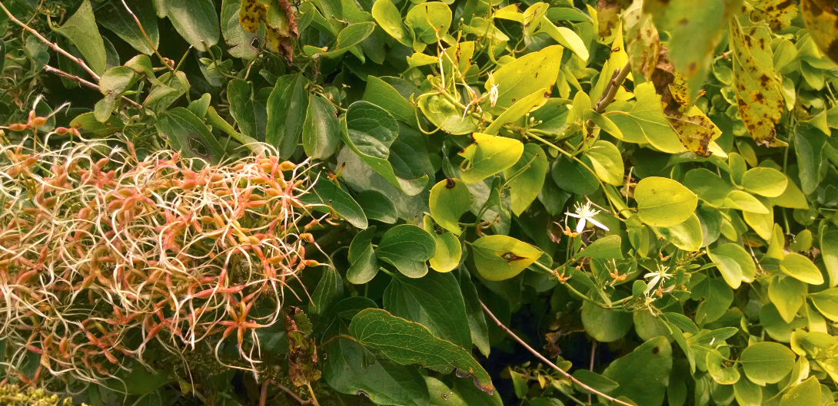
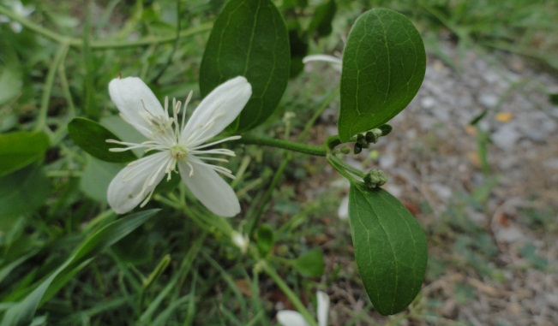
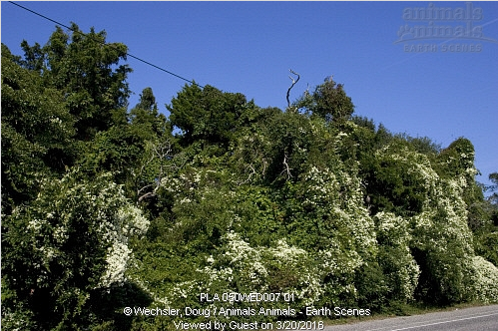
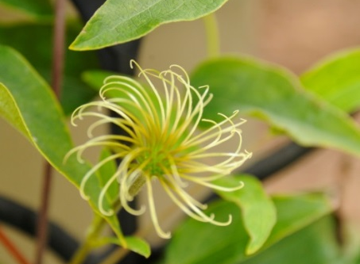
Sweet autumn clematis Clematis terniflora
Invasive vine in open habitats, climbing over other vegetation
Leaves are trifoliate, opposite, smooth margin.
Flowers with four white petals; fruits with feathery plumes

Slide 17
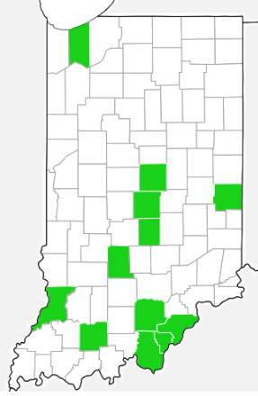
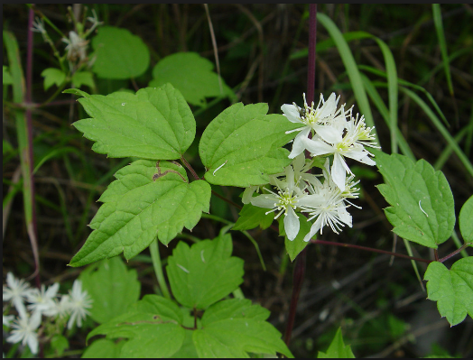
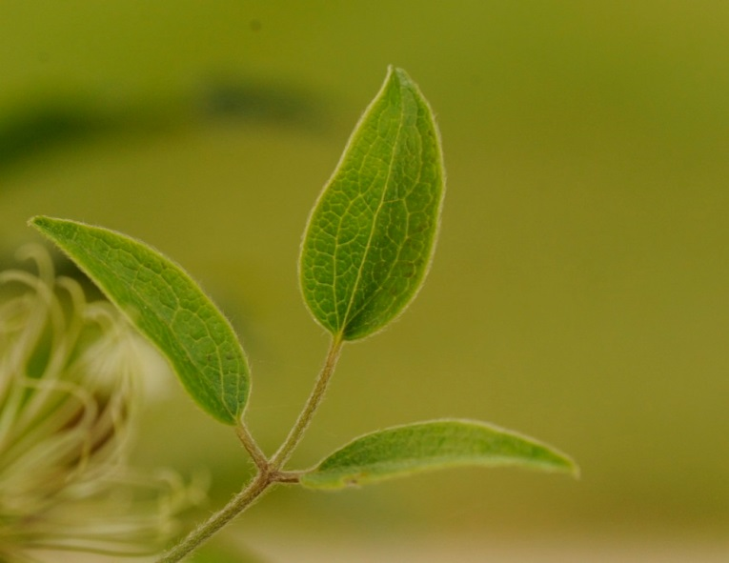
Sweet autumn clematis
Clematis terniflora
Scattered in Indiana, unclear how widespread it is. Reports are needed to better assess this species.
Has a native look-a-like, Clematis virginiana, which has toothed leaves.
Distribution as of 8/2018
Native Clematis virginiana
Invasive Clematis terniflora

Slide 18
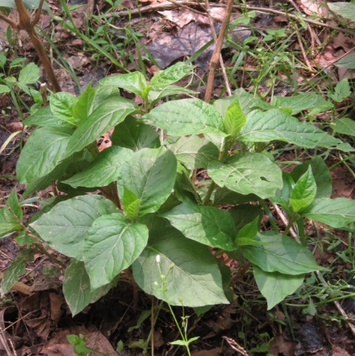
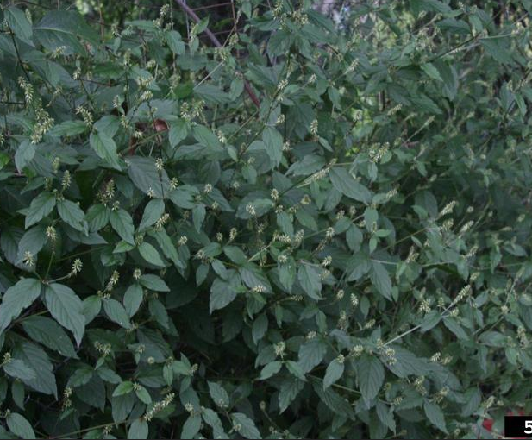
Japanese chaff flower Achyranthes japonica
The leaves are opposite, simple, and entire along the margins.
The flowers occur on erect spikes at the end of the stems and upper branches.
The flowers diverge at nearly a right angle from the spike, giving the flowers some what of a bottle-brush look.
When the fruit are formed, the spikes elongate greatly and the fruit lay flat against the spike . Each fruit has a pair of stiff bracts that aid in dispersal.

Slide 19
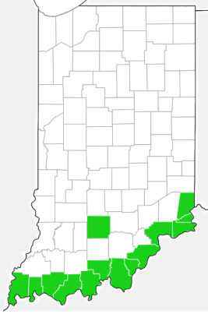
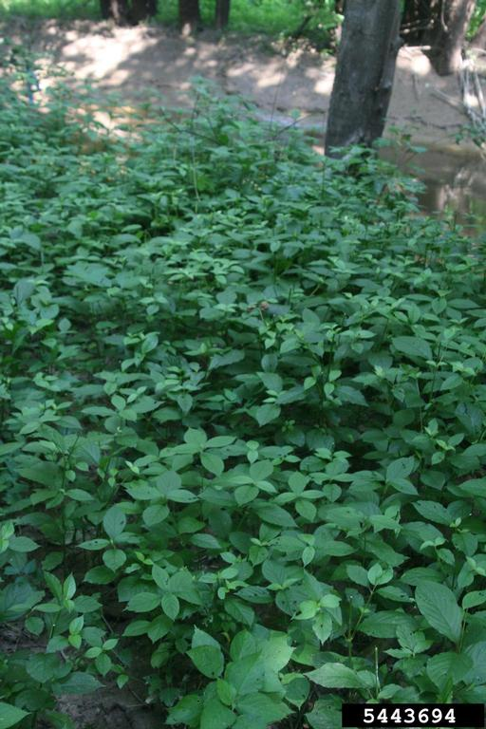
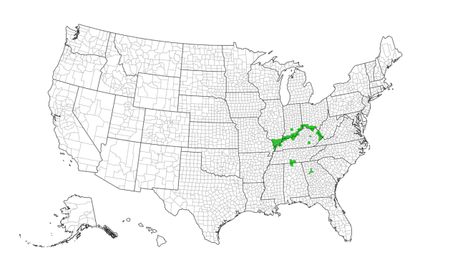
Japanese chaff flower Achyranthes japonica
This is a relatively new invader in Indiana found in riparian areas near the Ohio River
It is moving north quickly due to its barbed fruits and should be watched for and reported in all counties.

Slide 20
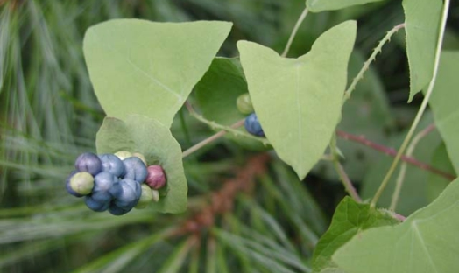
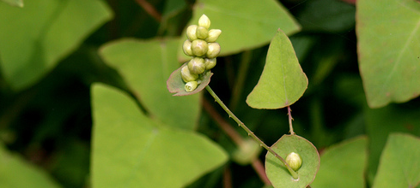
Mile-a-minute vine Persicaria perfoliata
Leaves alternate, nearly perfect triangles with a smooth margin
Vines and underside of leaves have small, stiff recurved barbs.
Small, cup- or saucer-shaped leaf structures, called ocreae, encircle the stem at each node
Clusters of small white, rather inconspicuous, flowers
emerge from the ocreae.
Flowers develop into clusters of deep, iridescent blue berry-like fruits, approximately 5 mm in diameter

Slide 21
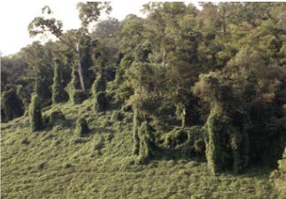
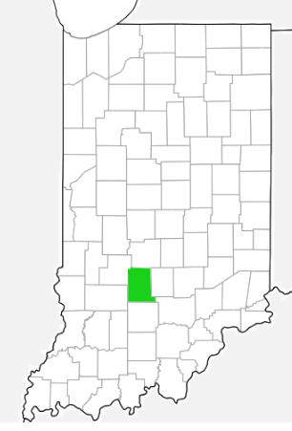
Mile-a-minute vine Persicaria perfoliata
One site in Monroe County, already eradicated.
Invasive vine in open habitats can spread quickly by birds scattering the fruits.
Distribution as of 8/2018

Slide 22
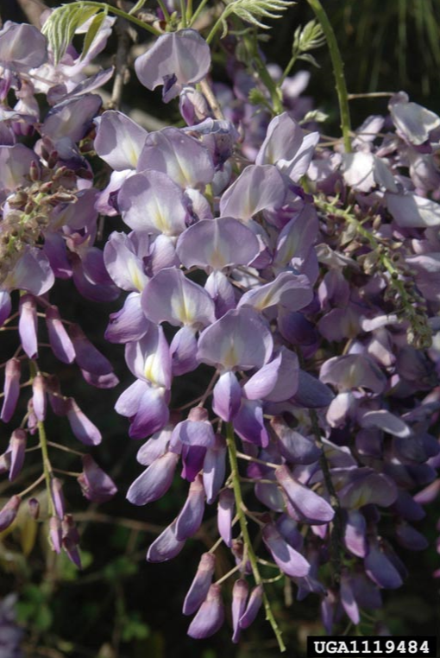
Wisteria Wisteria sinensis/
W. floribunda
Chinese and Japanese wisteria are similar looking invasive woody vines.
Alternate, pinnately compound leaves with 7-13 leaflets that are tapered and have wavy edges.
Dangling clusters of lavender flowers appear before the leaves emerge (the native wisteria, W. frutescens, has upright clusters of flowers that bloom when leaves have already emerged)
Fruits are fuzzy seed pods (the native wisteria has smooth seed pods)

Slide 23
Wisteria Wisteria sinensis/ W. floribunda
Fast-growing vine that can displace native vegetation.
Kills trees and shrubs by girdling them.
More reports are needed to better map and assess this species.
Wisteria sinensis Wisteria floribunda
Distribution as of 8/2018

Slide 24
Lesser celandine Ficaria verna
Short herbaceous perennial
Basal leaves are dark green, shiny, kidney- to heart-shaped and vary greatly in size.
Flowering occurs in March and April with showy, bright yellow, eight-petaled flowers.
This plant is ephemeral, and after fruits are produced in April the leaves turn yellow and disappear until the next year.

Slide 25
Lesser celandine Ficaria verna
Spreads through riparian areas through seeds, bulblets and tubers forming dense carpets.
More reports are needed to better map and assess this species.
Distribution as of 8/2018

Slide 26
Jetbead Rhodotypos scandens
Multi-stemmed shrub up to 6’ tall
Leaves opposite, simple, 2.5-4” long and doubly serrate, with ribbed veins.
Flowers in spring with white, four-petaled, 2” wide flowers.
Fruits are black when ripe, bead-like.

Slide 27
Jetbead Rhodotypos scandens
Invades forested areas creating a thick shrub layer which could displace native plant species.
More reports are needed to better map and assess this species.
Distribution as of 8/2018

Slide 28
Hairy willow-herb Epilobium hirsutum
Herbaceous perennial that spreads by rhizomes.
Stems erect and softly hirsute-pubescent, 1.5’-6.5’ tall.
Leaves opposite, sessile and often clasping at the base, 2-5” long with sharply serrulate margins.
Flowers July- Sept. with rose-colored, four-petaled, 1” wide flowers in racemes in the upper leaf axils.
Slender fruit capsules are 2-3” long.

Slide 29
Hairy willow-herb Epilobium hirsutum
Invades wetland areas creating a monoculture that can displace native plant species.
This is not a well-known species, and more reports are needed to better map and assess this species
Distribution as of 8/2018

Slide 30
Mimosa Albizia julibrissin
Small tree 10’-50’ tall often having multiple trunks.
Leaves delicate-looking, bi-pinnately compound and resembling ferns.
Flowers in early summer with very showy, fragrant pink flowers in groups at the end of branches.
Fruits are flat, 6” long seed pods.

Slide 31
Mimosa Albizia julibrissin
Invades any type of disturbed habitats, and is a particular problem in glades and barrens in southern IN.
Originally reported in the Ohio River counties, more invasions are being reported each year in counties north of the Ohio River.
More reports are needed to better map and assess this species.
Distribution as of 8/2018

Slide 32
Small carpetgrass Arthraxon hispidus
Annual grass up to 1.5’ tall
Leaves oval to lance-shaped, 1-3” long and 0.2” wide with wavy edges and heart-shaped, clasping bases. Leaf margins have conspicuous hairs.
Flowers in early fall in 1 to several, 1-3” long spikes.

Slide 33
Small carpetgrass Arthraxon hispidus
Invades wet areas such as stream banks, floodplains and shorelines.
Was only known from counties along the Ohio River until it was reported in Brown and Bartholomew Counties in 2016.
More reports are needed to better map and assess this species.
Distribution as of 8/2018

Slide 34
Chinese yam/Air potato Dioscorea polystachya
Herbaceous twining vine that grows to about 16.4’.
Leaves alternate proximally but can become opposite as they advance up the vine. They are up to 8 inches long and wide and heart to fiddle shaped (margins three-lobed) with prominent, parallel veins.
Chief means of reproduction are aerial, potato-like tubers (bulbils) located at leaf axils.

Slide 35
Chinese yam/Air potato Dioscorea polystachya
Forms dense masses of vines that cover and kill native vegetation in a variety of moist, disturbed habitats.
More reports are needed to better map and assess this species.
Distribution as of 8/2018

Slide 36
Ravennagrass Saccharum ravennae
Tall clumping grass 8’-12’ tall.
Leaves are in a basal tuft that can be several feet in diameter.
Flowering stem is largely naked of leaves with a feathery, fan-shaped plume at the top; flowers in early fall.
Stem is covered with fine hairs

Slide 37
Ravennagrass Saccharum ravennae
Invades wetlands and riparian areas.
More reports are needed to better map and assess this species.
Distribution as of 8/2018

Slide 38
Beefsteak Plant Perilla frutescens
Annual freely branching herb 1-6’ tall.
Square stems are hairy, with four parallel grooves.
Opposite leaves ovate or orbicular, coarse teeth on margins. Leaves can be green or purple on both sides.
Flowers held in pairs along stalks.

Slide 39
Beefsteak Plant Perilla frutescens
Fast moving annual species spreading along roads and in other disturbed habitats.
More reports are needed to better map and assess this species.
Distribution as of 8/2018

Slide 40
Catnip Nepeta cataria
Herbaceous perennial 2’-3’ tall.
Leaves opposite, triangular, soft hairy, and fragrant with coarse teeth and 1” petioles.
Stems square.
Flowers in summer with terminal racemes of small flowers in densely crowded whorls.

Slide 41
Catnip Nepeta cataria
Can spread aggressively in dry, disturbed habitats.
More reports are needed to better map and assess this species.
Distribution as of 8/2018

Slide 42
How to Report These Species
Mobile Device - Download and use the Great Lakes Early Detection Network (GLEDN) app.
Computer – Report at EDDMapS.org
Need Directions:
https://www.entm.purdue.edu/iisc/pdf/how-to-report-on-smartphone.pdf
https://www.entm.purdue.edu/iisc/pdf/how-to-report-on-website.pdf

