Slide 1
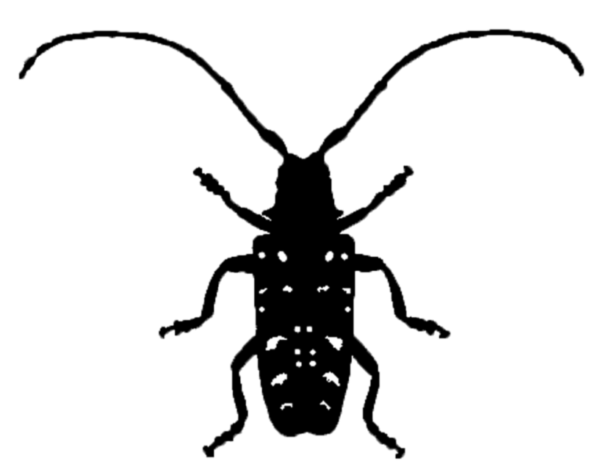
Asian longhorned beetle Biology Signs and Symptoms Response
Adapted from Presentations by
Amy Stone and Joe Boggs, Ohio State Extension
Early Detector Training
Forest Pest Outreach Survey Project
Notes:
ALB is an exotic invasive beetle that has not yet been found in Indiana, but has caused the removal and destruction of up to 90% of the trees in communities where it has been found. This ravenous insect can devour 13 different native hardwood tree genera, and it is a pest of high concern in the state. Before we get started I would like to acknowledge Amy Stone and Joe Boggs from the Ohio State University Extension. They kindly shared many of the slides in this presentation and provided the intellectual basis for its content.

Slide 2
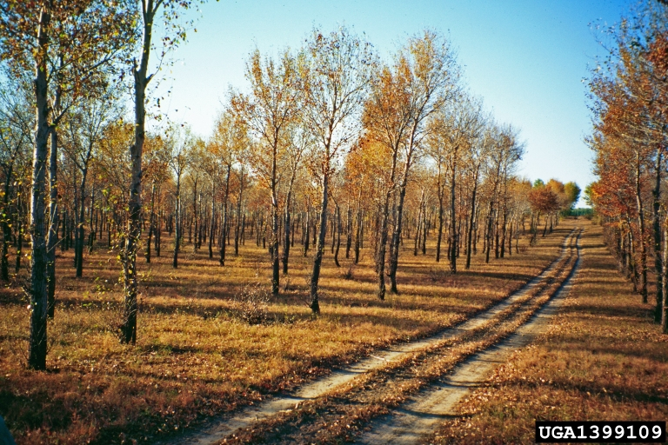
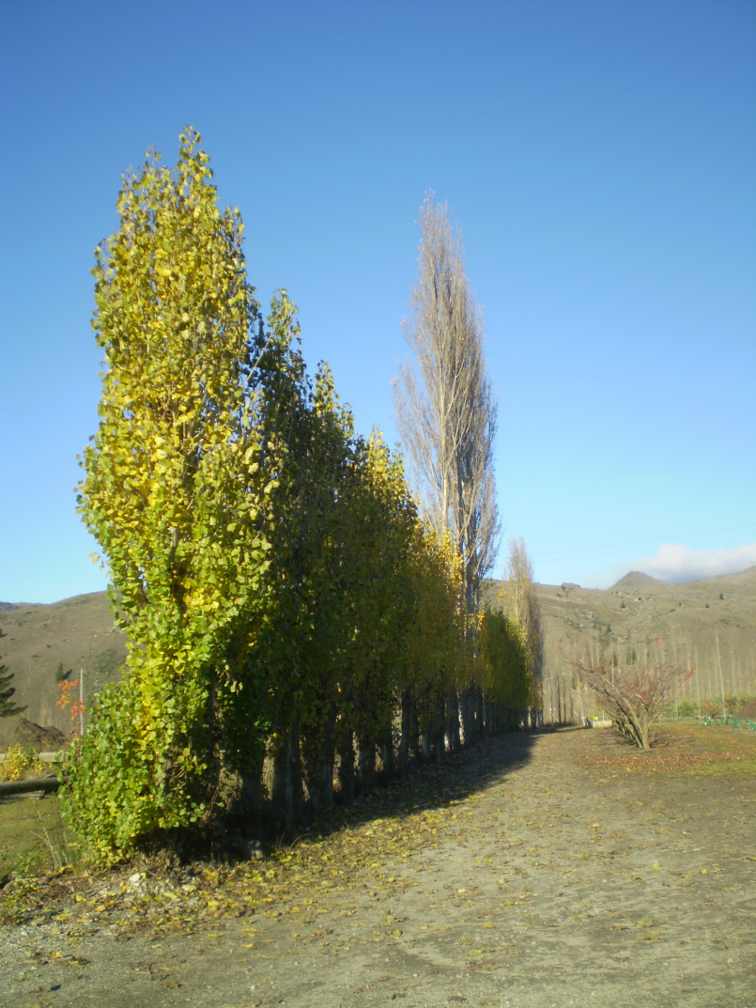
ALB is a SUPERPEST!
FPOSP
Early Detector Training
Unlike EAB, ALB is a killer even in Asia!
A destructive pest of poplar plantations (~40% Chinese plantations infested, about 9,000 sq. miles)
Poplar shelterbelts destroyed in 240 Chinese counties
200 million trees destroyed
Timber unsalvageable
Also a significant urban pest
Photo: Manfred Mielke
Poplar plantation, China
Poplar Shelterbelt

Slide 3
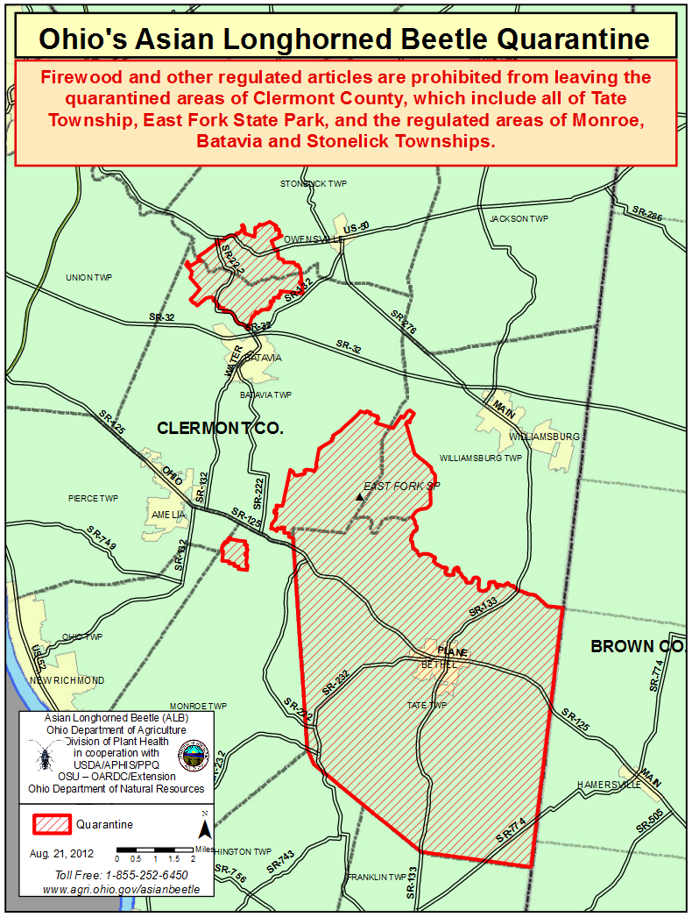
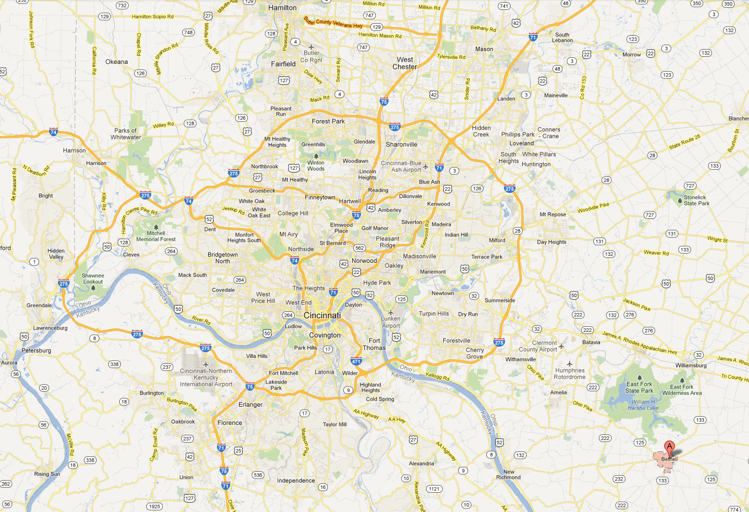
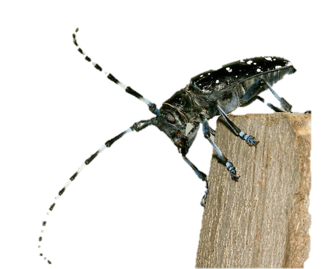
Discovered June 2011
INDIANA
FPOSP
Early Detector Training
9,412 ALB infested trees REMOVED (since 11/14/11)
9,971 trees confirmed infested
481,156 trees surveyed
61 square miles under regulation
Bethel is about 50 miles from the Indiana border
OHIO
CINCINNATI
KENTUCKY
ALB
Notes:
Of particular concern for Indiana is the latest infestation that was discovered in Bethel Ohio in June of last year. Surveys to attempt to delimit the infestation were begun immediately, and tree removals began in November. So far they have removed over 7500 infested trees in only a seven month period. They have surveyed nearly 119,000 trees and so far the quarantined area covers 56 square miles. The scary part for us is that Bethel is only about 50 miles from the Indiana border.

Slide 4
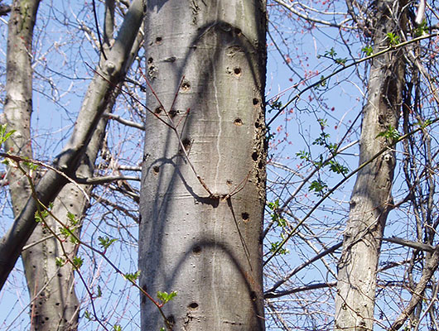
Training Overview
FPOSP
Early Detector Training
Biology
Signs and symptoms

Slide 5
Eradication “Success” Stories
5 - 6 Instars: larval stages
1-2 Years
FPOSP
Early Detector Training
Notes:
Female beetles chew oviposition pits into the tree’s bark, and carefully lay an egg underneath the bark. The first couple of larval stages feed in the phloem and cambial region just under the tree’s bark, and at later stages chew deeper and deeper into the wood of the tree, where they will pupate and complete transformation into an adult beetle. Adults then chew their way out, creating large emergence holes which are about the diameter of a #2 pencil. The adult beetles cannot survive the winter but they can overwinter as larvae or pupae within the tree.

Slide 6
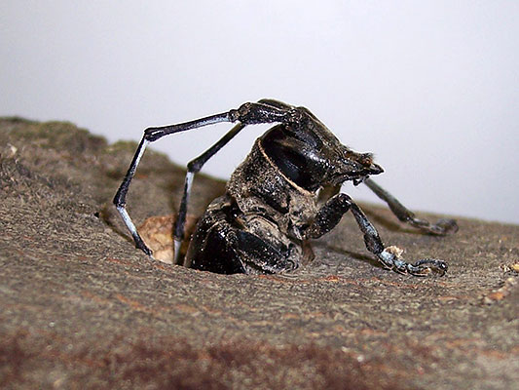
Biology
FPOSP
Early Detector Training
Adults emerge late May-October, peak in July
Long adult life span: 50-65 days
Females can lay 35-90 eggs during their lifetimes!
Adults strong fliers, but typically re-infest trees in local area

Slide 7
FPOSP
FPOSP
Signs and Symptoms

Slide 8
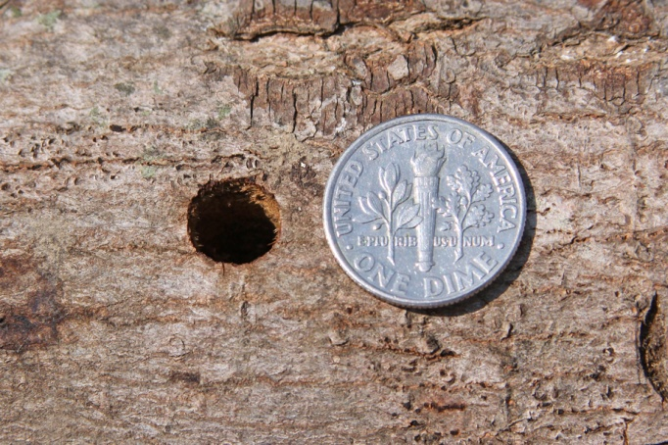
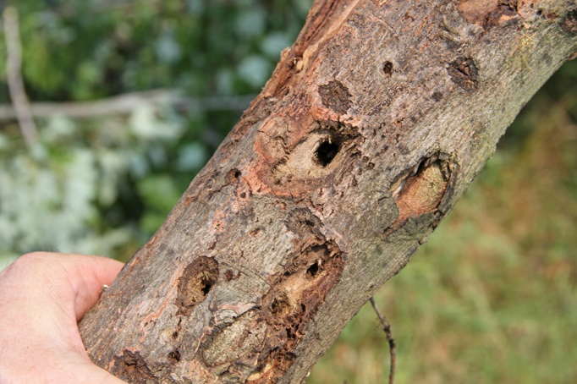
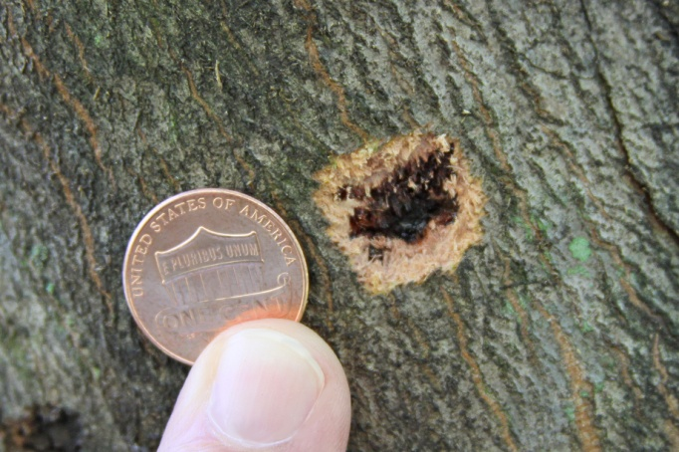
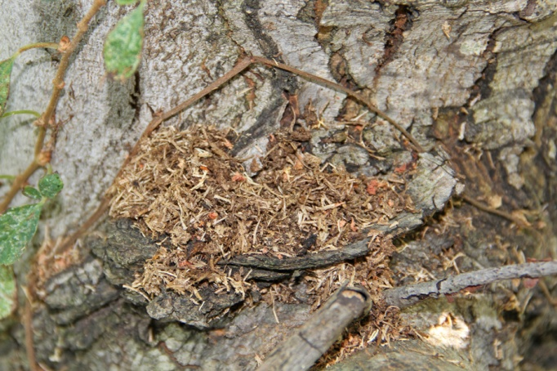
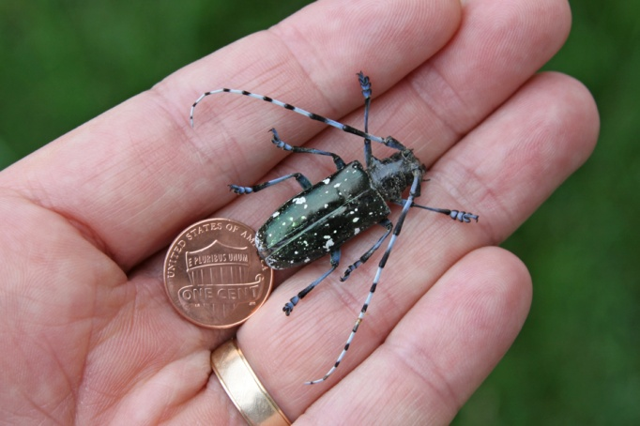
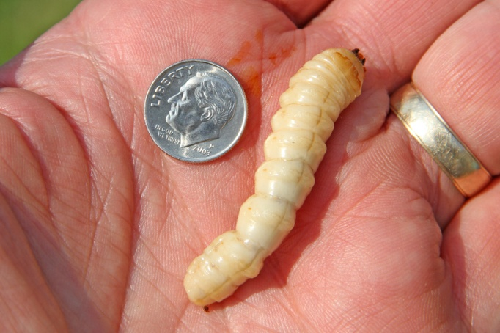
Identifying Heavily Infested Trees
Slide Courtesy Amy Stone
OSU Extension
FPOSP
Early Detector Training
Holes
Pits
Frass
Beetles

Slide 9
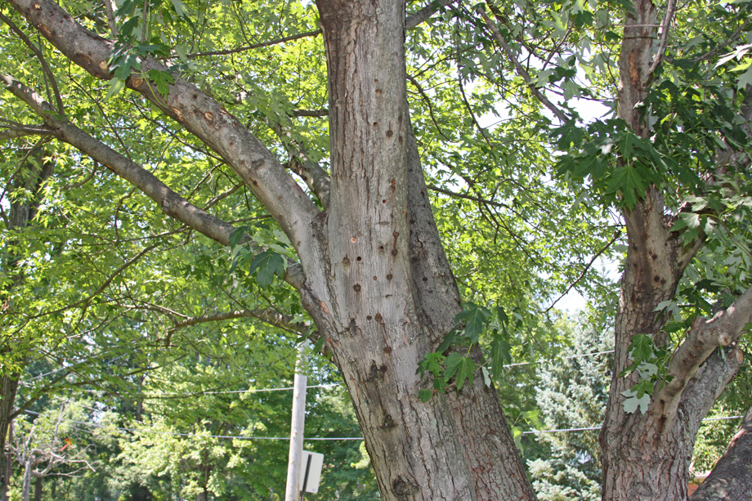
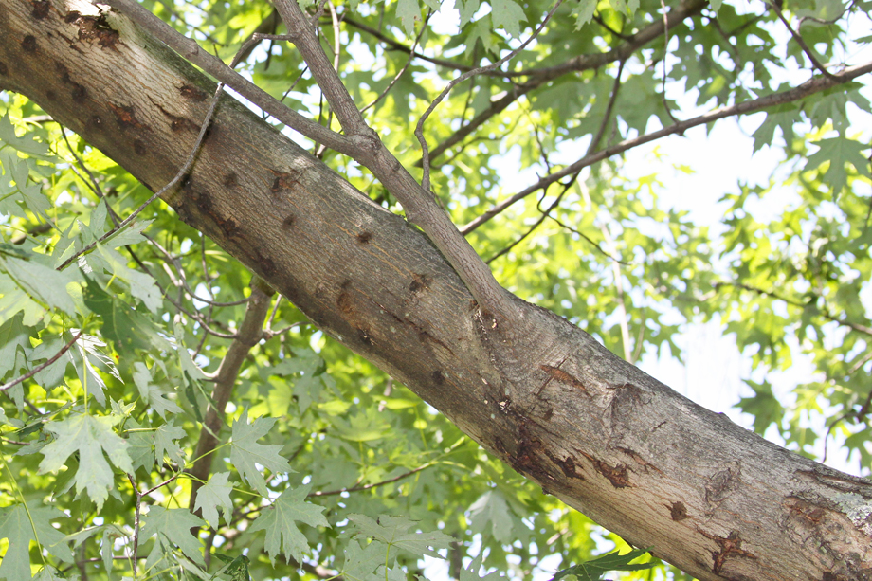
Holes
Slide Courtesy Amy Stone
OSU Extension
NOTE: Holes are on Living trunks and branches

Slide 10
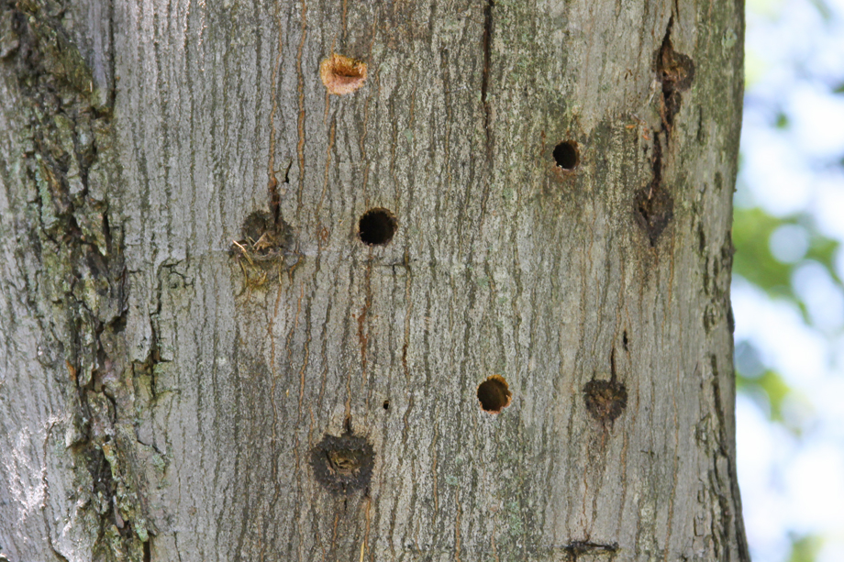
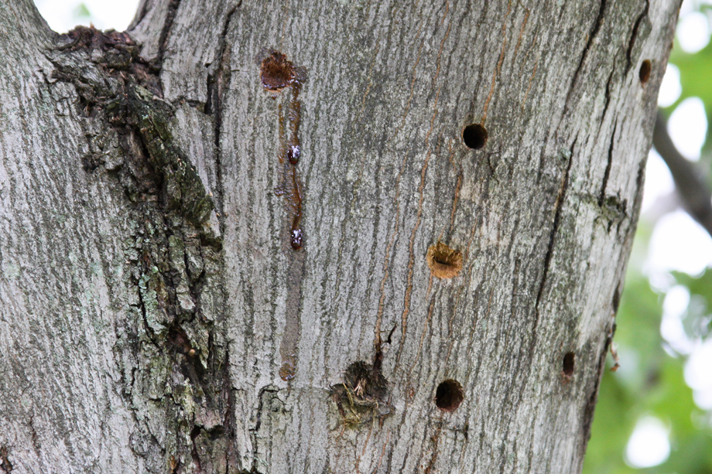
Holes
Slide Courtesy Amy Stone
OSU Extension
Oviposition Pit
Oviposition Pit
Oozing Sap
New Oviposition Pit
Adult Exit Holes
Adults will soon emerge through these holes
Adult Exit Holes

Slide 11
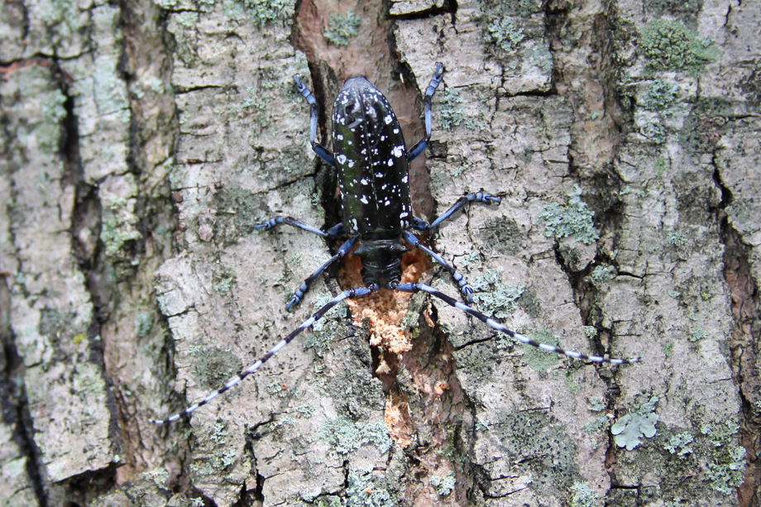
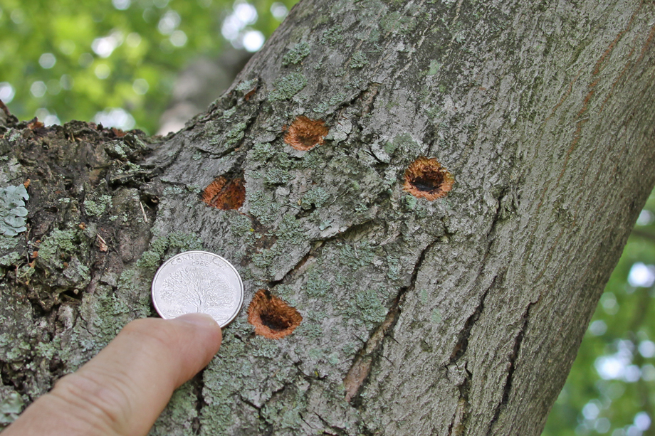
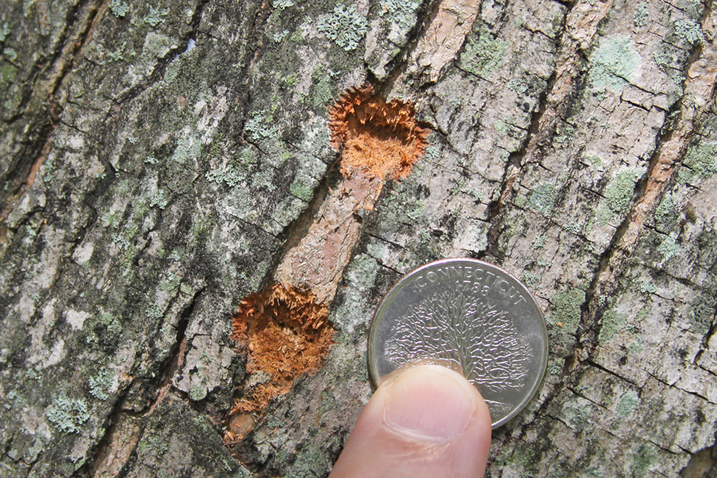
Holes: Oviposition Pits
Slide Courtesy Amy Stone
OSU Extension
Female Chewing an Oviposition Pit

Slide 12
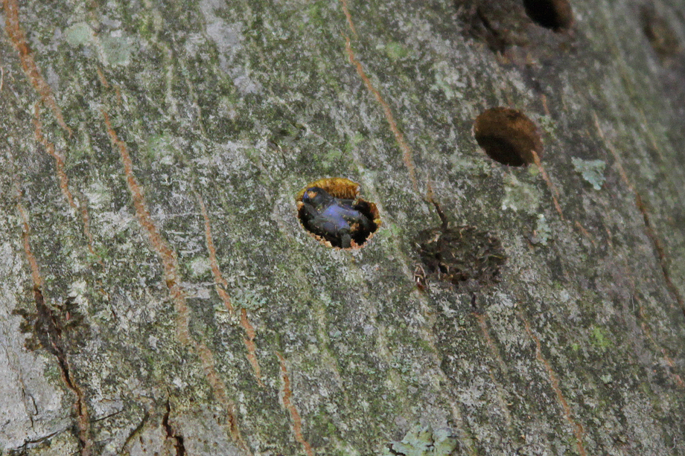
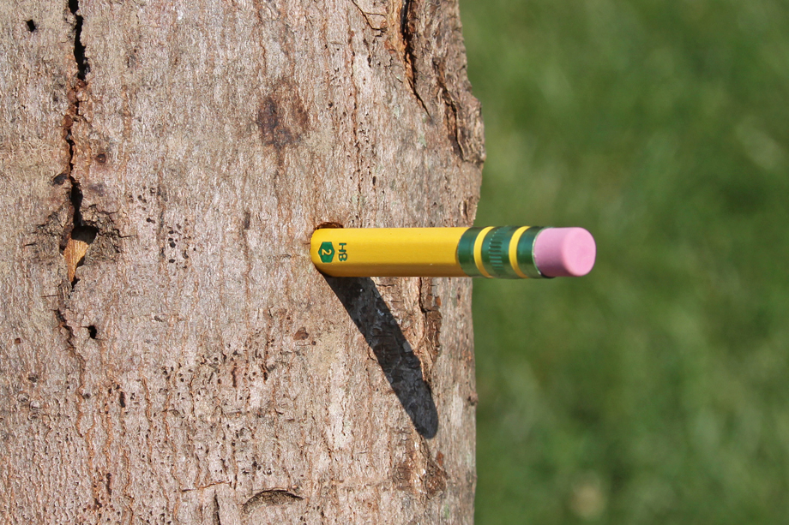
Holes: Adult Exit Holes
Slide Courtesy Amy Stone
OSU Extension
Adult Emerging

Slide 13
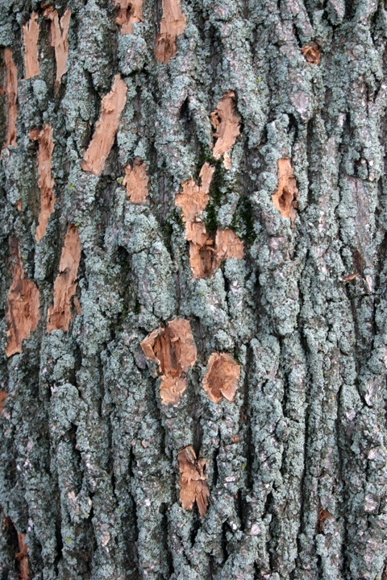
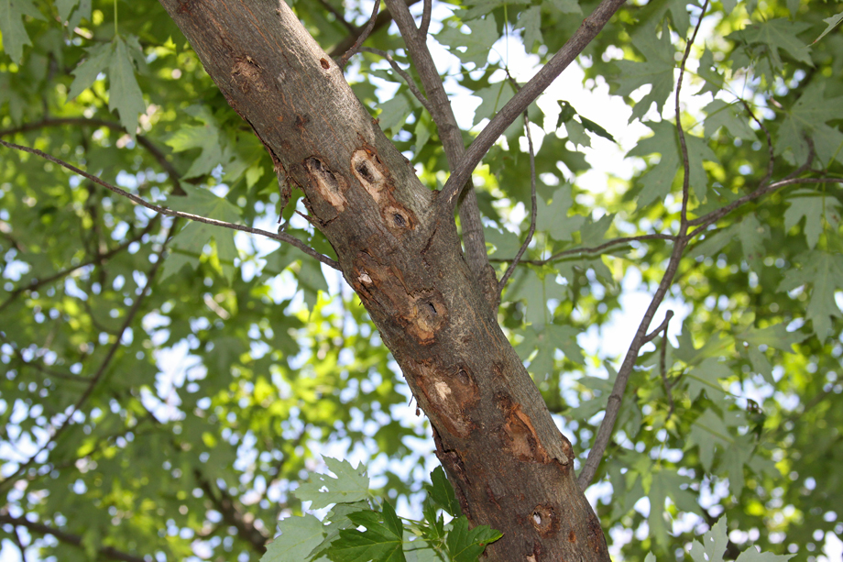
Holes: Woodpeckers
Slide Courtesy Amy Stone
OSU Extension
EAB Woodpecker Damage

Slide 14
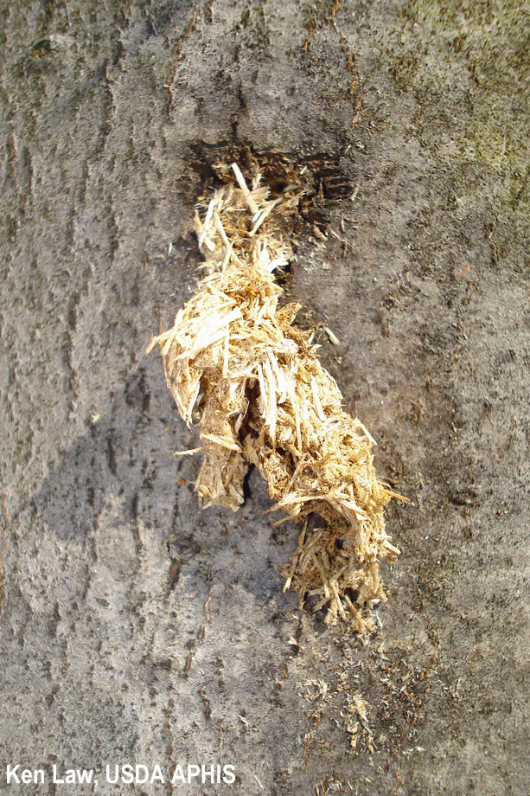
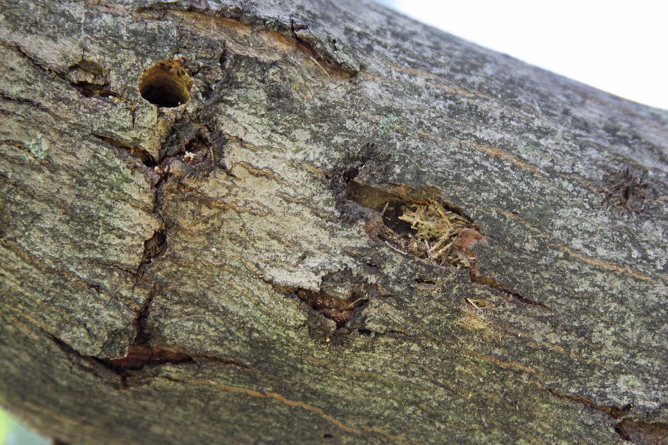
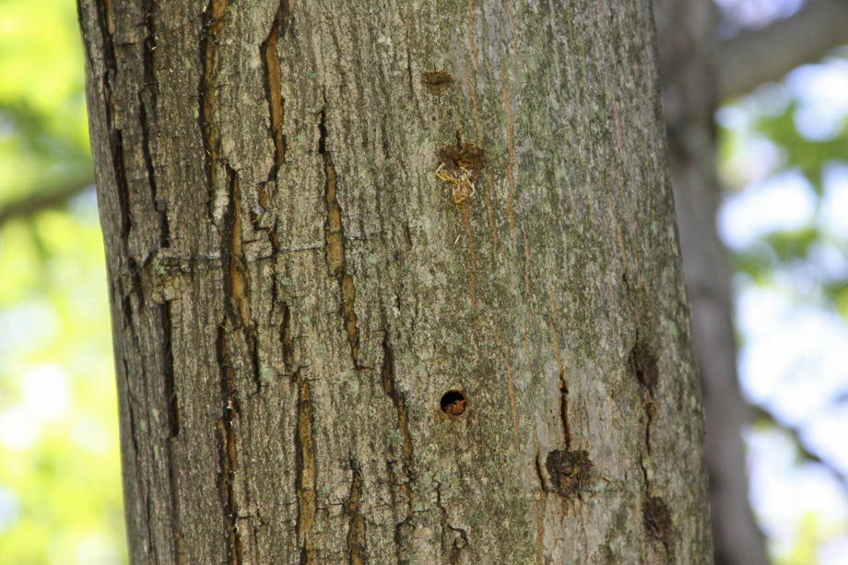
Frass
Slide Courtesy Amy Stone
OSU Extension
Frass: an adult will soon emerge through this hole

Slide 15
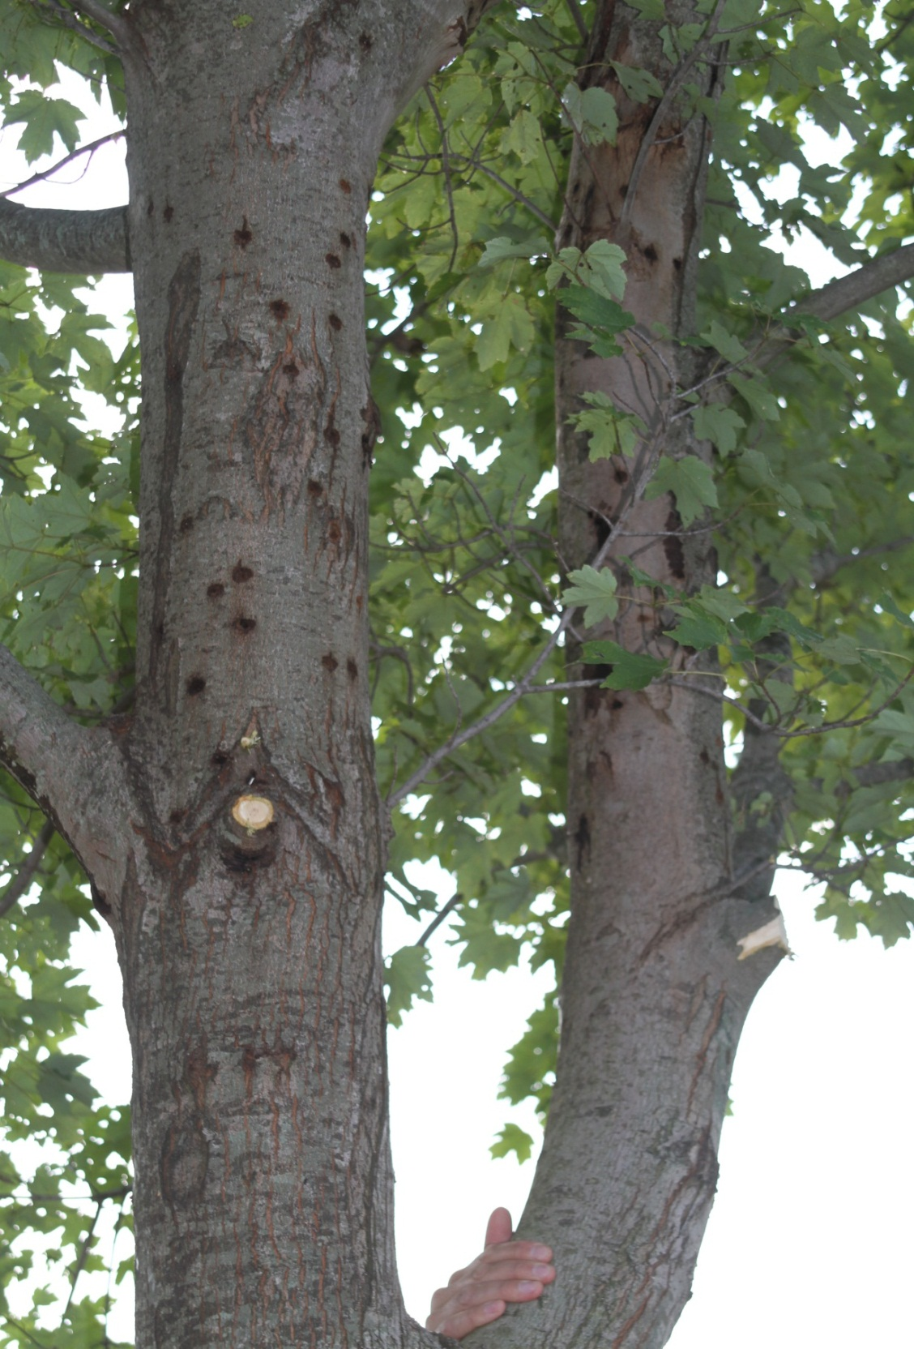
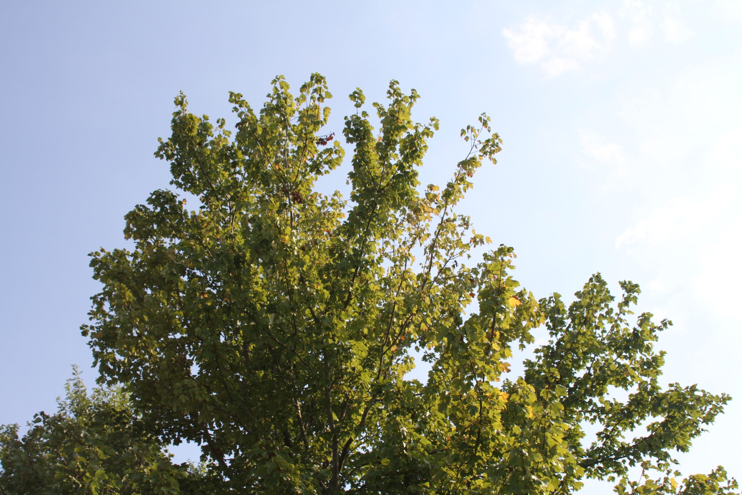
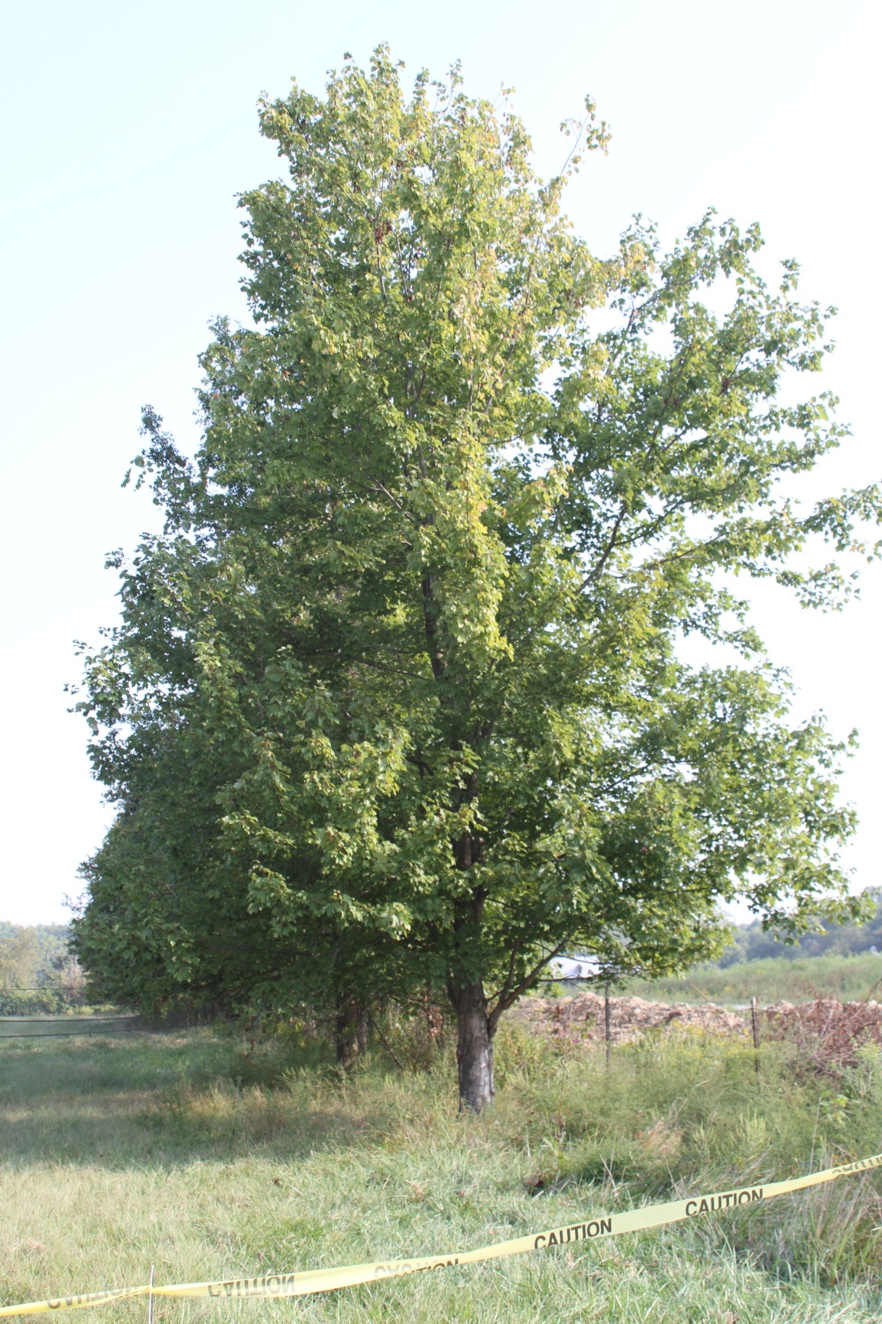
Note: Heavily infested trees may not show obvious canopy decline!
Canopy of same tree
FPOSP
Early Detector Training
A heavily infested tree in Bethel, OH
Close Inspection is Necessary!
Oviposition pits covering trunk of same tree
Photos Courtesy Cliff Sadof
Purdue Extension

Slide 16
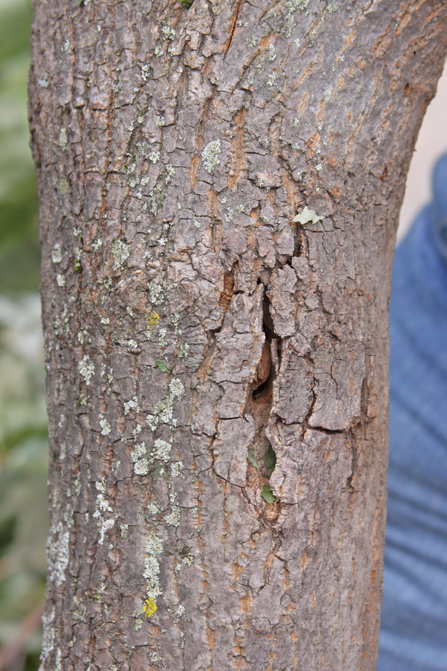
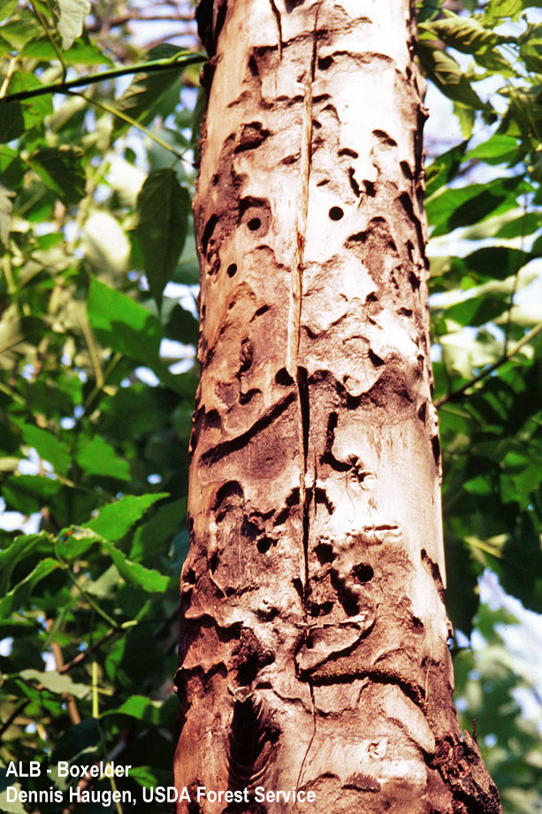
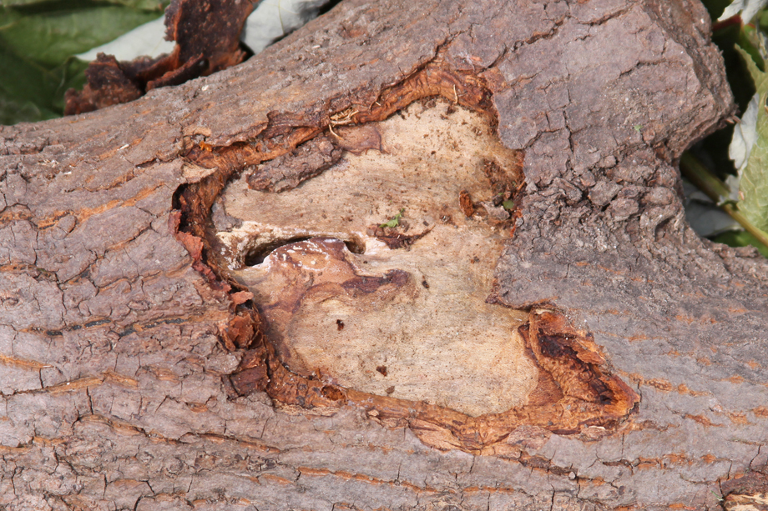
Bark Cracking / Sloughing
Slide Courtesy Amy Stone
OSU Extension

Slide 17
The Larvae
Slide Courtesy Amy Stone
OSU Extension
Larvae may be found in LIVING trunks or branches or in RECENTLY CUT trunks or branches (this season)

Slide 18
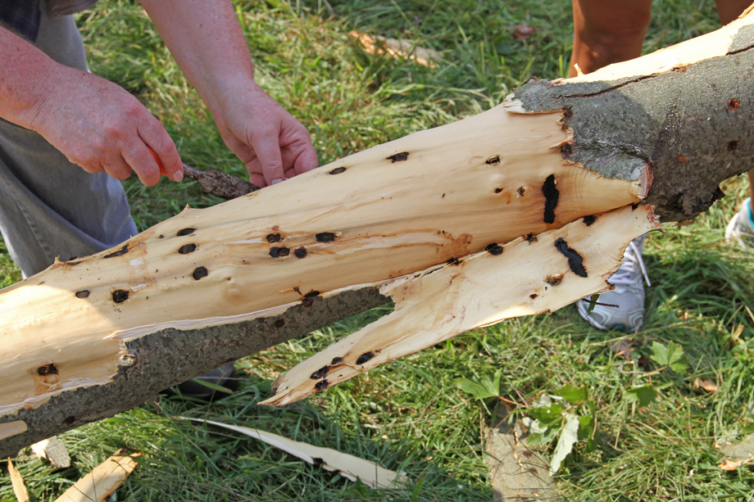
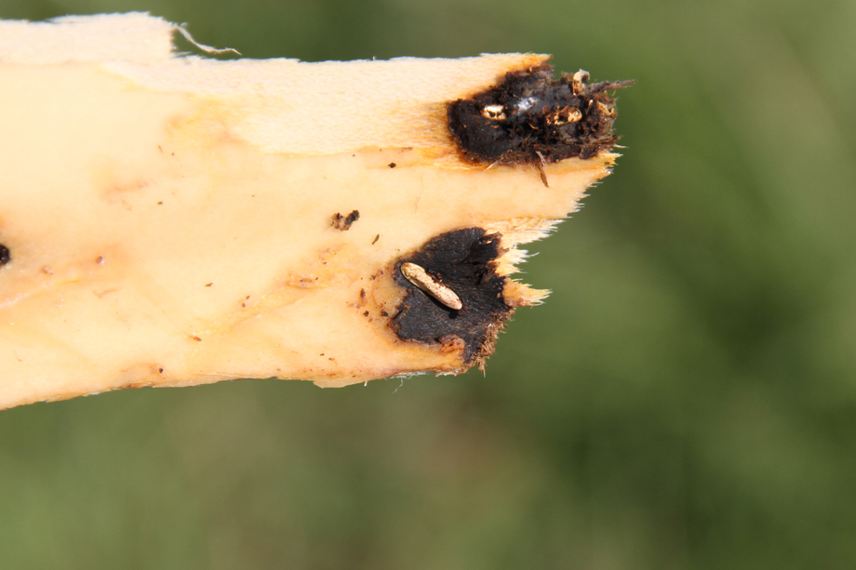
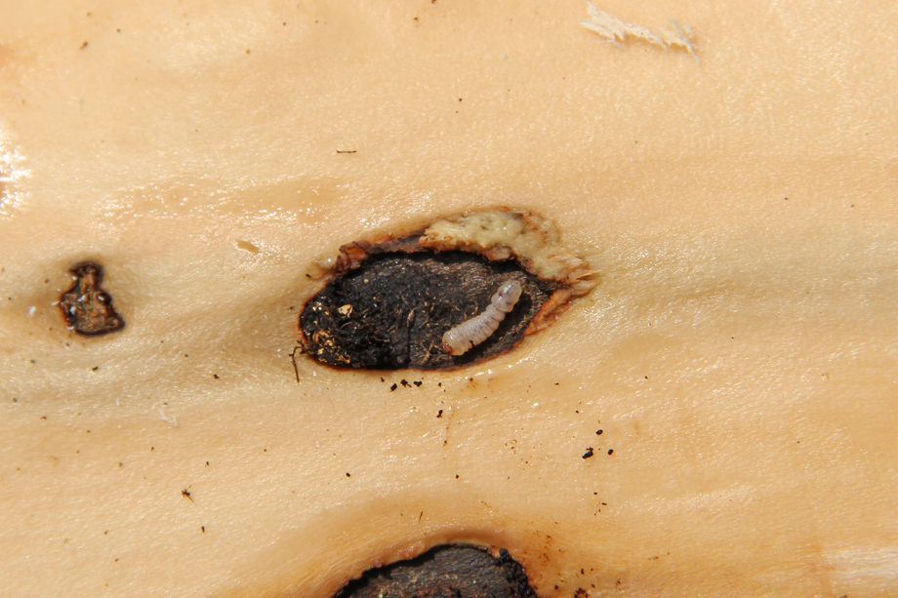
Young larvae feed in phloem, enter xylem as they grow.
Slide Courtesy Amy Stone
OSU Extension

Slide 19
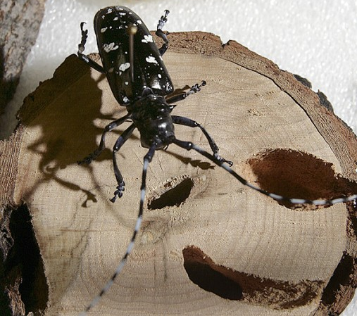
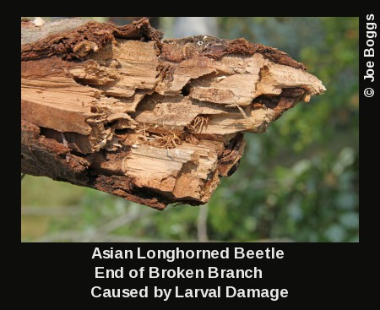
Look for ALB after Storm Damage!
FPOSP
Early Detector Training
Infested trees are structurally compromised

Slide 20
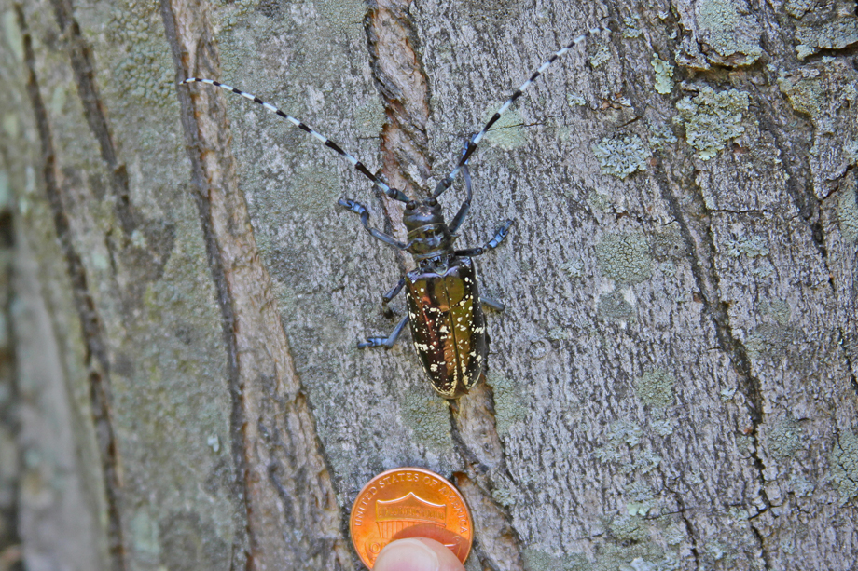
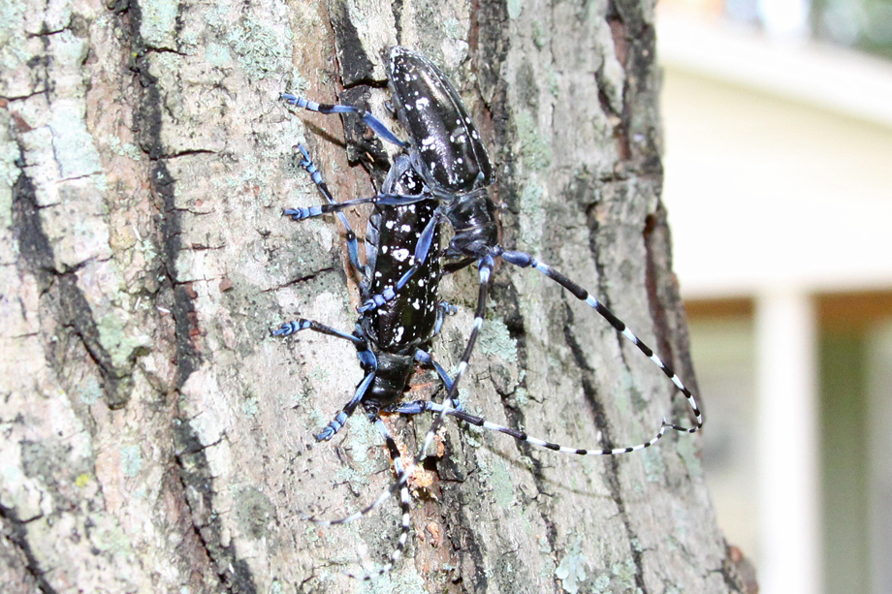
The Beetle
Slide Courtesy Amy Stone
OSU Extension
Male guarding a female as she chews an oviposition hole
CITIZEN REPORTING VERY IMPORTANT!
The Worcester, MA, ALB infestation was found by a homeowner who identified the beetle!

Slide 21
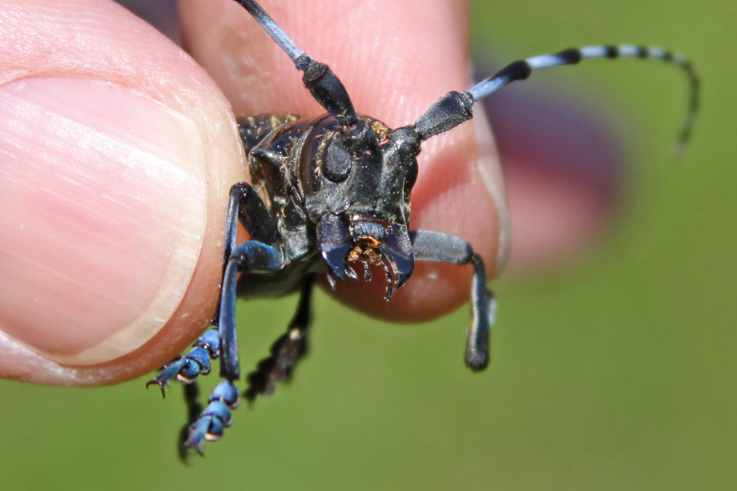
Feeding Damage
Slide Courtesy Amy Stone
OSU Extension
Powerful Mandibles

Slide 22
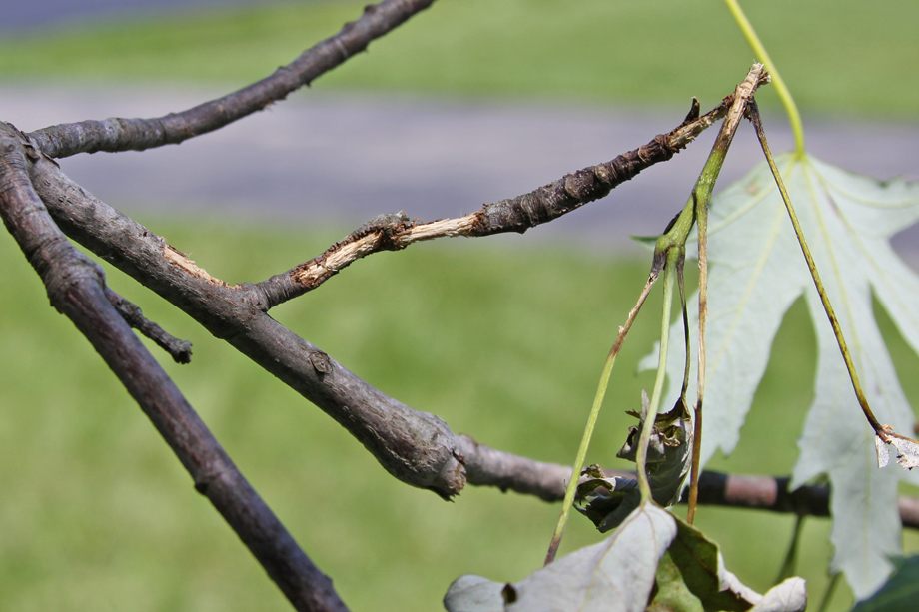
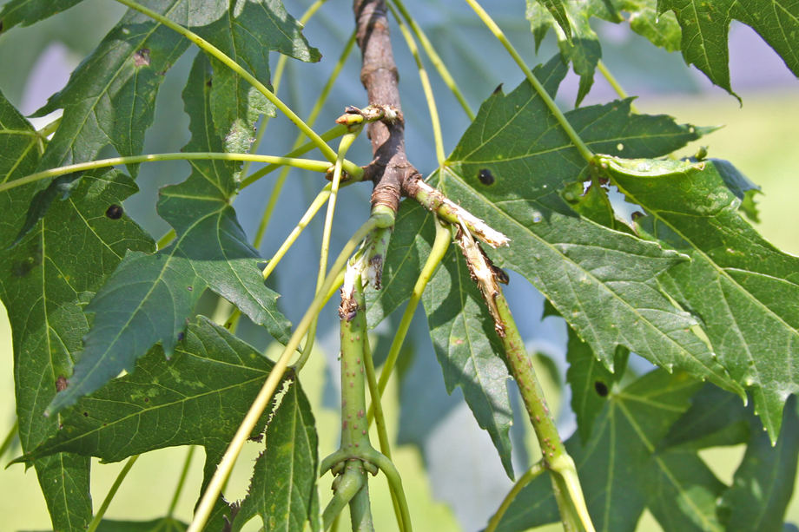
Feeding Damage: Twig/Petiole
Slide Courtesy Amy Stone
OSU Extension

Slide 23
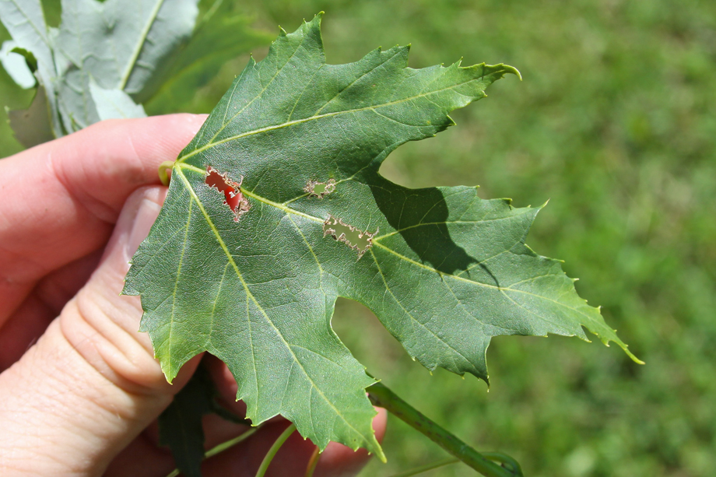
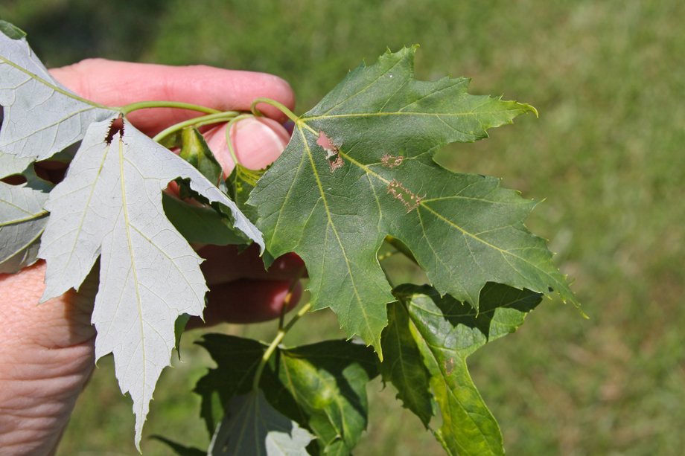
Feeding Damage: Leaf Veins
Slide Courtesy Amy Stone
OSU Extension

Slide 24
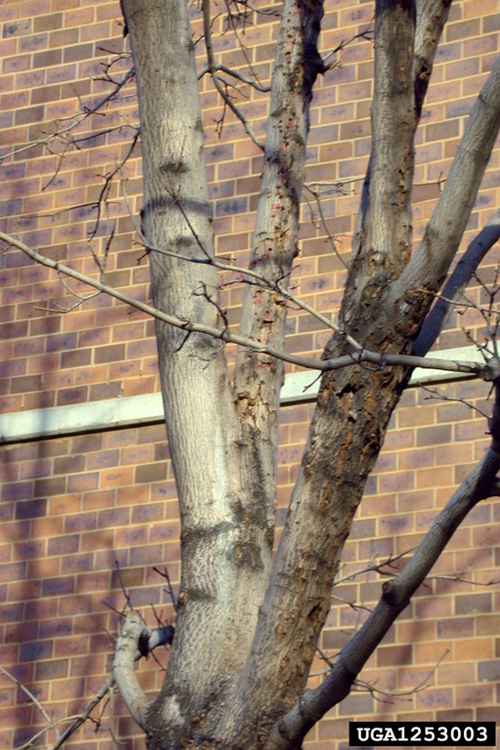
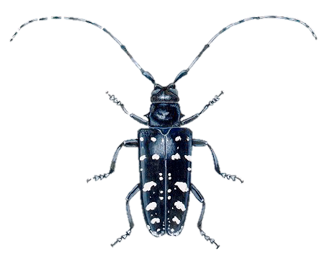
Review
FPOSP
Early Detector Training
Establishment of this insect would be extremely devastating (dwarfing impact of EAB…)
Detection and eradication are extremely challenging (but possible)
Early detection is key!
Thomas B. Denholm, NJ Department of Ag.
Notes:
Early detection of ALB infestations is key to successfully controlling them. Be on high alert for any signs that might resemble ALB damage. This can be an extremely devastating pest if it escapes into our native forests. And if you do see any insect that looks like an ALB, please be sure to collect it or photograph it and report it immediately.

Slide 25
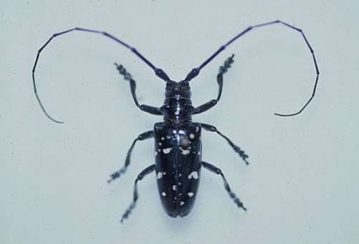
ALB Host Trees
Slide Courtesy Amy Stone
OSU Extension
FPOSP
Early Detector Training
Very Good Hosts
Other Hosts
All Maples (Acer):
Boxelder
Norway
Red
Silver
Sugar
Horsechestnuts / Buckeyes (Aescelus spp.)
Elms (Ulmus spp.)
Willow (Salix spp.)
Birch (Betula spp.)
Sycamore / Planetree (Platanus spp.)
Poplar (Populus spp.)
Mimosa (Albizia julibrissin)
Katsura (Cercidiphyllum japonicum)
Ash (Fraxinus spp.)
Goldenraintree (Koelreuteria paniculata)
Mountainash (Sorbus spp.)
Hackberry (Celtis spp.)
PREFERRED
GUESS I’LL EAT IT IF
THERE’S NOTHING BETTER…

