Slide 1
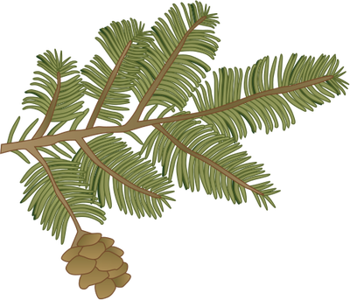
Hemlock Woolly Adelgid Biology Signs & Symptoms
Early Detector Training
Forest Pest Outreach Survey Project

Slide 2
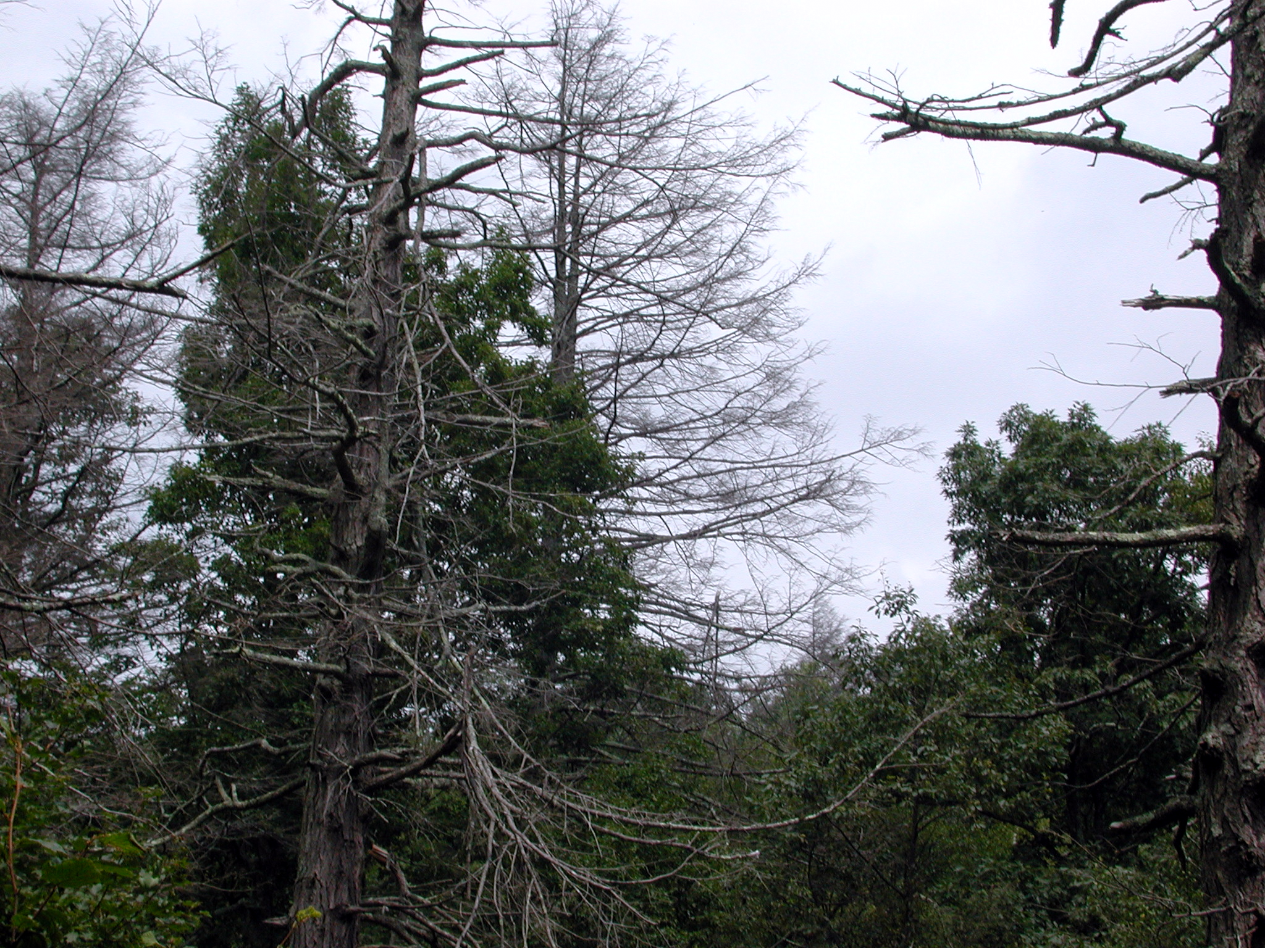
Heavy HWA infestations can kill trees in 3-4 years!

Slide 3
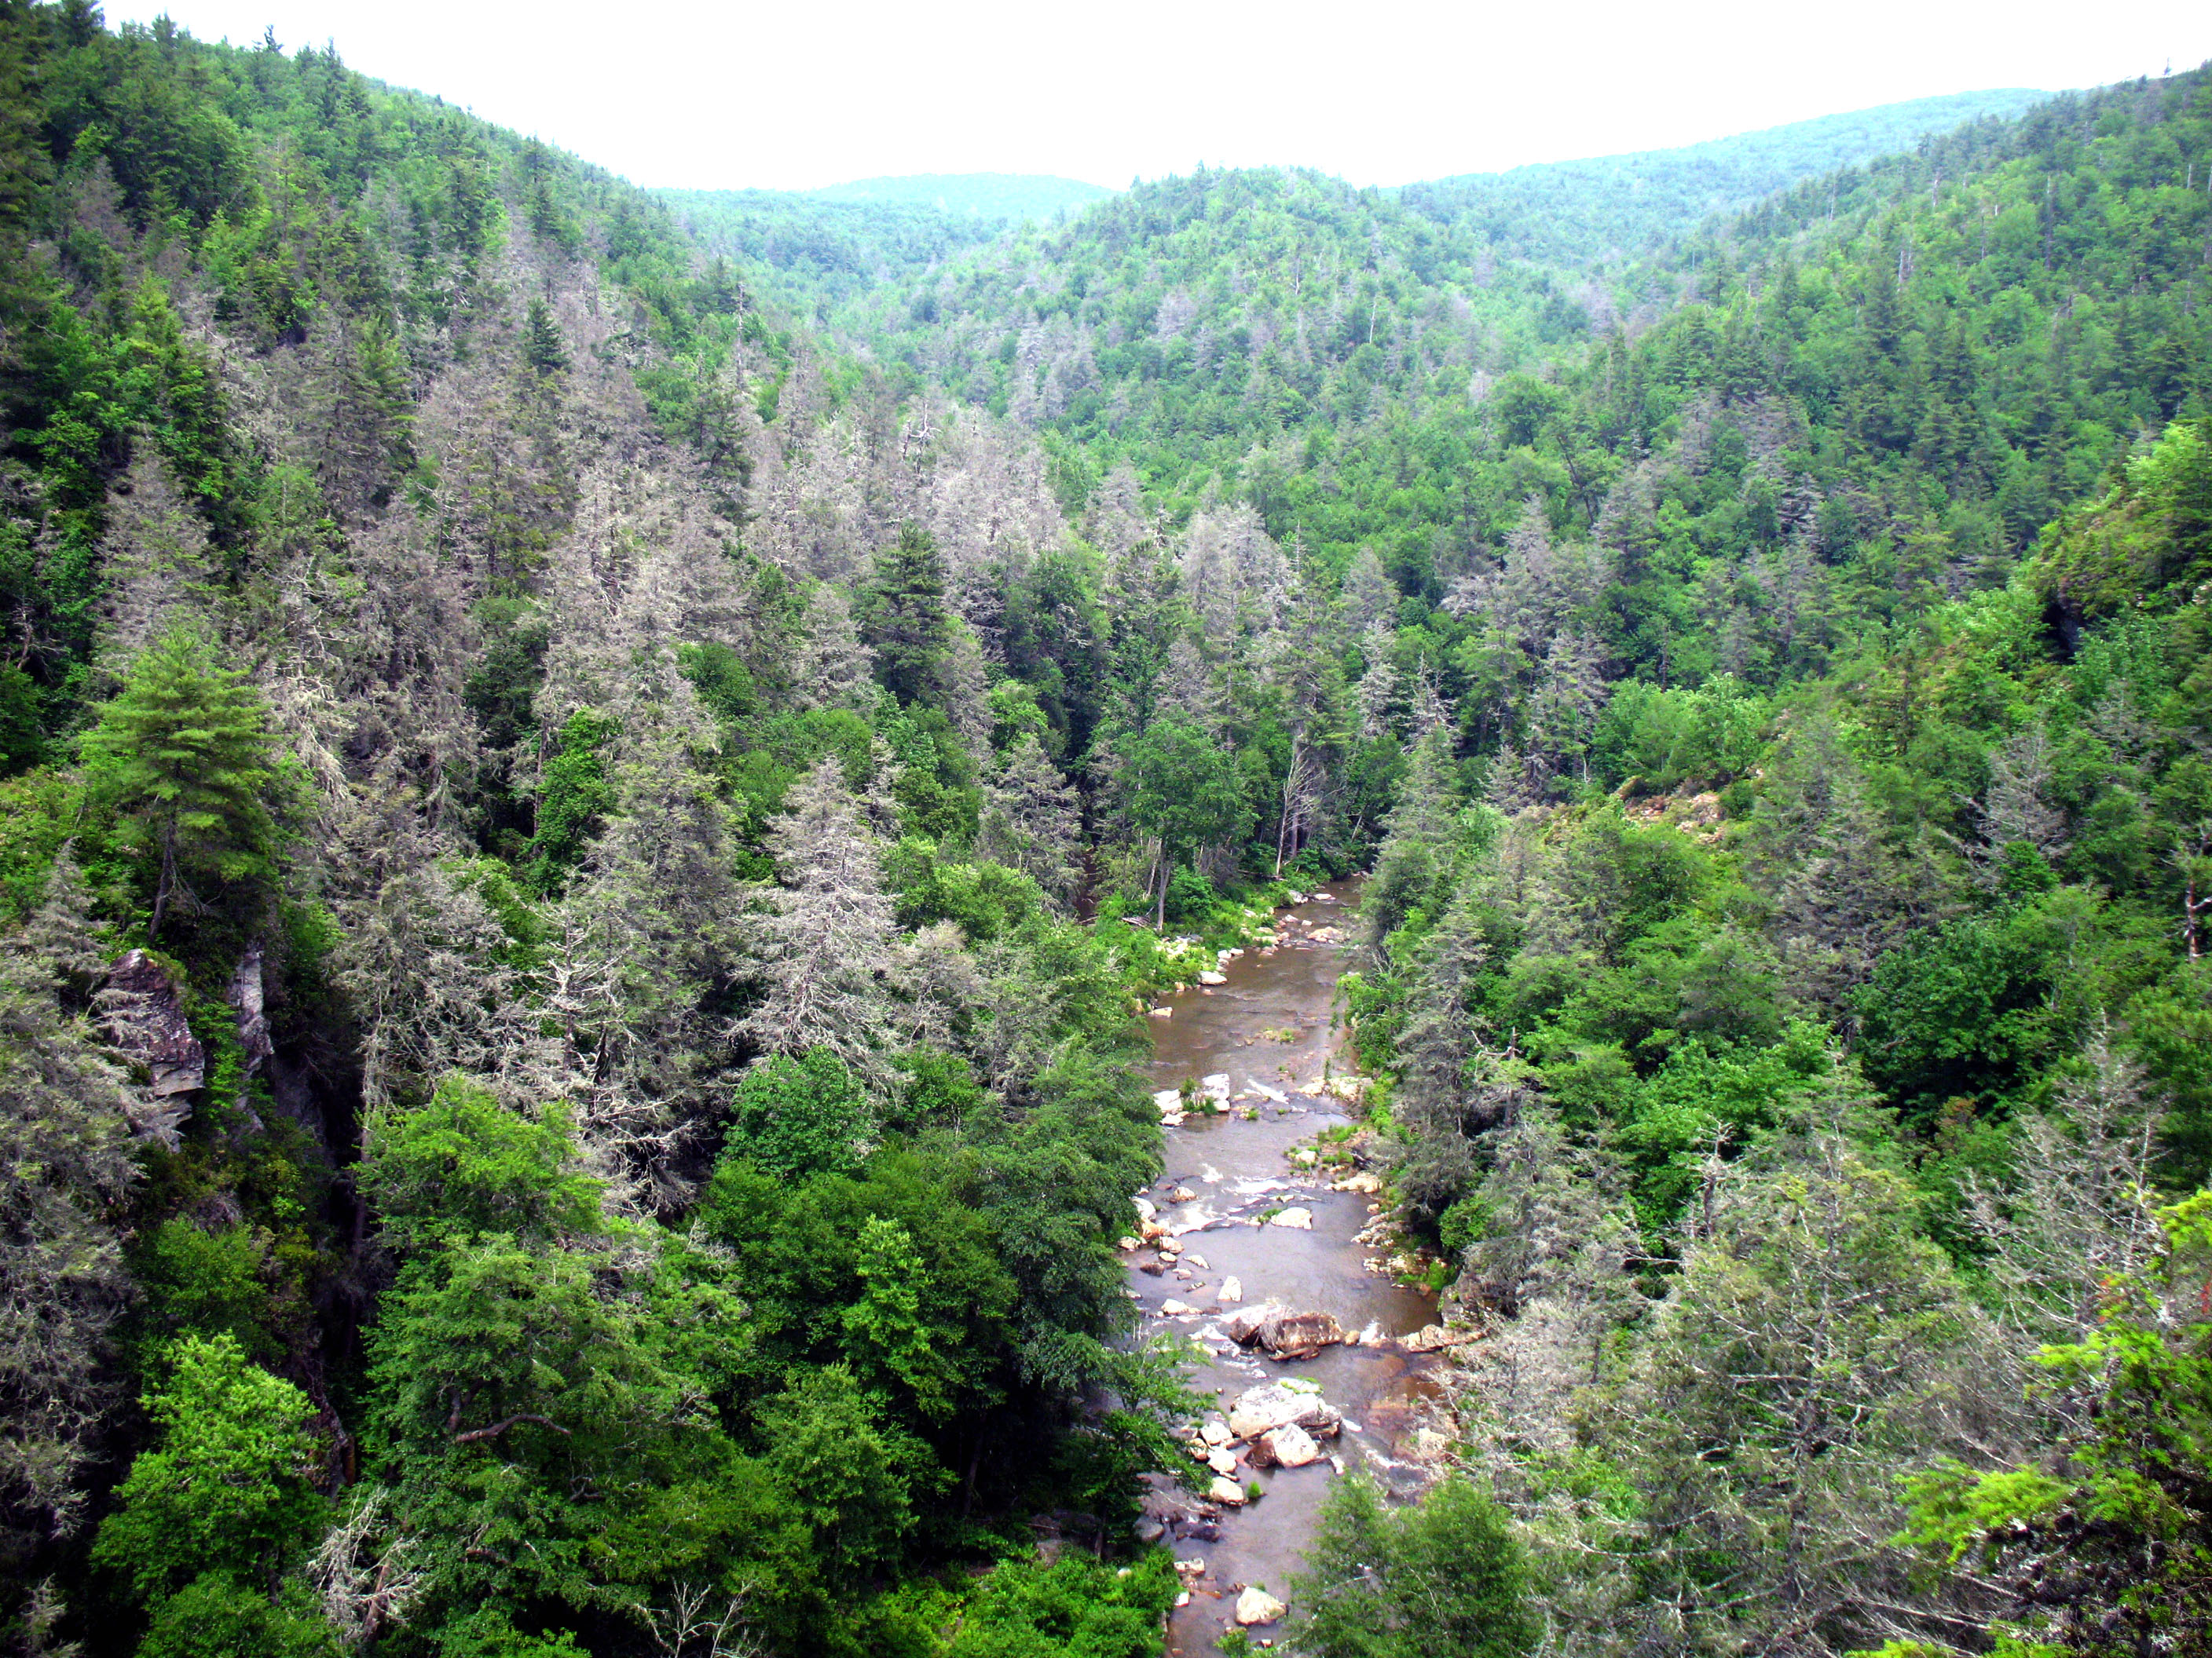
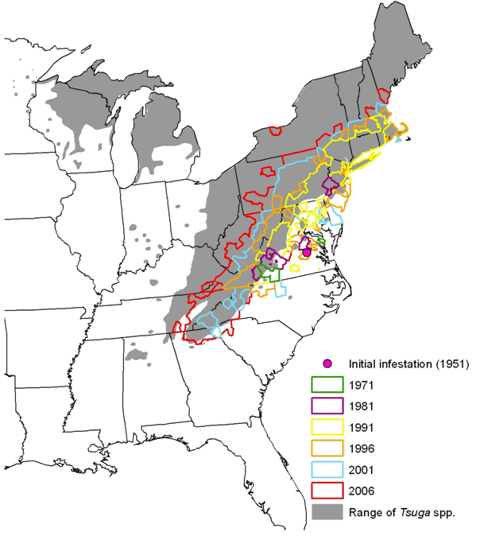
Eastern hemlock in eastern NA
HWA can decimate our oldest forests…
FPOSP
Hemlocks can live for 800 years!
Early Detector Training
Most shade tolerant tree in Eastern NA
Grows on almost 19 million acres of forests
Predominant species on 2.3 million acres
www.forestthreats.org

Slide 4
Impacts
FPOSP
Early Detector Training
Biological Impacts
Economic Impacts
Eastern hemlock (Tsuga canadensis) and Carolina hemlock (Tsuga caroliniana)
90 species of birds are closely associated with hemlock forests
Aquatic animals are more abundant in streams sheltered by hemlocks in eastern NA
22% of total volume of softwood growing stock in northeast
7% of sawlogs and 12% annual pulpwood in New England
Wood used for pulp, paper, lumber, and mulch

Slide 5
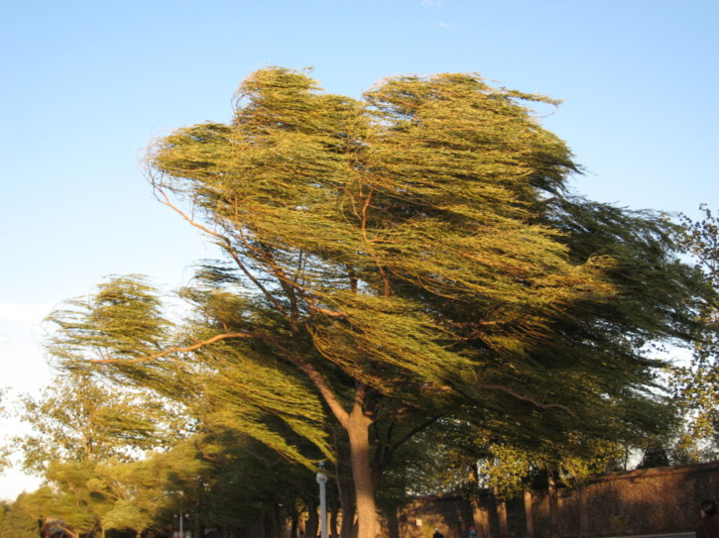
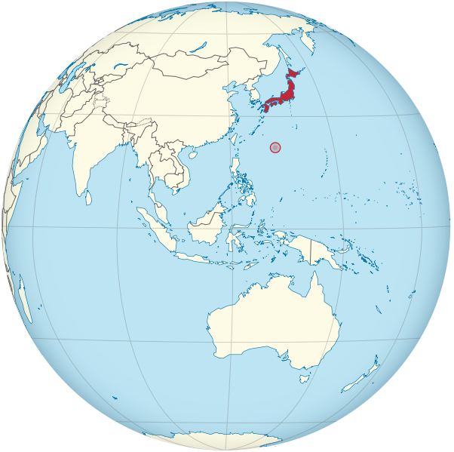
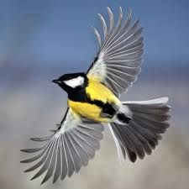
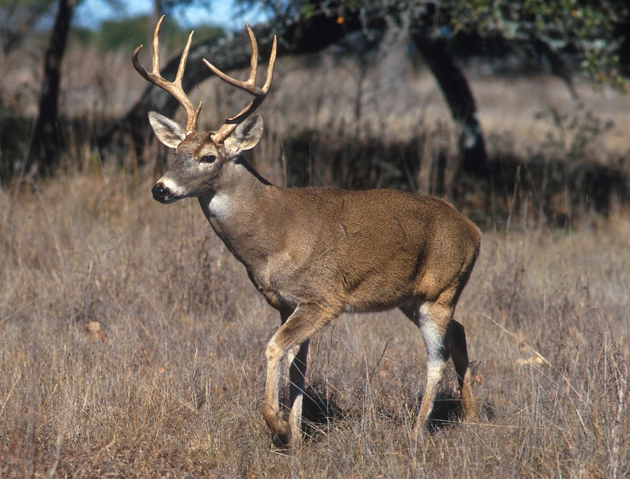
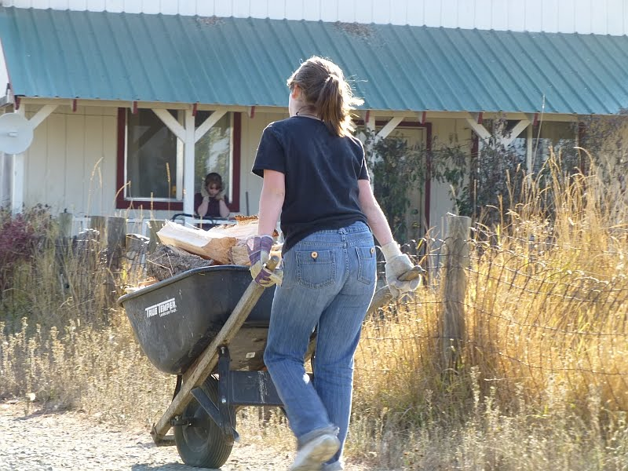
Biology and Basics
FPOSP
Early Detector Training
An invasive adelgid from Japan
Utilizes two hosts to complete its life cycle in native range
Two generations per year
Spreads via wind or phoresy (hitching rides with animals)

Slide 6
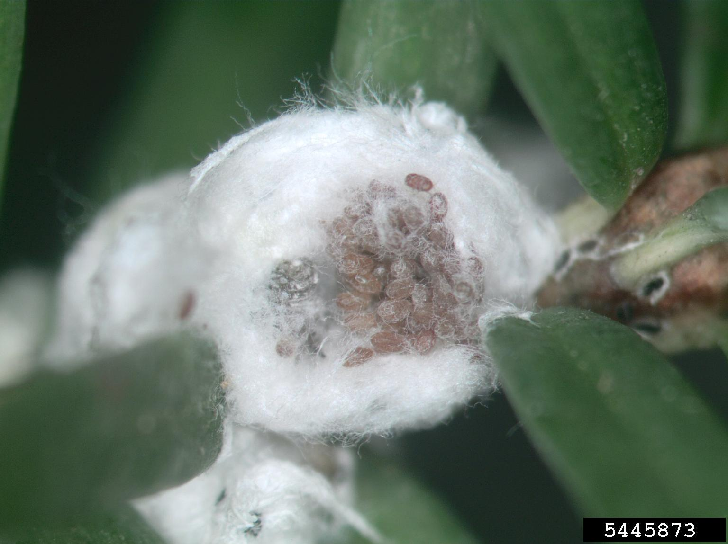
Biology and Basics
Small, dark reddish-brown insects with white, woolly covering
Females lay up to 300 eggs in lifetime
forestpests.org

Slide 7
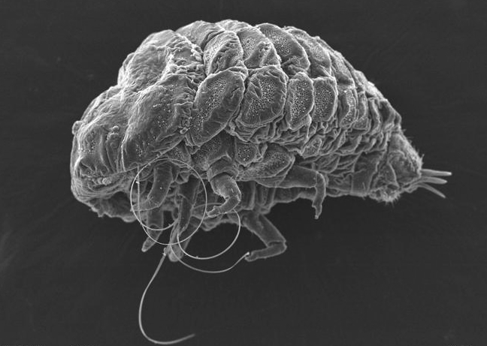
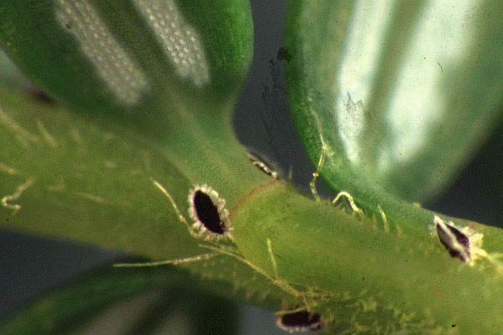
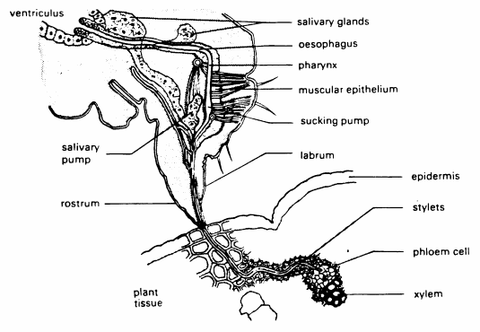
How Does HWA Kill Trees?
FPOSP
Early Detector Training
Both larvae and adults feed on the trees. Piercing-sucking mouthparts are inserted into the bases of needles and tap into the vascular tissue.
science.kqed.org
ohiodnr.gov
www.vaxteko.nu

Slide 8
Life Stages of HWA
FPOSP
Early Detector Training
Hemlock woolly adelgid has two generations per year, overlapping in the spring.
Sistens
Overwintering generation
Egg, overwintering nymphal stage, 2-4 nymphal stages, adult
Progrediens
Spring generation
Wingless form (remains on hemlock host)
Winged form that searches for spruce host
Egg, 4 nymphal stages, adult
Notes:
In North America, hemlock woolly adelgid is parthenogenetic (only females occur, reproducing without males) and produces two generations a year. One, the sistens, is wingless, hatches in late spring, overwinters, and survives about nine months. he other, the progrediens, hatches in early spring, is comprised of both wingless and winged (sexupara) offspring, and survives for about three months. Sexupara fly from hemlock in search of a species of spruce (Picea) on which to deposit eggs Fig. 3). However, a suitable species of spruce is not present in North America, so this portion of the populatin dies before sexual reproduction occurs.

Slide 9
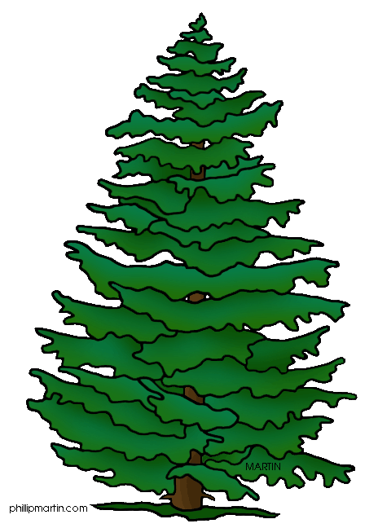
HWA Lifecycle in Eastern N.A.
FPOSP
Early Detector Training
SISTENS
Aestivating Nymph
OCT
NOV
Nymphs 2-4
SEP
DEC
AUG
JAN
JUL
FEB
Crawler
HEMLOCK
JUN
MAR
Adult
Eggs
SPRUCE
MAY
APR
Adult
PROGREDIENS
Eggs
Nymphs 2-4
Crawler
Winged Adult
Notes:
In North America, hemlock woolly adelgid is parthenogenetic (only females occur, reproducing without males) and produces two generations a year. One, the sistens, is wingless, hatches in late spring, overwinters, and survives about nine months. he other, the progrediens, hatches in early spring, is comprised of both wingless and winged (sexupara) offspring, and survives for about three months. Sexupara fly from hemlock in search of a species of spruce (Picea) on which to deposit eggs Fig. 3). However, a suitable species of spruce is not present in North America, so this portion of the populatin dies before sexual reproduction occurs.

Slide 10
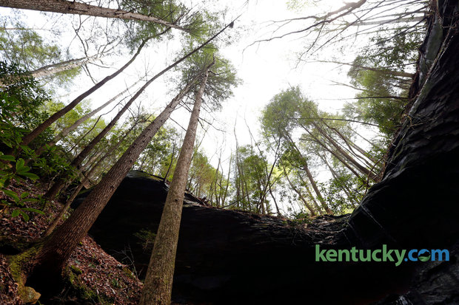
Signs…
FPOSP
Early Detector Training
and Symptoms
and Symptoms

Slide 11
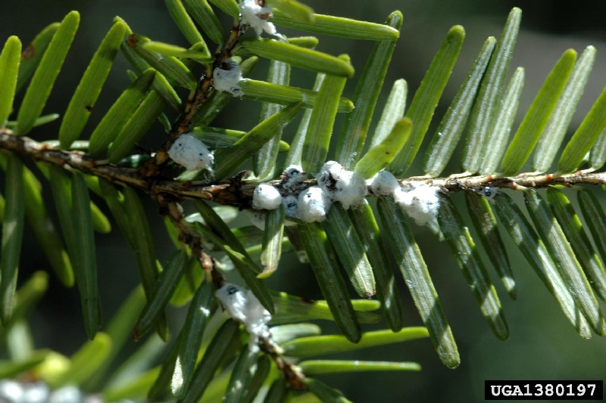
Look For…
FPOSP
Early Detector Training
Hemlock may look ill
White filaments of wax on hemlocks
Typically persist after individual has died
Notes:
While some of these symptoms resemble other diseases or abiotic problems that ash trees can experience, when these are present in combination, they are extremely diagnostic of the presence of EAB. Presented in the order they typically are seen on an infested tree.

Slide 12
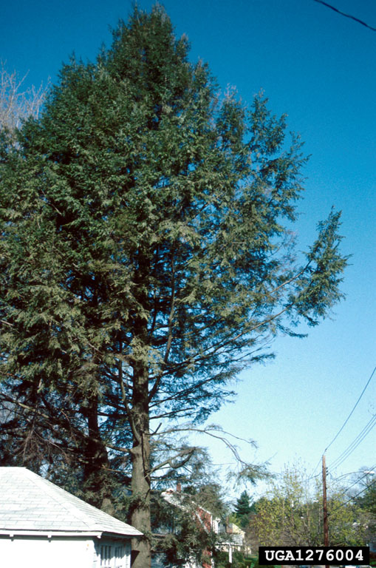
Sickly looking hemlock
As HWA feed, they remove phloem sap from needle bases. When infestations are high and prolonged, enough nutrients are depleted by HWA that the tree will start experiencing dieback and eventually death.

Slide 13
White filaments of wax
FPOSP
Early Detector Training
Eggs are laid in white filaments of wax near bases of needles. Wax is associated with multiple stages of HWA.
Notes:
Woodpeckers are extremely good at detecting where EAB larvae are under the bark. They scrape off flakes of bark to get at the larvae underneath, creating light colored patches on the branches and trunks.
An excellent early warning sign that the tree is infested.

Slide 14
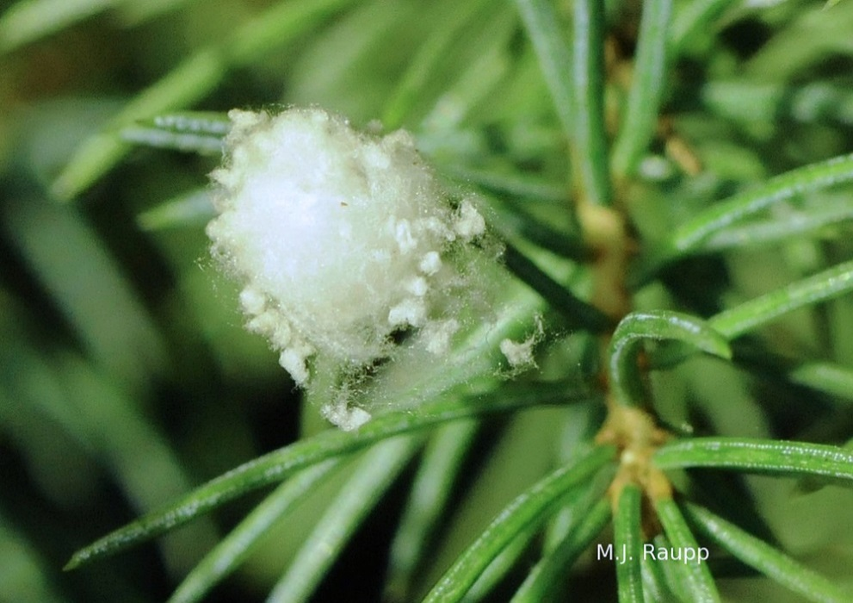
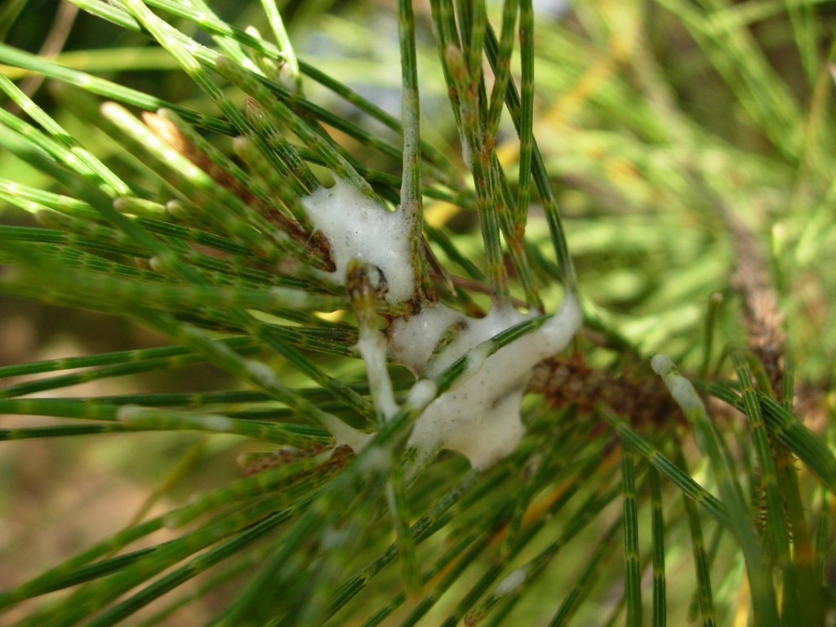
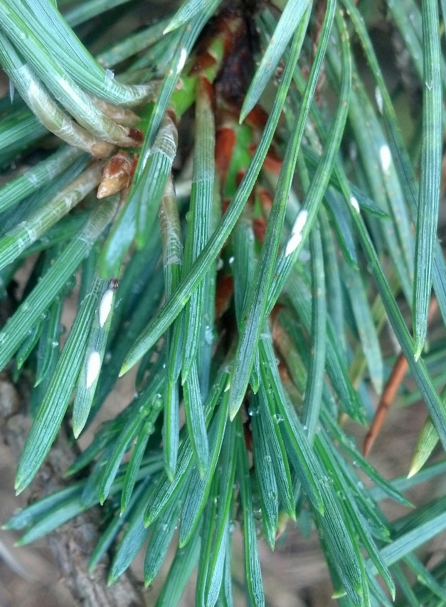
Watch out for the look alikes…
FPOSP
Early Detector Training
Spider egg sacs
Pine needle scale
(armored scale on needles)
extension.udel.edu
Spittlebugs
(Excrement makes foamy substance)
www.bugfolks.com

Slide 15
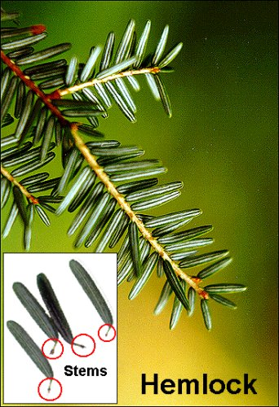
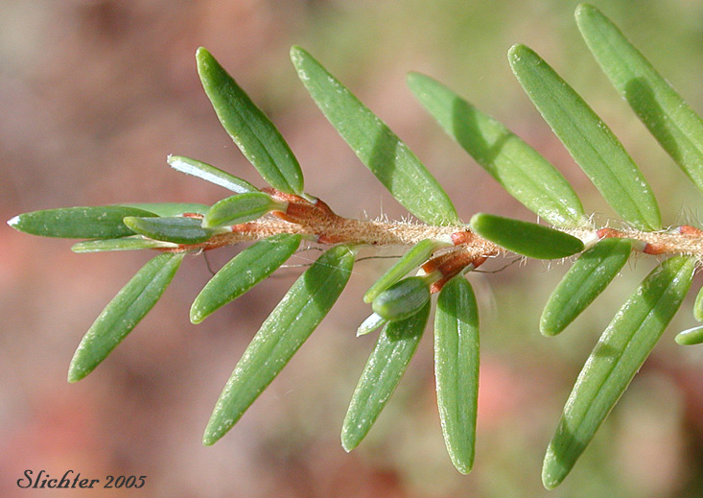
Identifying Hemlock Trees
FPOSP
Early Detector Training
Hemlock needles have “stems” that attach to the twig

Slide 16
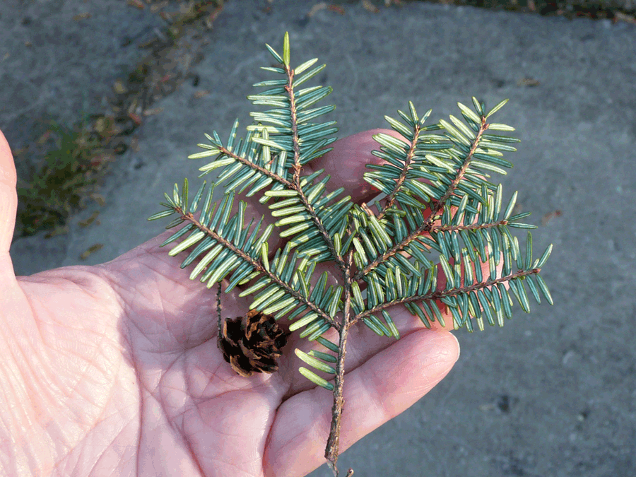
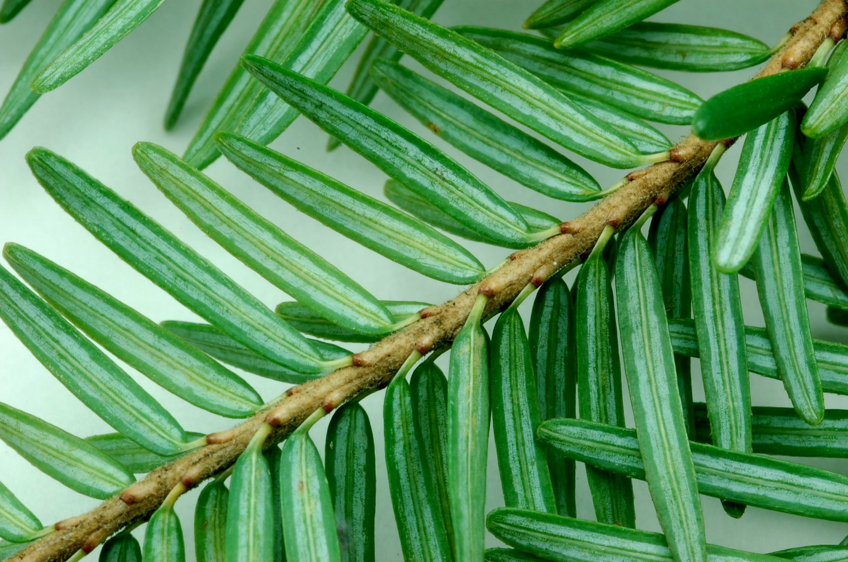
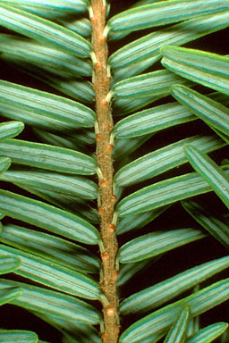
Identifying Hemlock Trees
FPOSP
Early Detector Training
Two rows of needles on each side of twig, blue bands on underside
www.treetopics.com
commons.wikimedia.org
photobomb-pictures.fbistan.com

Slide 17
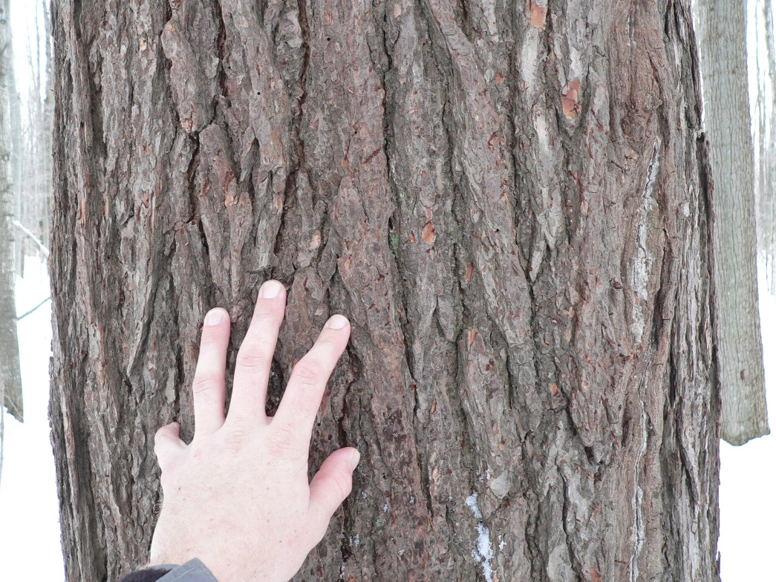
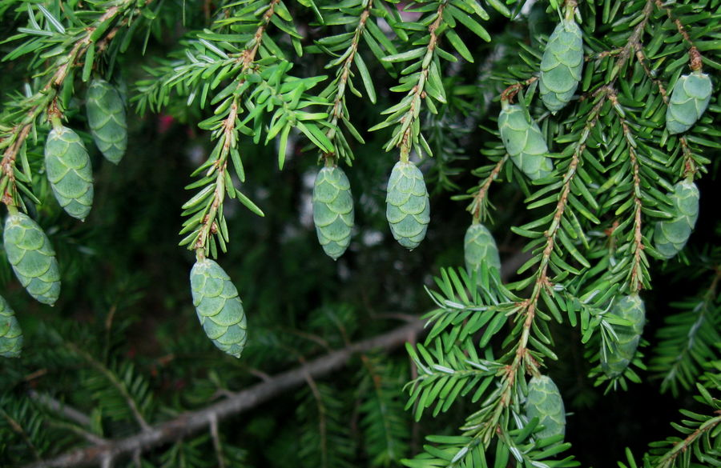
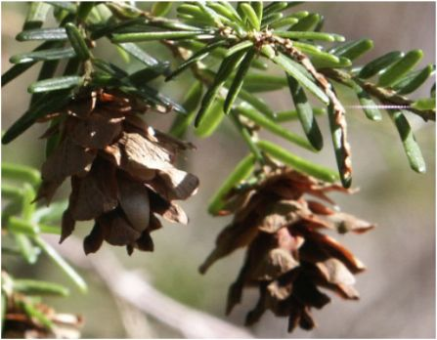
Identifying Hemlock Trees
FPOSP
Early Detector Training
Smooth bark on young trees; Mature bark thicker, flattened ridges and orange-ish tint
Cones start green before turning brown and can remain on trees for years
www.thelensflare.com
share2.esd105.org

Slide 18
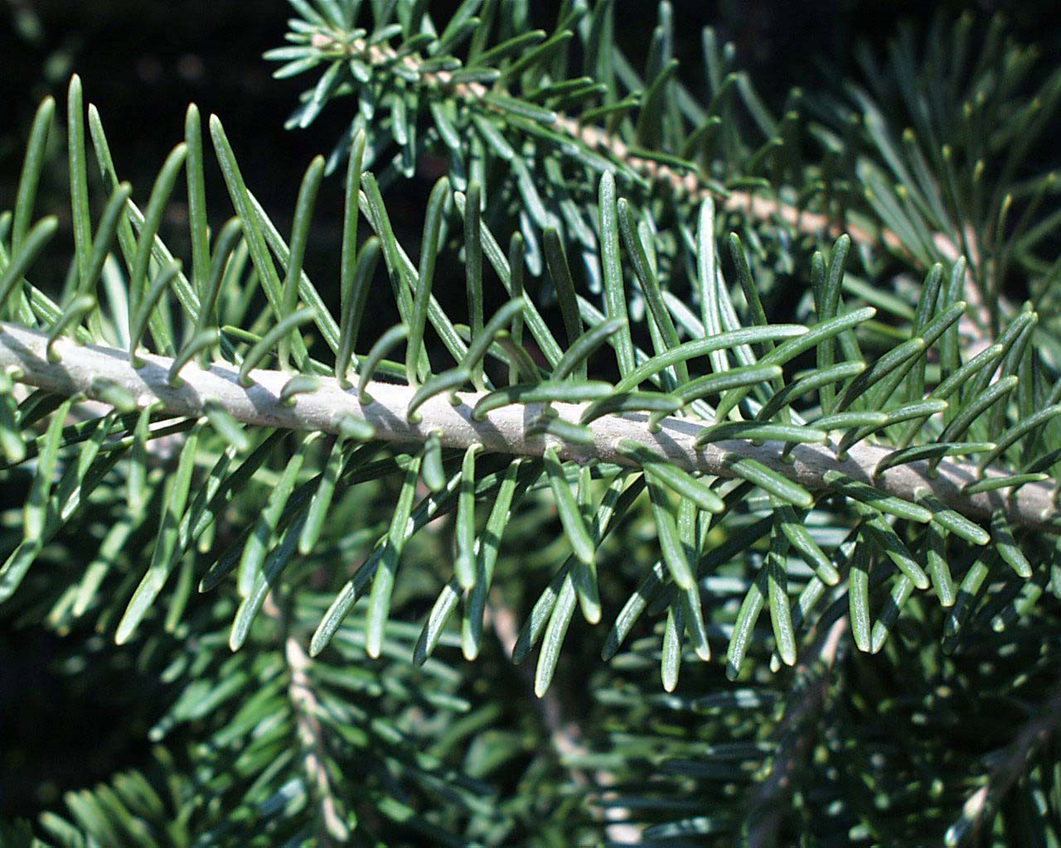
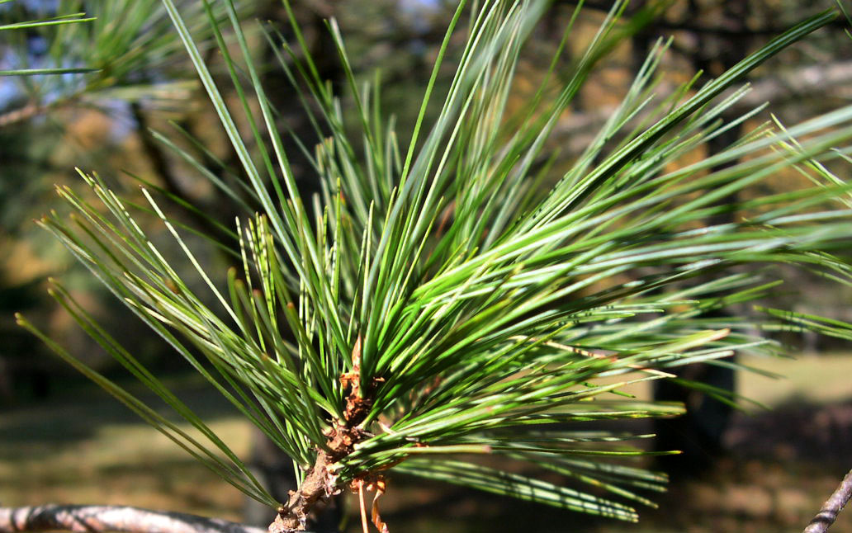
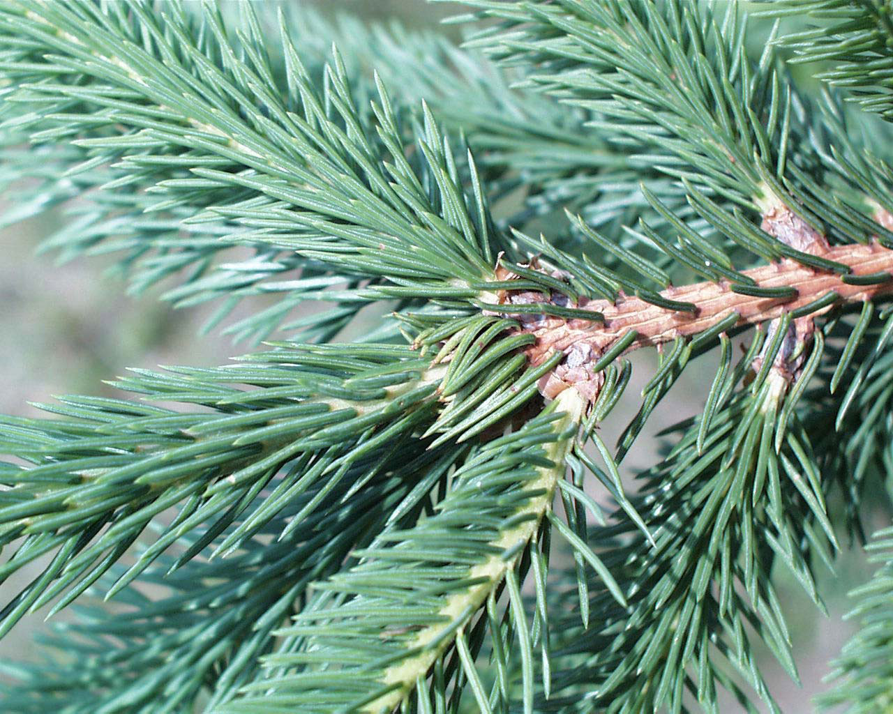
Some look-alikes…
www.extension.iastate.edu
FPOSP
Fir
Early Detector Training
Pine
Spruce
filesite.org
www.bio.brandeis.edu

Slide 19
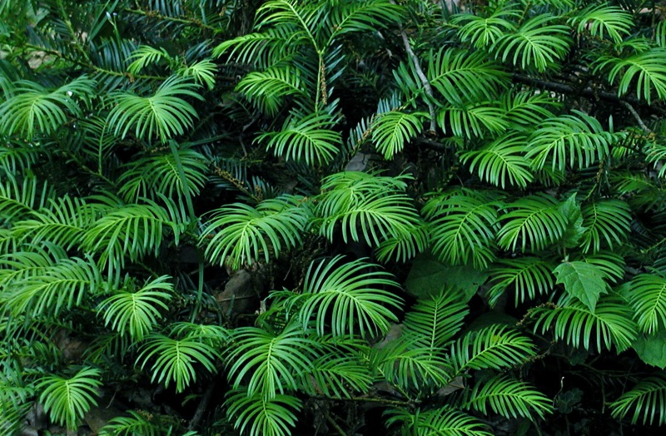
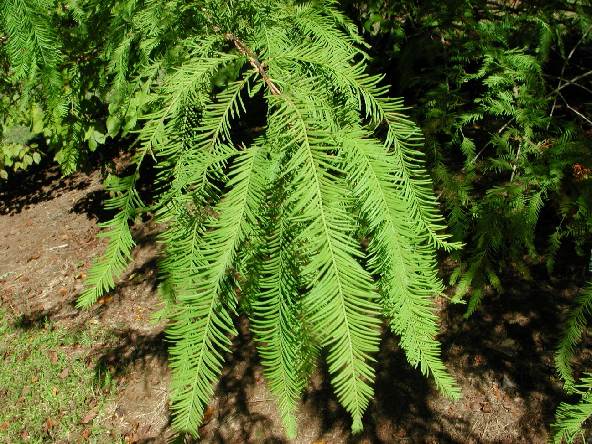
Some look-alikes…
FPOSP
Early Detector Training
Remember! Hemlock needles have “stems” that attach to the twig
http://uptreeid.com/PICSconifers/EHEMleaf.jpg
Bald cypress
Yew
debsgarden.squarespace.com
www.my-photo-gallery.com

Slide 20
Review
FPOSP
Early Detector Training
Keep your eye out for the distinct, white tufts of wax
Insecticide treatments are useful for more urbanized areas where economically feasible
Biocontrol is promising for sustainable management of HWA

Slide 21
Questions?
FPOSP
Early Detector Training
www.forestthreats.org
Notes:
5 quiz questions…

